Slide 1
Estuaries serve as a Buffer in the Face of Climate Change
Candace Penn
Squaxin Island Tribe
Natural Resources

Slide 2
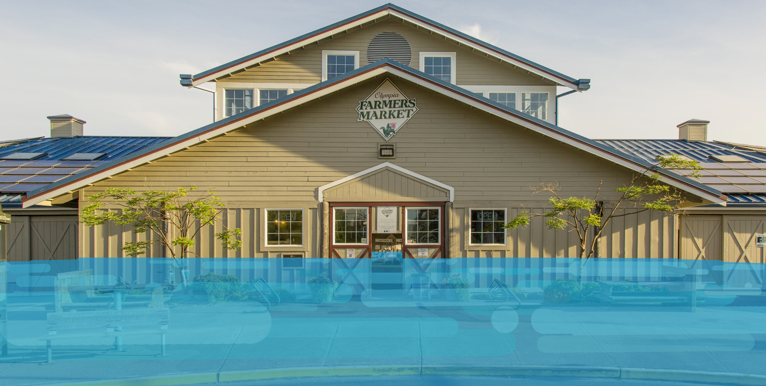
Overview
Current Sea Level Rise conditions and projections.
  Olympia, WA
  Squaxin Island Tribe
Estuaries Buffer Impacts of Sea Level Rise
  Storm Surges, King tides, Flooding
Why are Estuaries Vulnerable?
Communities Health
Squaxin Tribes Environmental Plan
  Climate Change

Slide 3
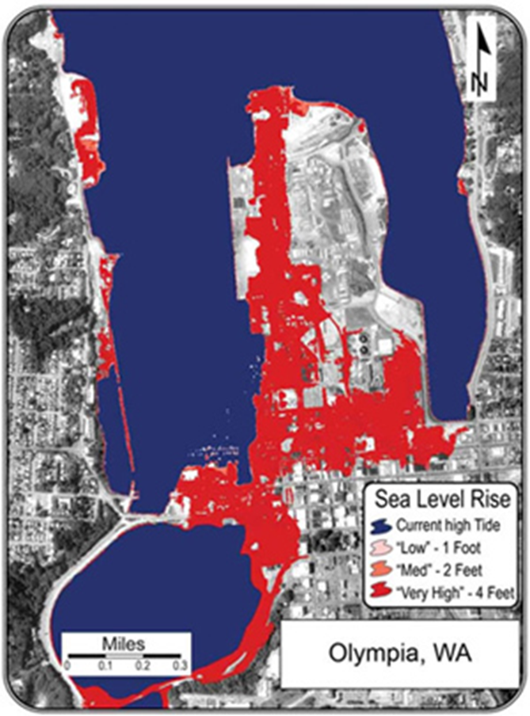

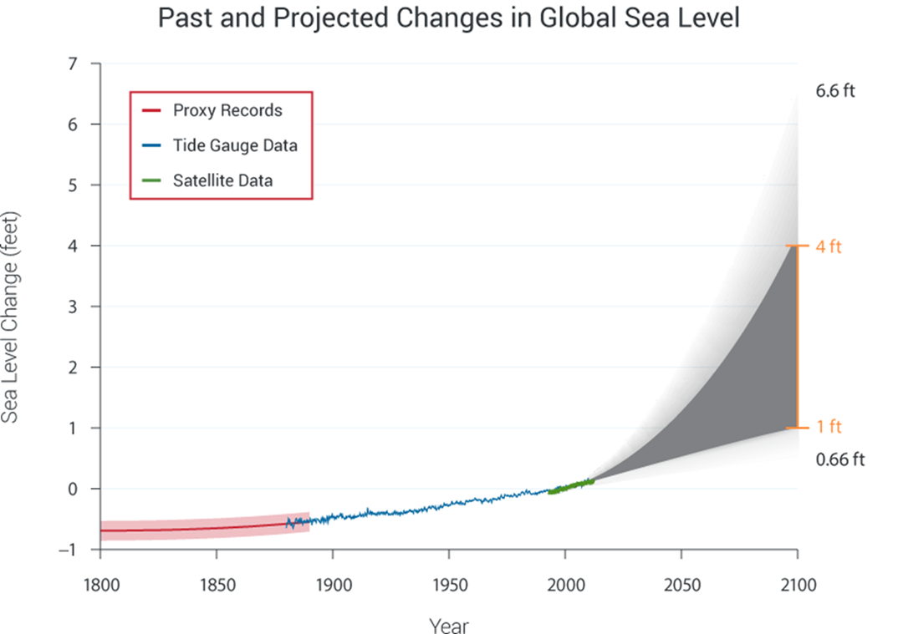

Slide 4
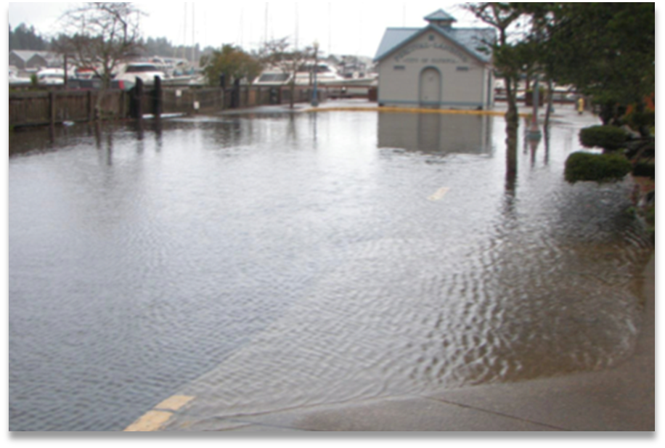
Why are Estuaries so Important?
Reduce Flooding
Soak up Heavy Rains
Improve Water Quality
Buffer Upland Areas from
  Crashing Waves
  Storm Surges
  Soil Erosion

Slide 5
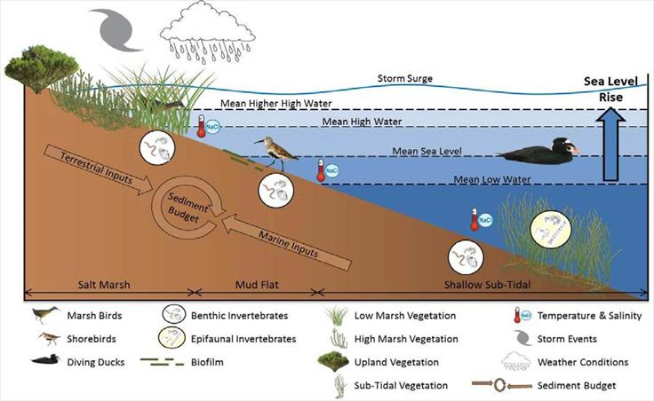
Signals of Climate Change in Estuaries
Water/Air Temperature
Changes in Precipitation
Sea Level
Freshwater inflow
Coastal storms
Coastal Currents

Slide 6
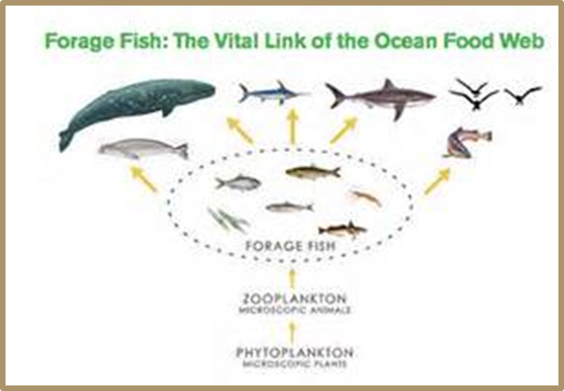
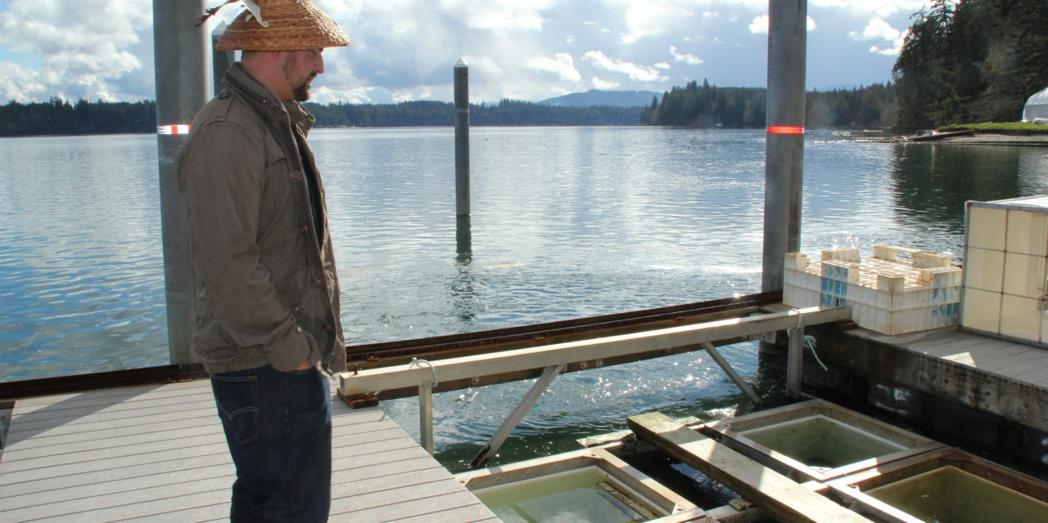
Climate Change Impacts in Estuaries
Habitat
Species Range
Coastal Economies
Destruction or Loss of Habitat
Nutrient Cycling
  HABs
  Hypoxia
Water Quality
Higher Temperatures
Competition for food
Food Web
Manmade Infrastructure
Transportation
Tourism
Land use changes
First foods

Slide 7
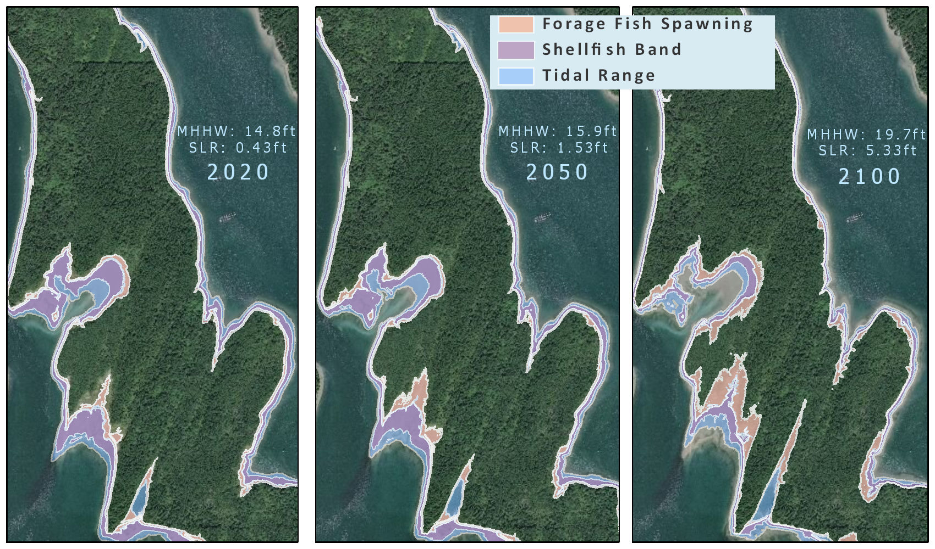
The Squaxin Island Tribes
The Squaxin Island Strong interconnected way of life depends on a strong, vital natural environment: clean and abundant water/air, and healthy ecosystems.

Slide 8
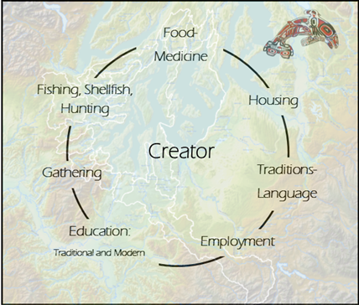
Community Wellbeing Project
Physical Health
Community Health
Natural Resources Security
Cultural use and Practice
Education
Self-determination
Resilience/balance

Slide 9
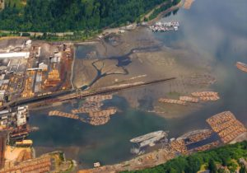
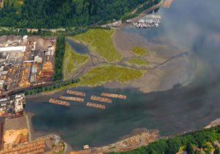
Shelton Harbor Restoration
Remove 811 creosote pilings
Remove 1/2 mile of armored shoreline
Remove 1/4 mile of inter-tidal dikes
Restore 47 acres of saltmarsh
Restore 1/2 mile of shoreline riparian
Conserve 51 acres of tidelands and over 14 acres of riparian upland

Slide 10
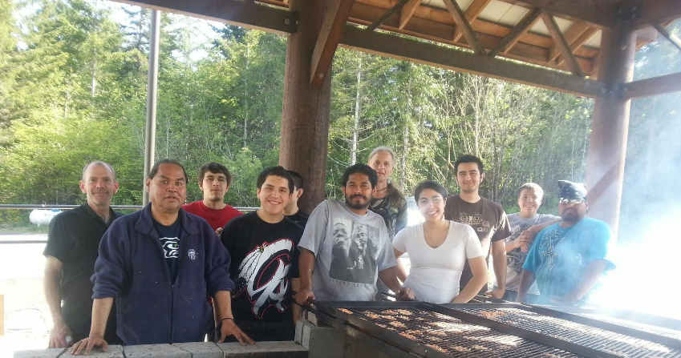
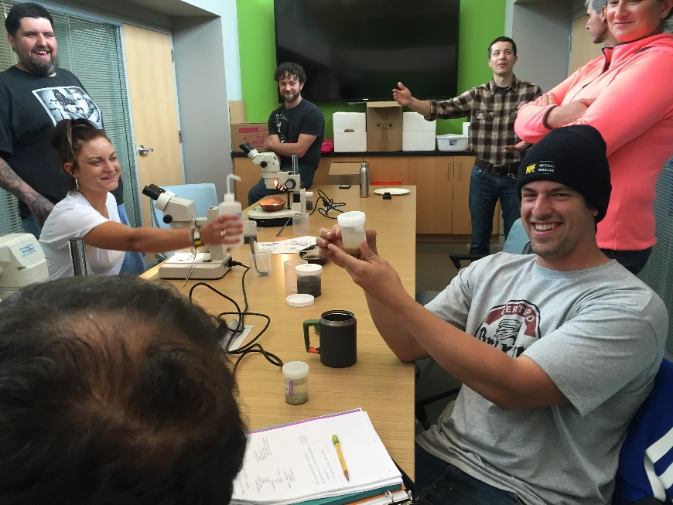
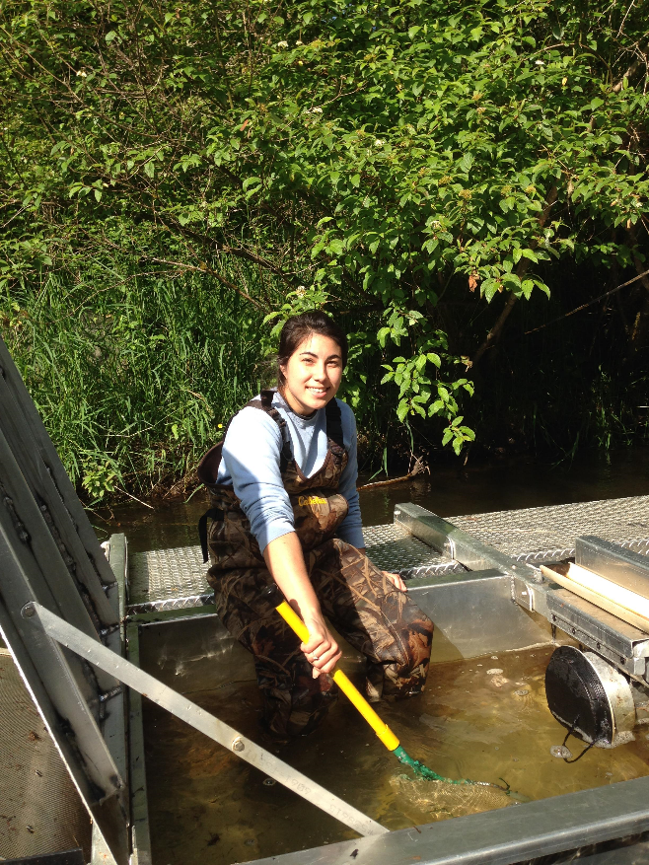
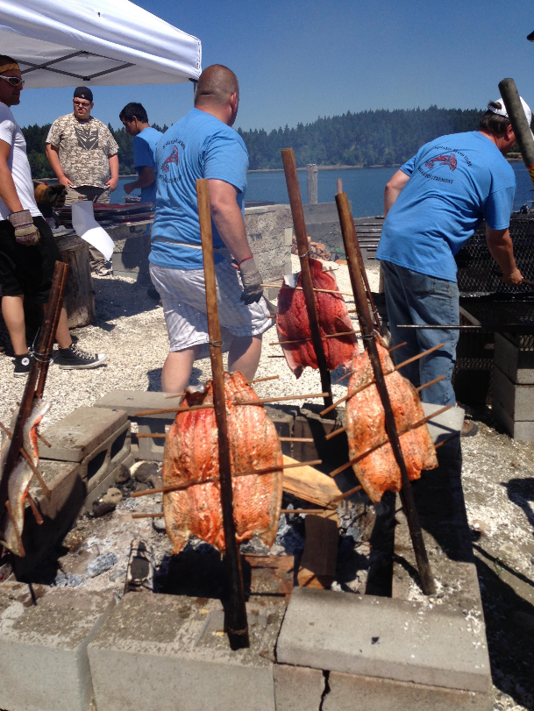
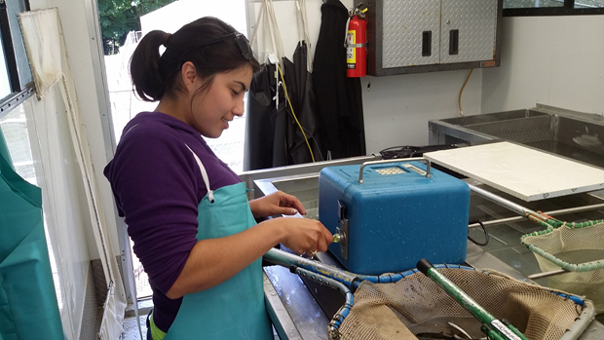
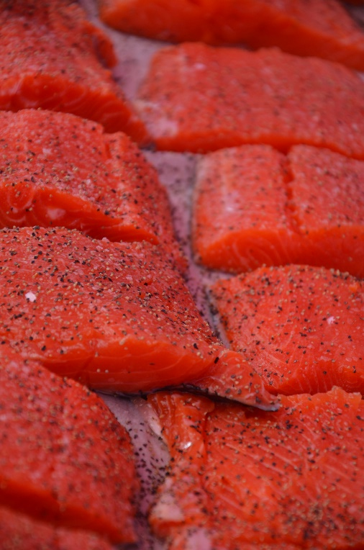
Thank You

Slide 11
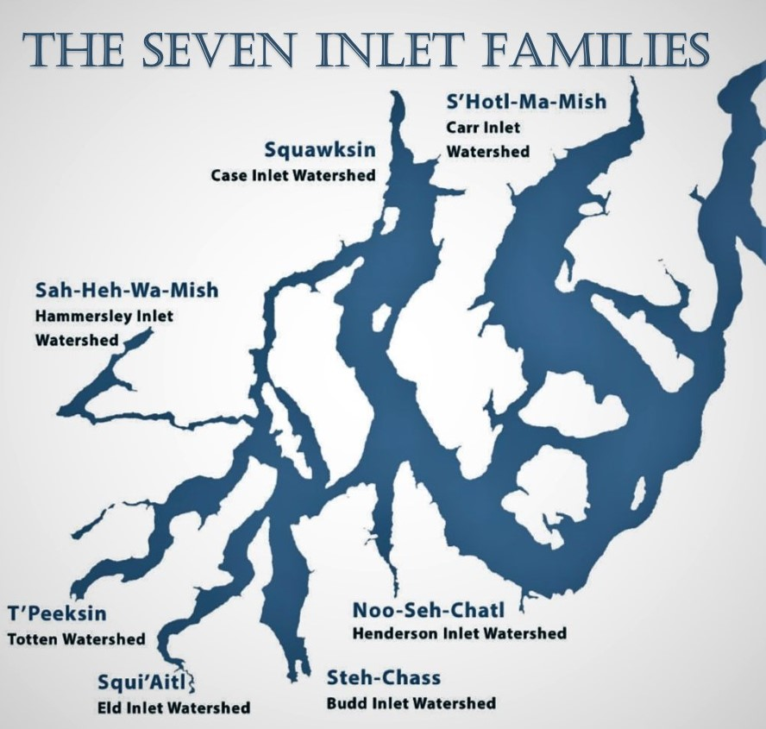
http://squaxinisland.org/government/who-we-are/

Slide 12
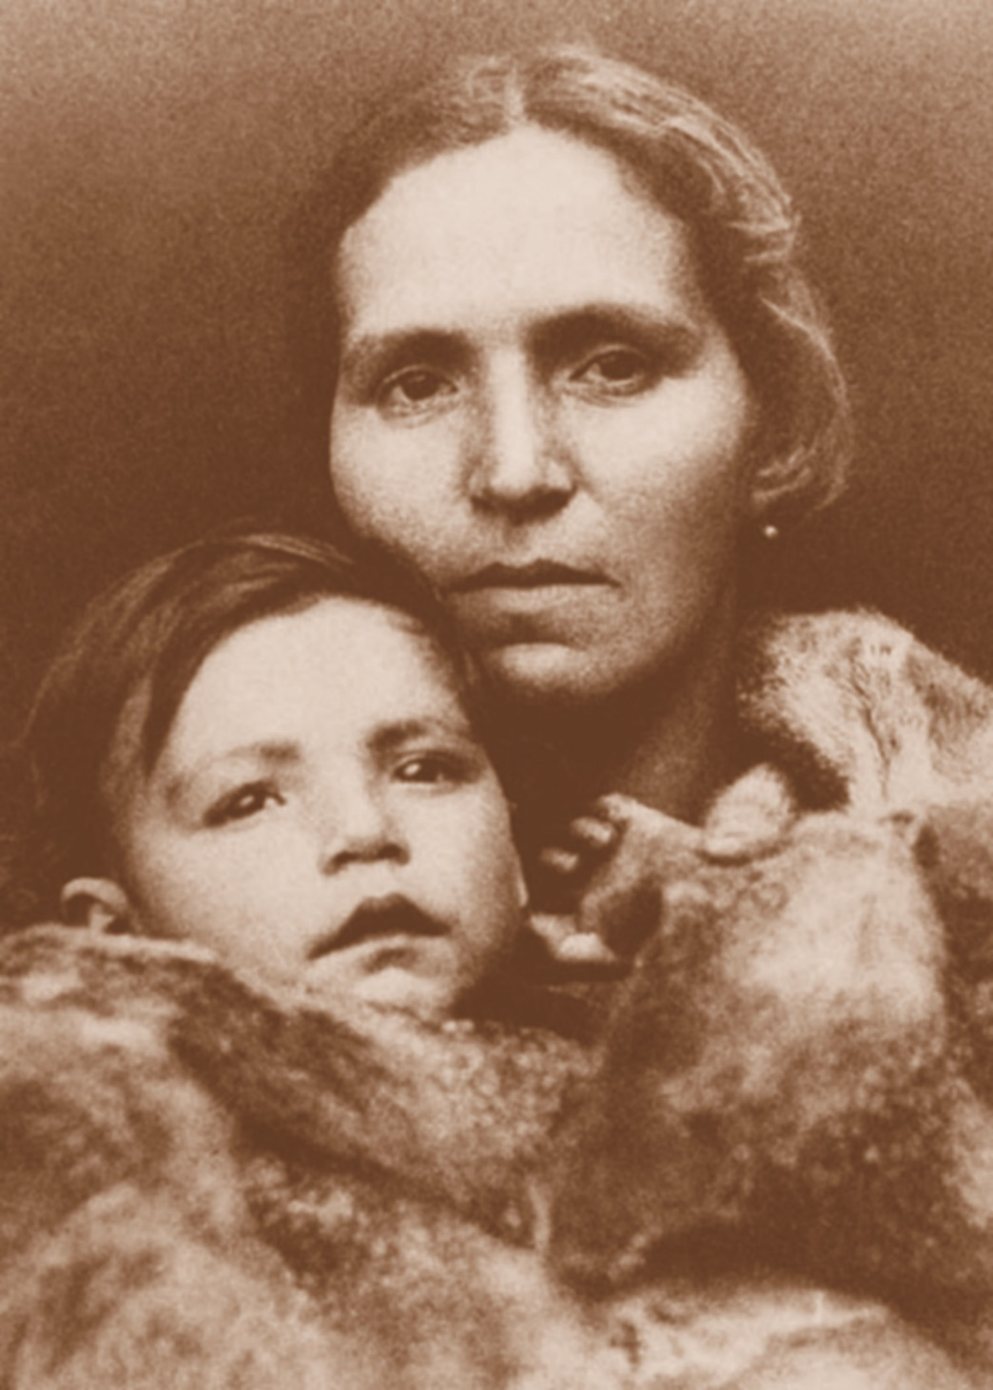
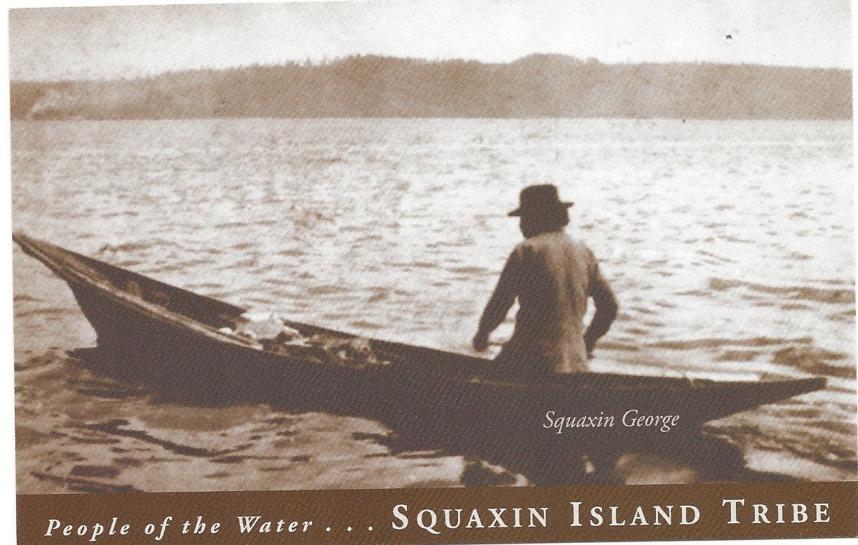
Left: Annie Weiss
Top: Squaxin George

Slide 13
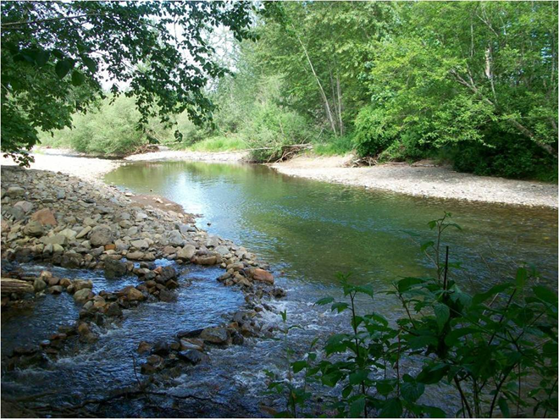
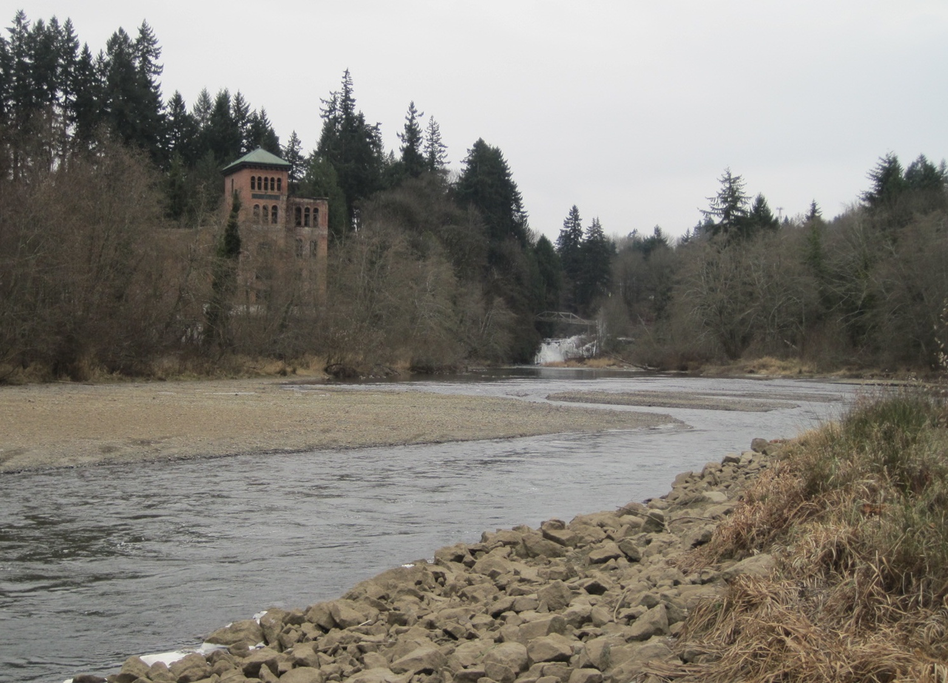
The Steh-Chass River
Now Known as the Deschutes

Slide 14
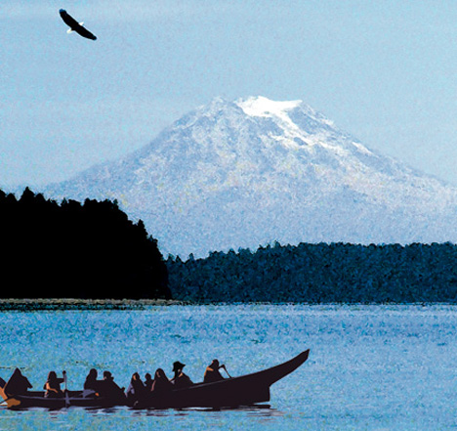
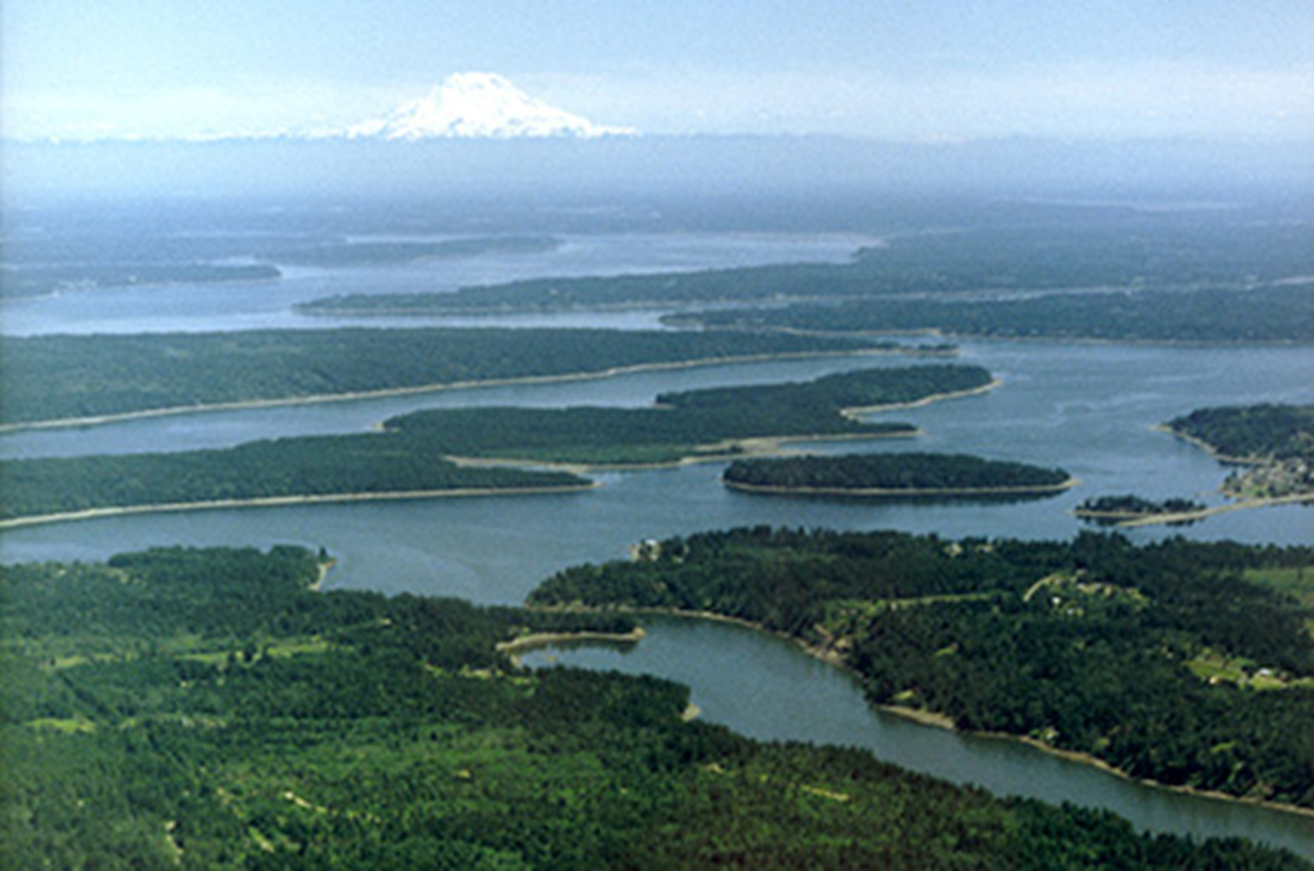
Image Credit: http://squaxinislandtourism.com/special-events/canoe-journey
http://www.start-wa.com/squaxin.html

Slide 15



