Slide 1
Squaxin Island Tribe Natural Resources Department
Scott Steltzner
Environmental Program Manager
Notes:
N.R. concentrates on science and government to government relations
This is easy for me. The science is clear and unquestioned. No matter what some others, who story changes month to month, promote.

Slide 2
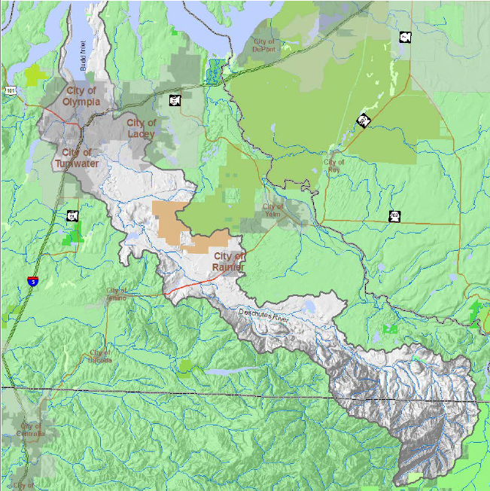
Notes:
One watershed from the upper reaches of Deschutes in National Forest to Boston Harbor at the mouth of Budd Inlet.
What happens in one area affects other areas.
Take short walk down watershed and talk about how science led to projects.

Slide 3
TMDL (total maximum daily load)
How much pollutant can a system handle
Reduce where and by how much
Budd Inlet and Deschutes Estuary broke off for more study
Deschutes freshwater complete
temperature, fecal coliform, DO, pH, phosphorous, and sediment
Budd Inlet ongoing
dissolved oxygen
Notes:
How much pollutant can a system handle? If too much where reduce and how much.
Like sediment.
Process led by Ecology. Includes Lake and Budd Inlet but these broke off for more study. Freshwater done.
Temperature, fecal coliform, DO, pH, phosphorous, and sediment.
Report goes into great detail what to decrease and where.
Temperature, fecal coliform, DO, pH, phosphorous, and sediment.
Report goes into great detail what to decrease and where.
Provides targets how much to reduce

Slide 4
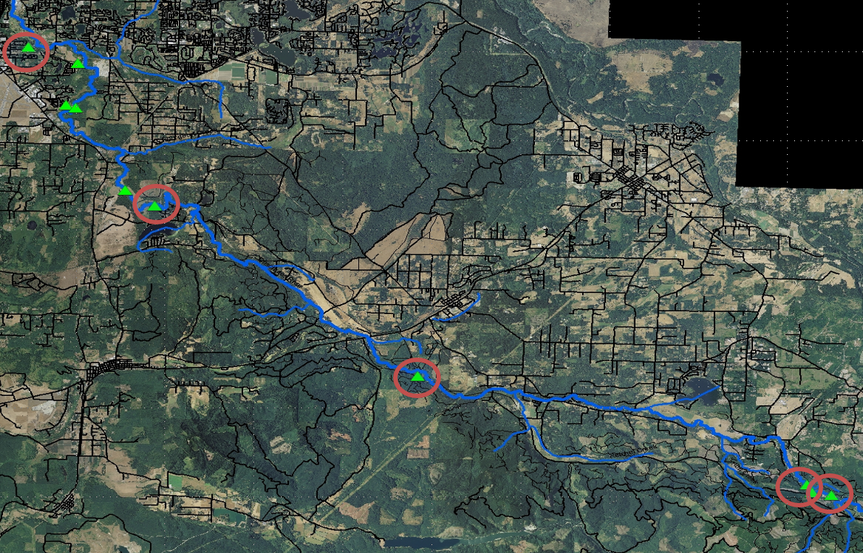
Top Ten Sediment Sites
Notes:
Prioritized the 10 sites putting in the most sediment
All 10 determined to be human influenced
5 of these have designs done and await funding

Slide 5
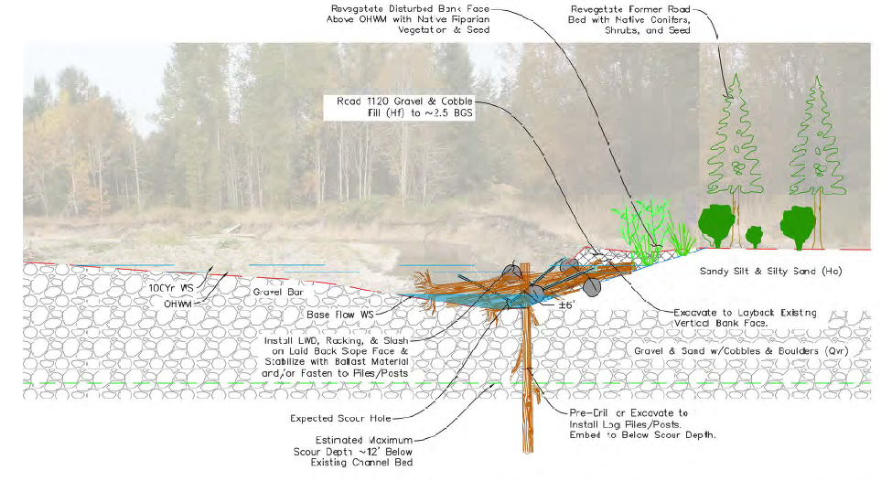
Sediment- Vail Tree Farm
Notes:
Prioritized the 10 sites putting in the most sediment
All 10 determined to be human influenced
5 of these have designs done and await funding

Slide 6
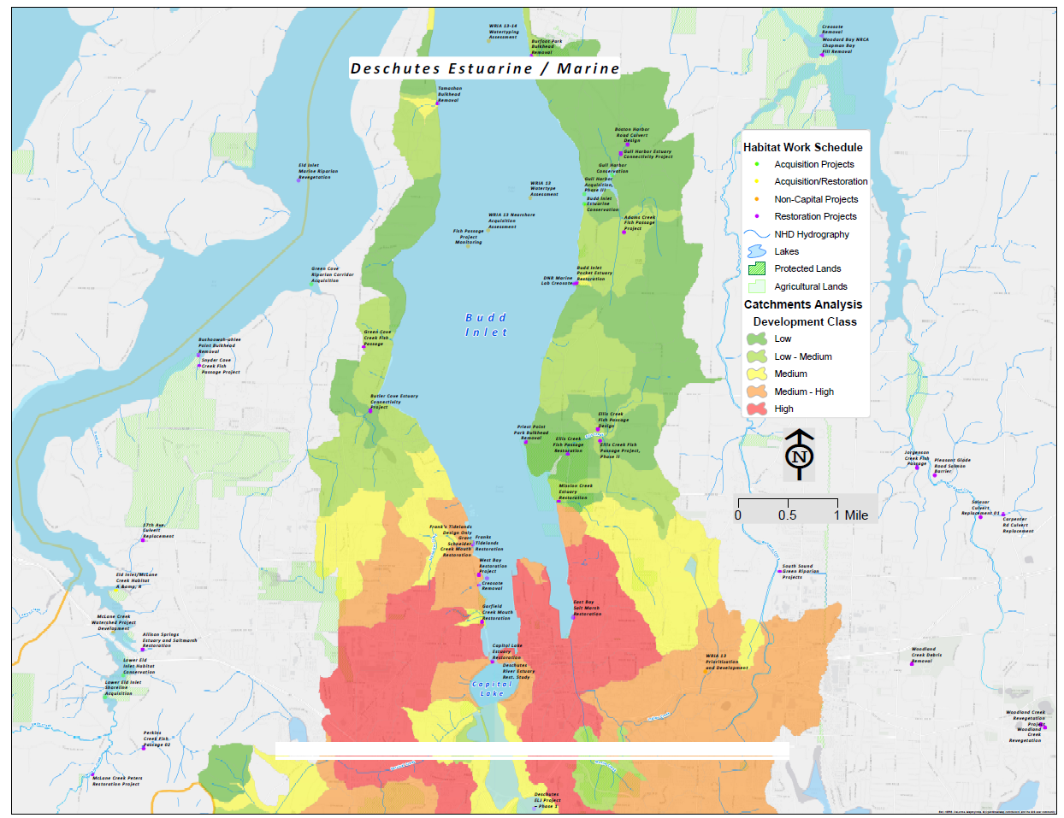
Budd Inlet
Notes:
Budd Inlet
Some heavily urbanized but some like east shoreline in great shape.
Catchment Analysis
Produced a shoreline analysis of the catchments draining into Budd Inlet.
Shows that in more urbanized areas must to large projects or grouped projects that take of most of a problem.
In less urbanized areas can do smaller or individual projects.

Slide 7
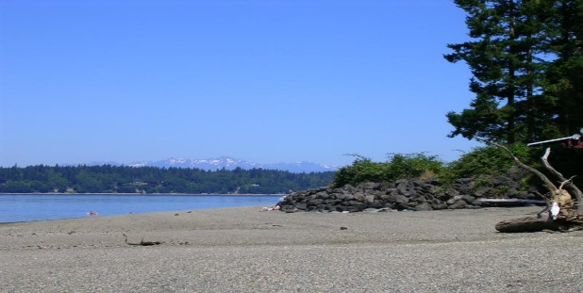
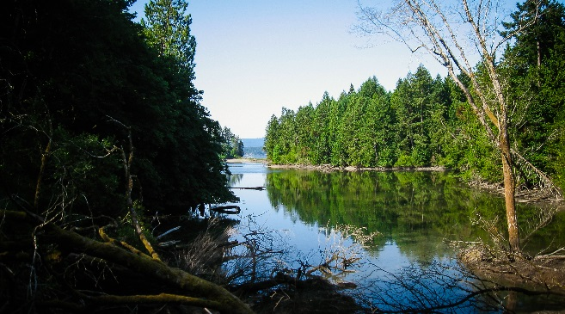
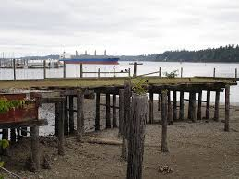
Budd Inlet
Notes:
City, Port and Tribe are working on restoration plan for West Bay that will look to rehabilitate over 1.1 mile of shoreline. That’s significant at any scale.
A few years ago partnered with private land owners, Tribe and Port to removal over 400 creosote pilings and 7,000 sf of overwater structure along 1.2 miles of shoreline.
City removed a bulkhead on the north of Priest Point Park while Port removed dam on Mission Creek on the South Side.
Working with County to remove unnecessary bulkhead on Burfoot Park.
Essentially all of Gull Harbor has been placed into conservancy.

Slide 8
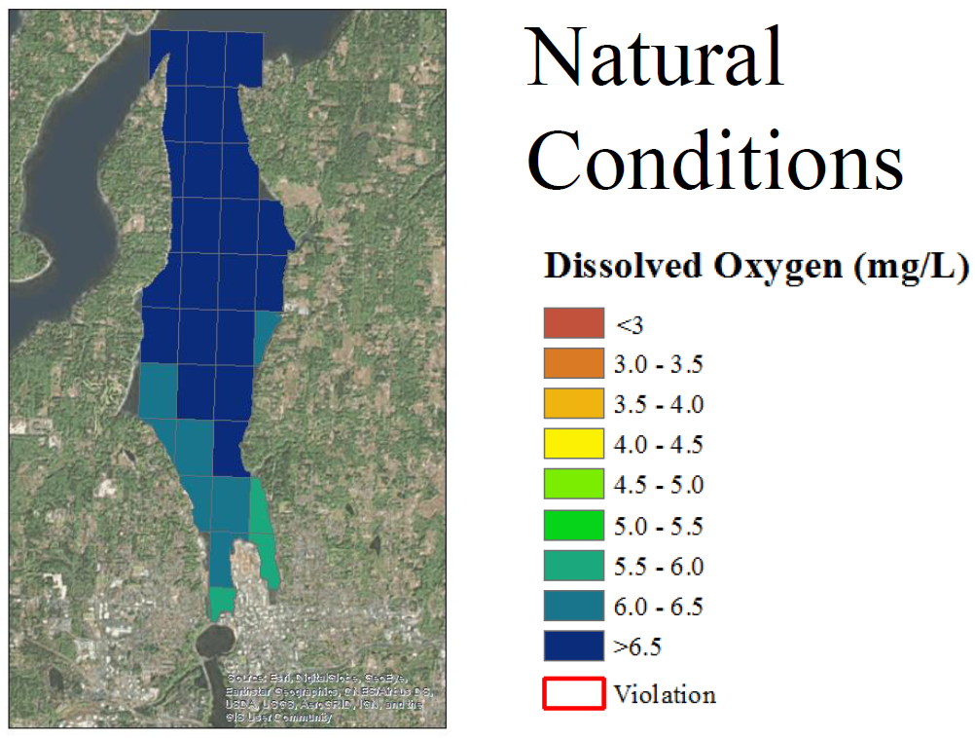
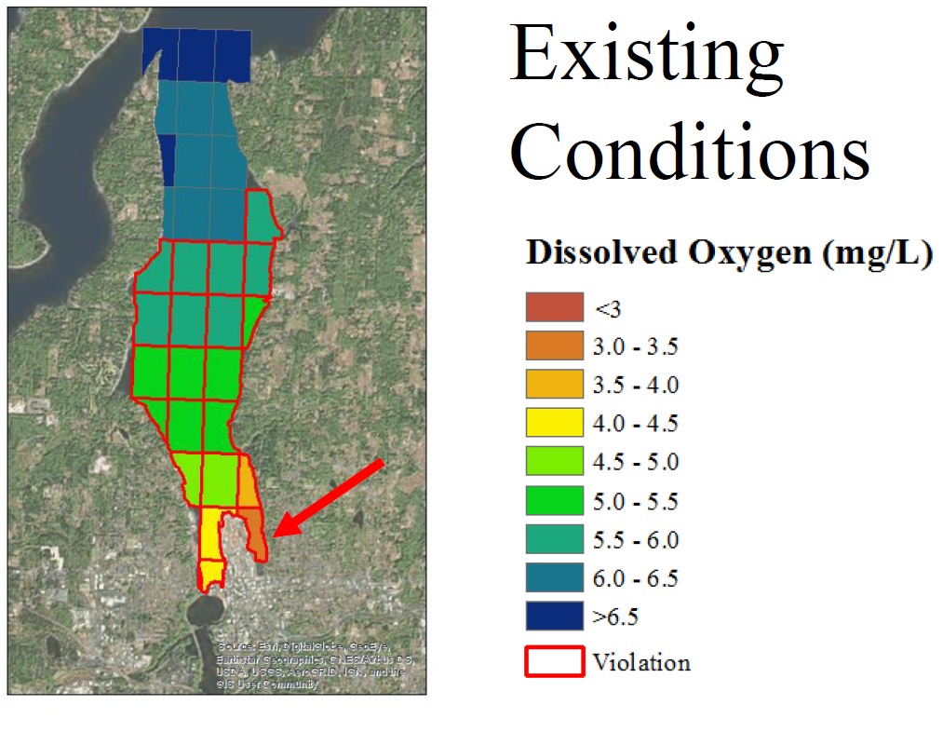
Deschutes Estuary

Slide 9
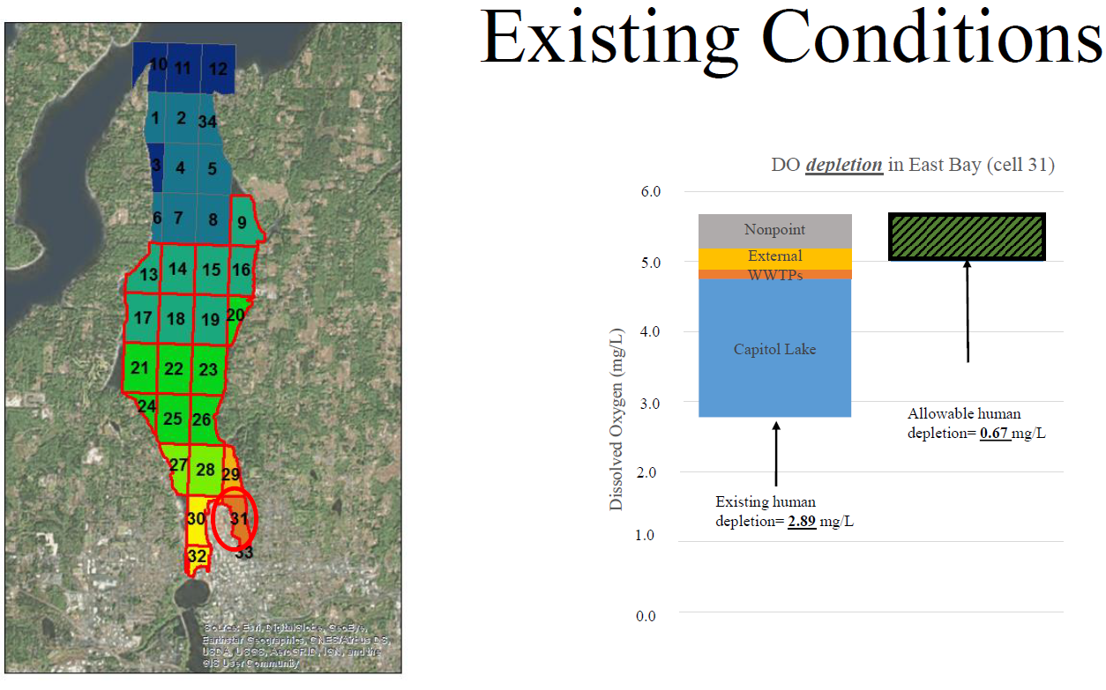
Deschutes Estuary

Slide 10
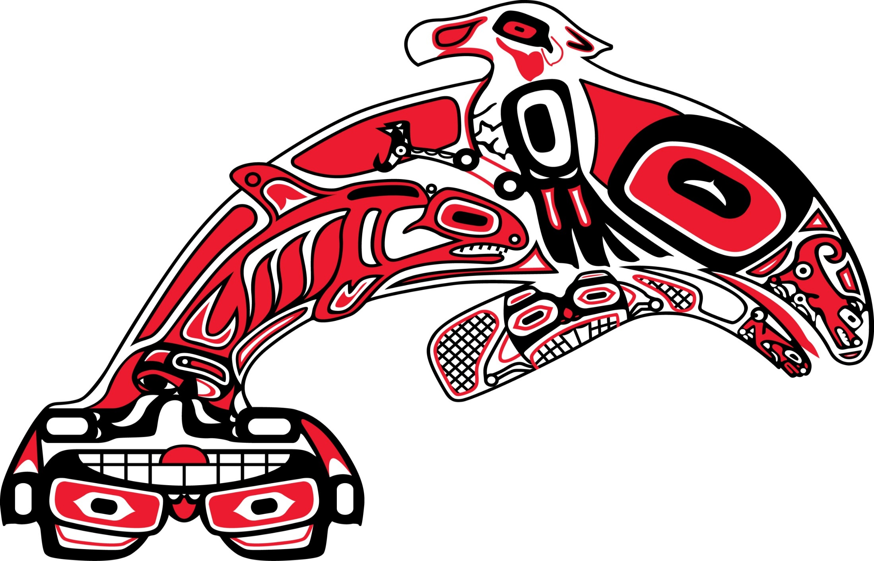
Thank You!
Alliance for a Healthy South Sound
www.healthysouthsound.org

