Slide 1
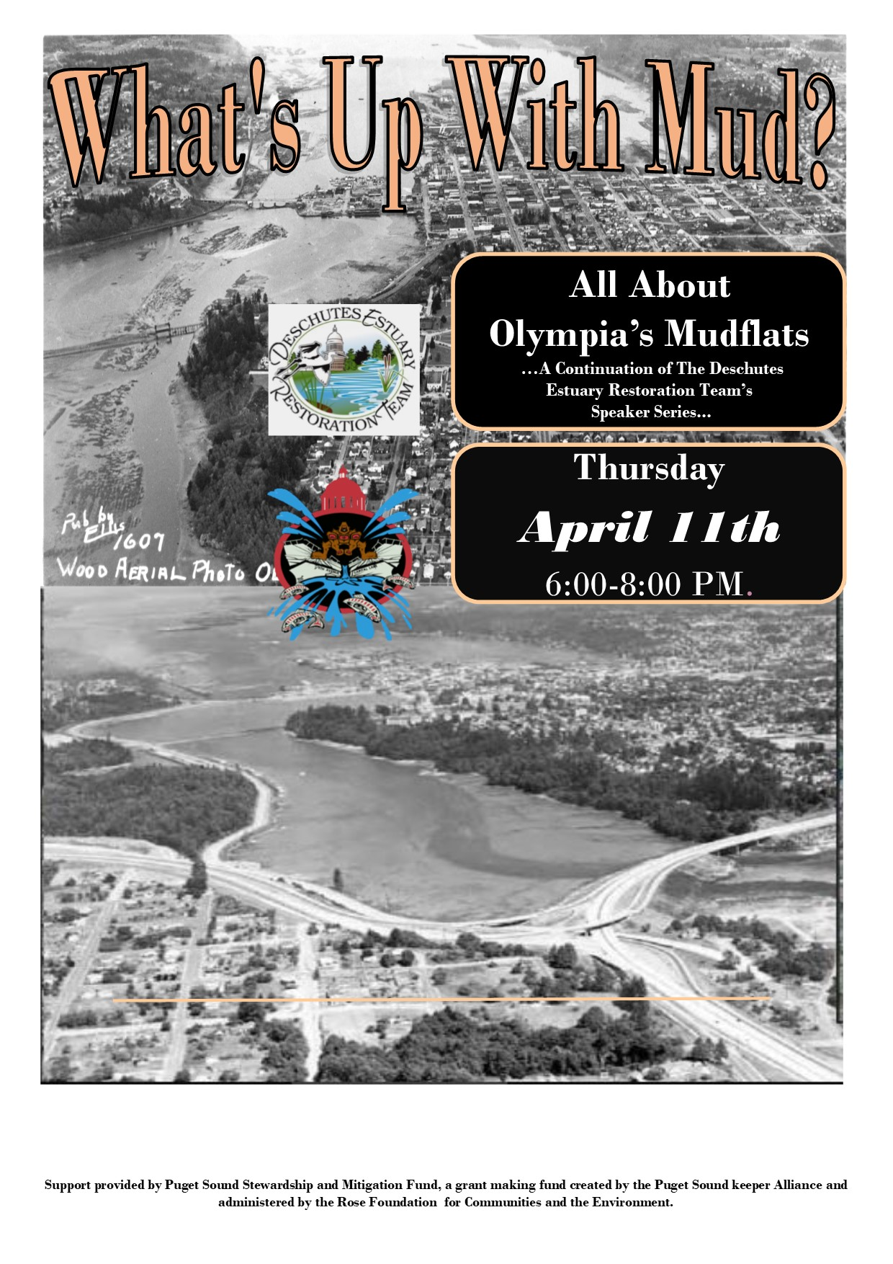
Welcome!
Speakers
Speakers:
Sue Patnude (Deschutes Estuary Restoration Team)
Maurice Major (Cultural Resource Specialist)
Daniel Einstein (Olympia Coalition for Ecosystems Preservation )
Jeff Dickison (Squaxin Island Tribe Nat. Resources)
Special thanks to the Blue Heron Bakery for providing pizza!

Slide 2
Deschutes Estuary Restoration Team What’s Up with Mud? April 11, 2019
Contact Info:
olydert@gmail.com
www.deschutesestuary.org

Slide 3
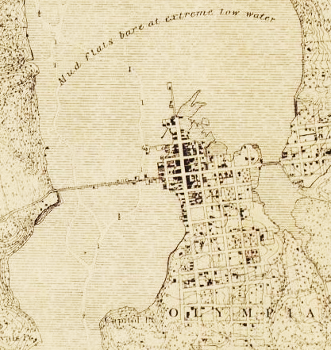
Quick History
Deschutes Estuary, known as the Steh-Chass - existed for thousands of years before Capitol Lake was created. The 5th Avenue dam was constructed in 1951 and created Capitol Lake.
Much of the historic estuary was dredged to created the port peninsula, downtown Olympia, Heritage Park, the “isthmus”, rail and freeway crossings, Deschutes Parkway.
Historic Olympia Shoreline and Steh-Chass Estuary

Slide 4
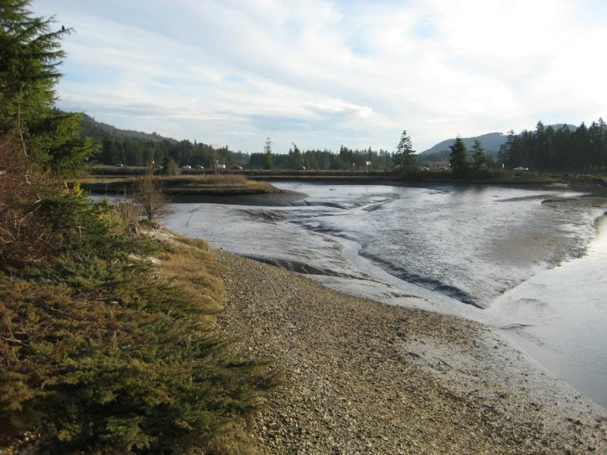
Quick Facts
More than 260 acres could be restored back to a functioning estuary
Removal of the dam and adjacent fill to create a 500 foot wide opening would restore tidal flows
Estuary restoration is one of the top priorities for South Puget Sound recovery and is the single largest habitat project
Mud Bay, Eld Inlet Mudflats at Low Tide

Slide 5
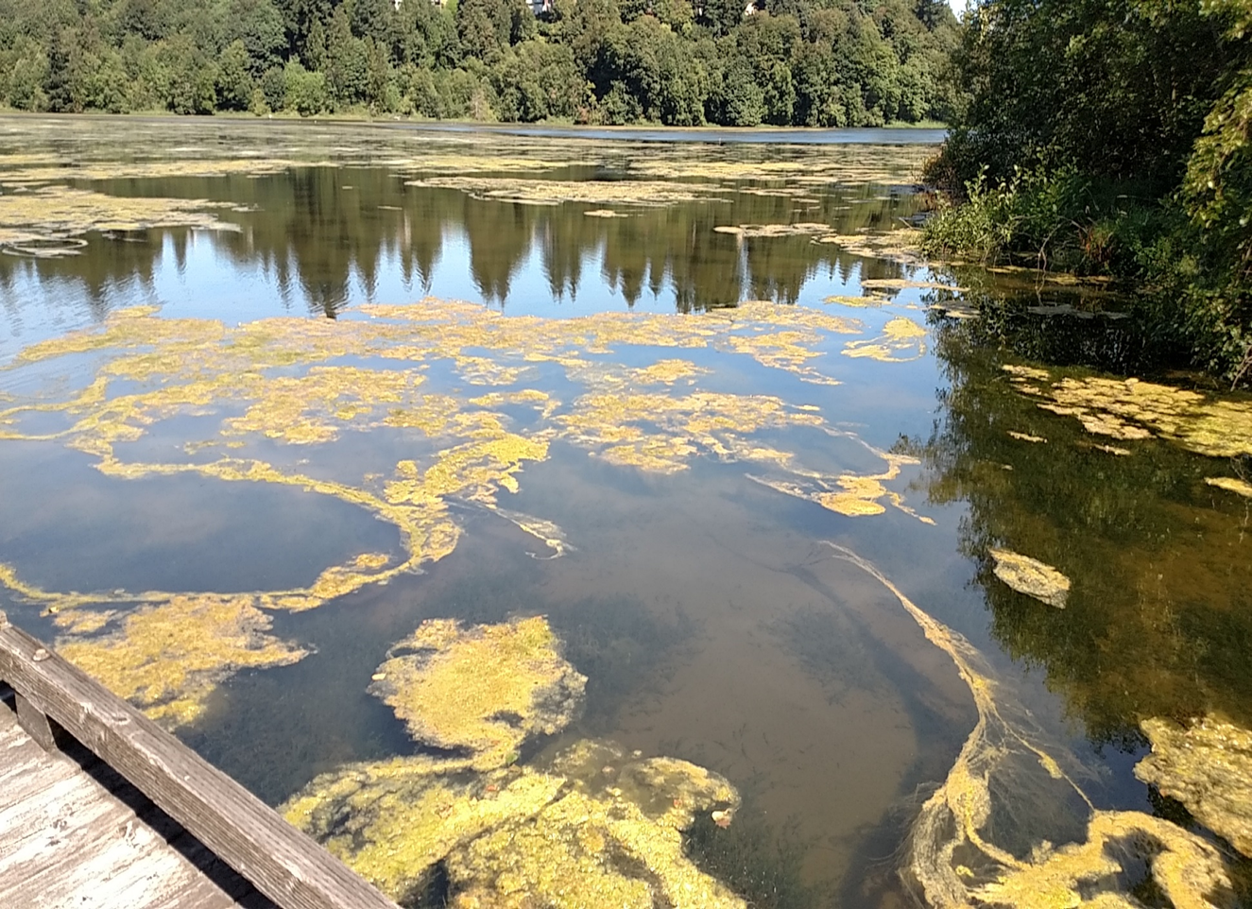
Environmental issues caused or exacerbated by Capitol Lake
Invasive species thriving due to presence of warm shallow lake: Eurasian milfoil, purple loosestrife, New Zealand mud snails, etc.
High levels of phosphorus and other nutrients from fertilizers in runoff cause algal blooms, dissolved oxygen (DO) depletion, warmer temperatures

Slide 6
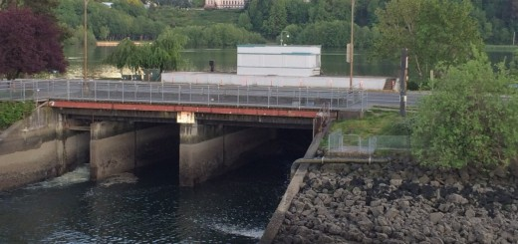
The 5th AVE. Dam Creates Sediment Starvation in Estuary
Excessive sedimentation (approx. 35,000 cubic yards annually) accumulates in Capitol Lake
Excessive sedimentation has also contributed to warming, shoaling, and impeded ecological function
Budd Inlet is in Violation of Federal Water Quality Standards
Diminished water quality leads to inability to protect and sustain designated beneficial uses protected under WAC 173-201 and federal CWA

Slide 7
Budd Inlet The Steh-Chass Sediment Cleanup Sites
Multiple legacy sources (1920s through 1980s) in Budd Inlet have contributed to contaminated sediment sites
11 cleanup sites active since 2007 under Ecology’s direction; recent data available from Port of Olympia (2016) and Ecology (2016)
Numerous dischargers [PLPs] involved
Cascade Pole, Port, City, West Bay Marina, Hardel Mutual Plywood, BMT Northwest, etc.
Wide variety of contaminants from wood treatment, plywood mfg, stormwater runoff; key “drivers are dioxins/furans (CDDs/CDFs) & carcinogenic PAHs (cPAHs)

Slide 8
Dioxins/Furans (CDD/Fs) in Budd Inlet Sediment
Complex mixtures of highly persistent, bioaccumulative organic compounds
Partly originate from historical wood preservation activities like creosote pile painting (e.g. from pentachlorophenol), numerous other sources
Highly toxic to both ecosystem and humans, carcinogenic to humans
Lowest screening level 5 ng/kg TEQ (pptr), Ecology’s cleanup level 13 pptr
As of 2016, East Bay higher than West Bay sediments: 21 pptr vs 15 pptr
Concentrations still somewhat elevated in places; currently approx. 40 ng/kg in East Bay (highest was Port shipping berth, approx. 4,000 ng/kg in 2008)

Slide 9
Carcinogenic PAHs in Budd Inlet Sediment
Persistent and toxic to both human health and the environment; seven PAHs have been classified as probable human carcinogens (cPAH)
Ubiquitous complex mixtures with widespread origins; frequently originate from urban stormwater runoff (from internal combustion engines)
Summary of cPAH exceedances:
Regional background of 21 µg/kg TEQ (ppb)
Lowest screening level 9 ppb
Concentrations currently > 500 ppb widespread in East Bay
As of 2016, East Bay higher than West Bay sediments: 148 ppb vs 15 ppb

Slide 10
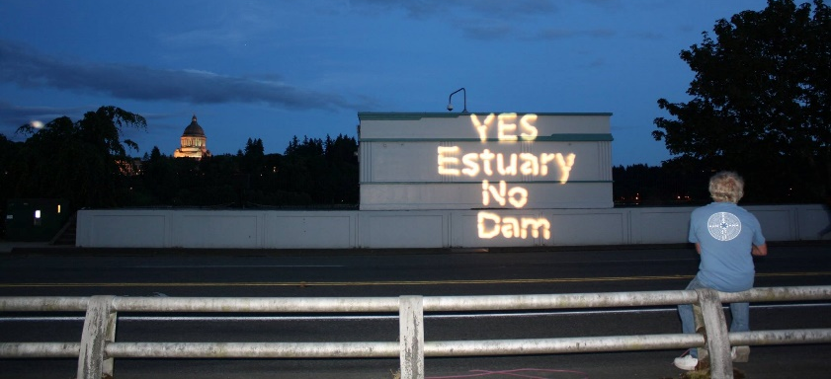
Environmental problems alleviated by removing 5th Avenue dam
1) Clean sediment from the Deschutes watershed will be transported downstream into Budd Inlet and into the Sound, which will improve sediment quality over time
2) Sedimentation is a natural process and clean sediment will create and promote healthy intertidal habitat for invertebrates, outmigrants, eelgrass, and other biota
3) Water quality in Budd Inlet will improve. Increased circulation will help reduce the burden on LOTT.
4) Both in-migration and out-migration of migratory salmonid species (e.g. ESA-listed salmonid species such as Chinook salmon) will be restored

Slide 12
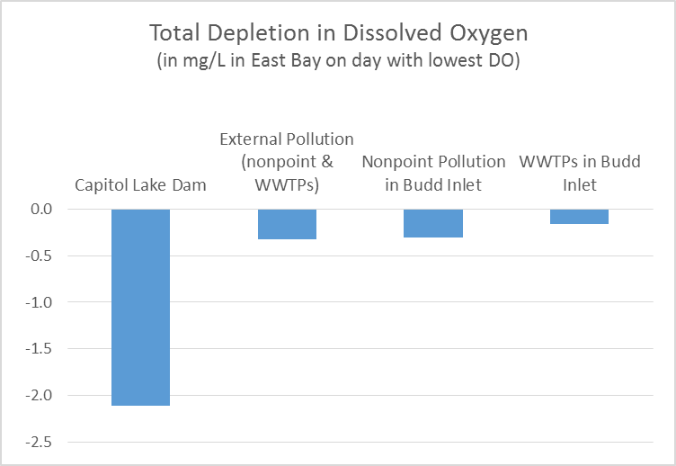

Slide 13
Some Potential Sediment Control Features (Identified in Environmental Impact Statement Process)
Upstream riparian erosion control – several sites identified
Sediment trap in Middle Basin or South Basin
Initial dredging in middle and north basins
Sediment control structure to deflect deposition away from Port and recreational boating facilities
Maintenance dredging in Lower Budd Inlet

Slide 14
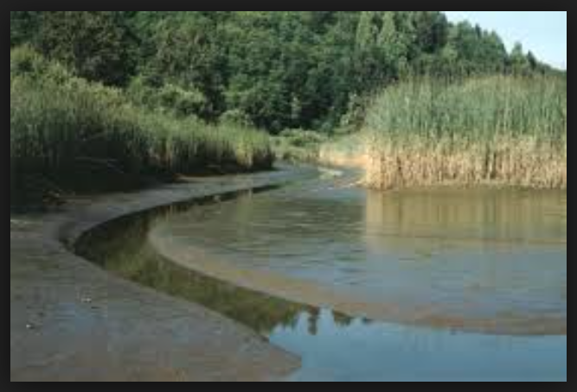
Sediment Brings Life
Sediment is the foundation for life forms in a marine ecosystem
River sediment is too abundant for sediment reservoir. On-going dredging = $$$
Productive estuaries need sediment to build the food web – the web of life
Carbon sequestration happens deep in estuary sediments
Dam removal and long-term sediment management strategy needed

Slide 15
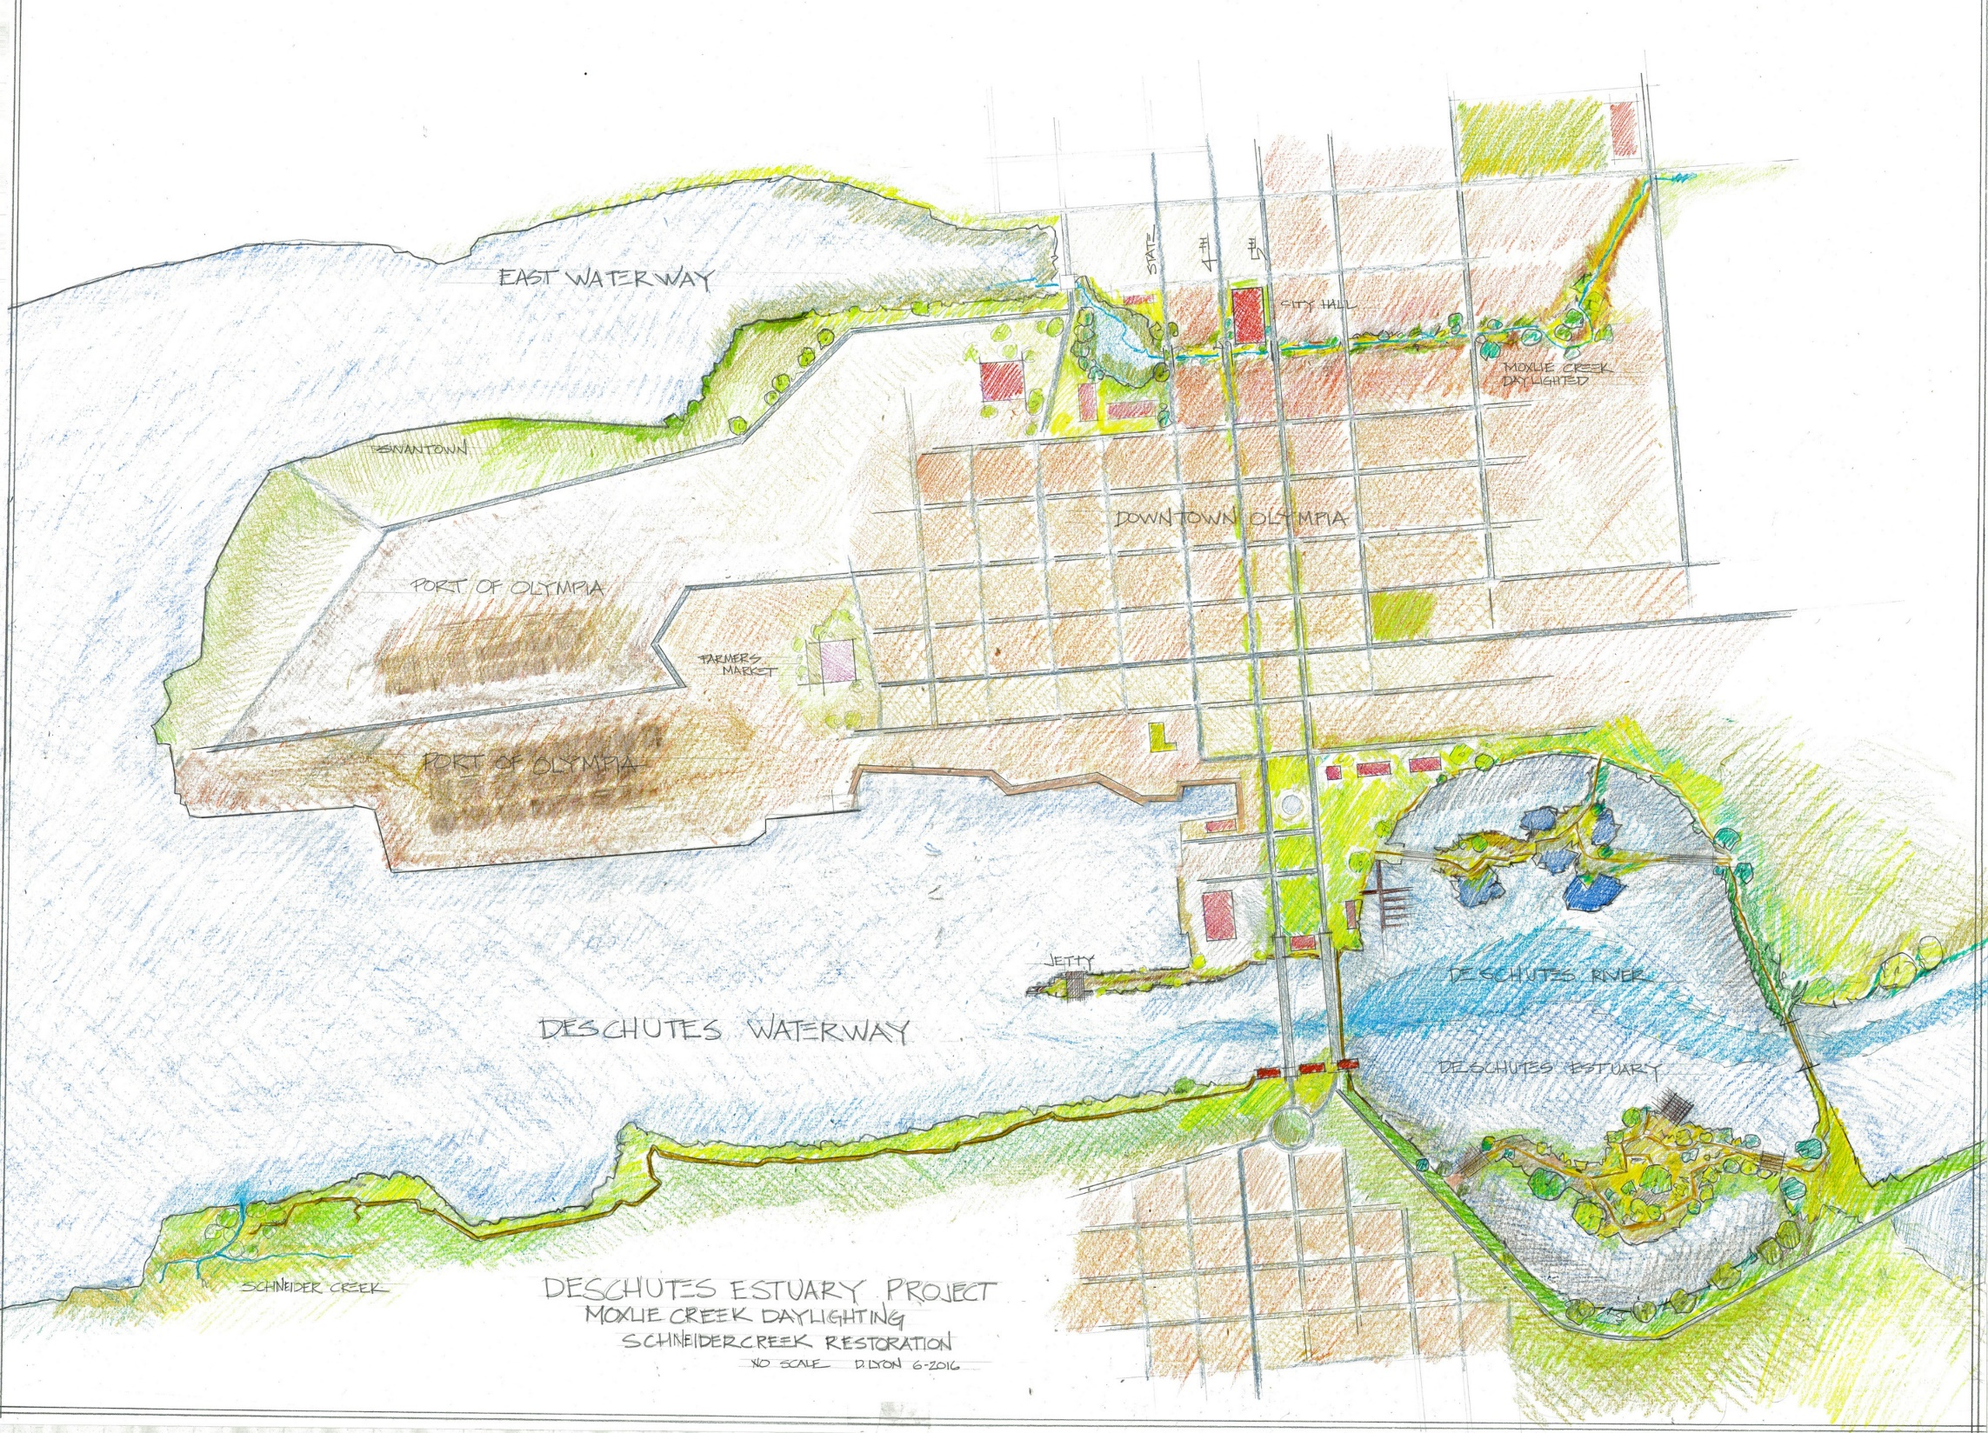

Slide 16
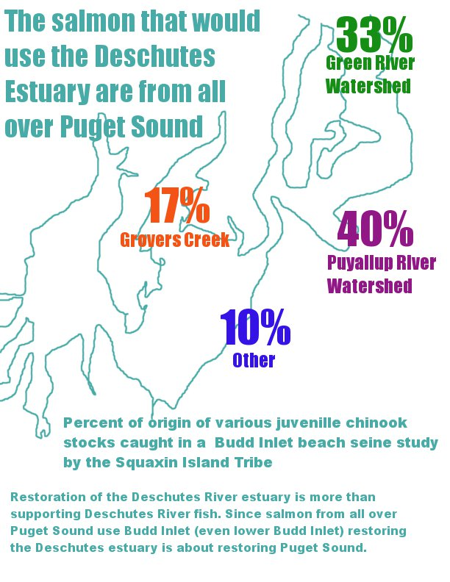

Slide 17
Best Available Science
Capitol Lake Dam has the largest impact on Clean Water Act violations in Budd Inlet (Ecology, 2012 & 2015)
Coastal Blue Carbon Analysis – estuaries have high carbon sequestration
Huge reduction in habitat for freshwater invasive species (9)
Large increase in estuarine habitat for salmon juveniles and adults
Independent Peer Review by Published and/or Recognized Scientific Experts
Deschutes Estuary Feasibility Study and other previous studies
Ecology’s Focus Sheet on Understanding the Scientific Process
Ecology’s TMDL Studies -- positive impact on LOTT and other marine discharges

Slide 18
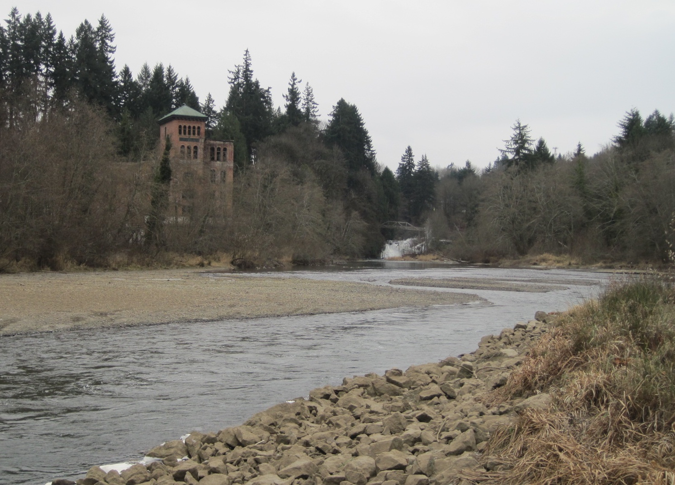

Slide 19
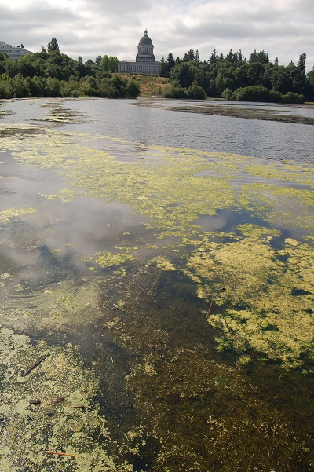
Capital campus vision with lake was created by architects and landscapers, not by hydrologists or ecosystem experts.
Since the 1970’s we have recognized the mistakes of the past and have worked toward a sustainable future
All indications are that creation of a lake at the mouth of the Deschutes River was and is an ecological disaster
Let’s look to the future for better solutions, not repeat the mistakes of the past

Slide 20
