Slide 1
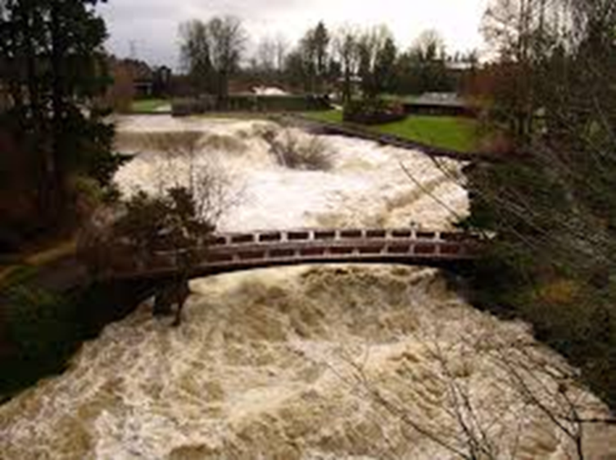
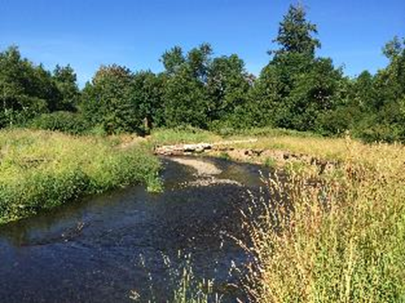
Deschutes River Habitat

Slide 2
Overview
High Temperatures
High Fine Sediment
Limited River Roughness/LWD
Low Off-Channel Connectivity/Floodplains
Lack of Habitat Complexity/Rearing
Reduced Riparian Vegetation
Low Summer Flows

Slide 3
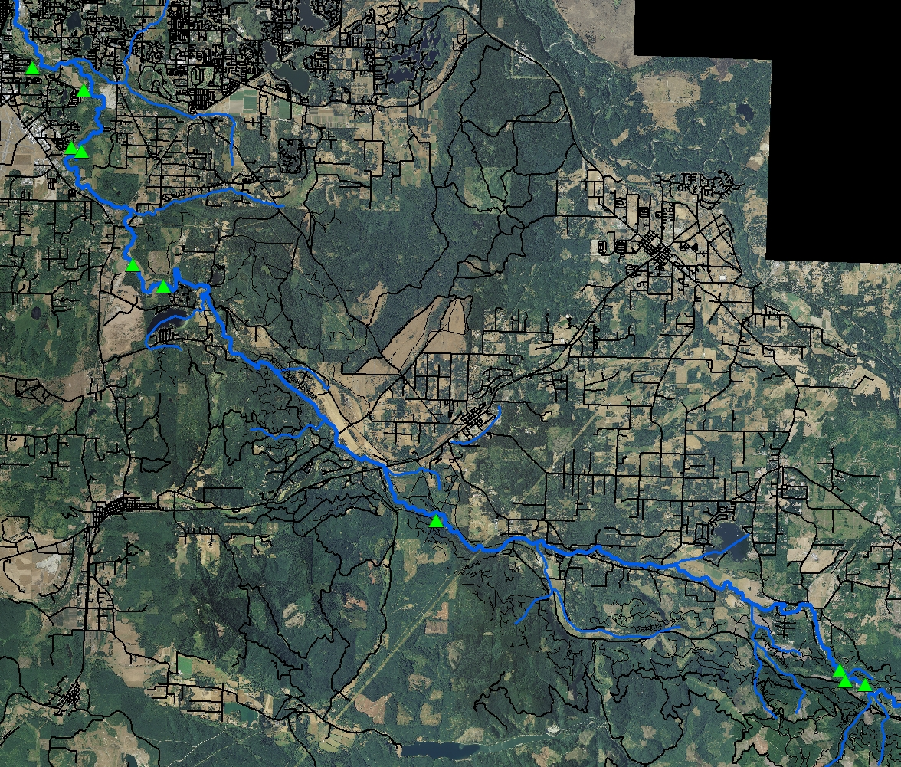
Top 10 Erosion Sites

Slide 4
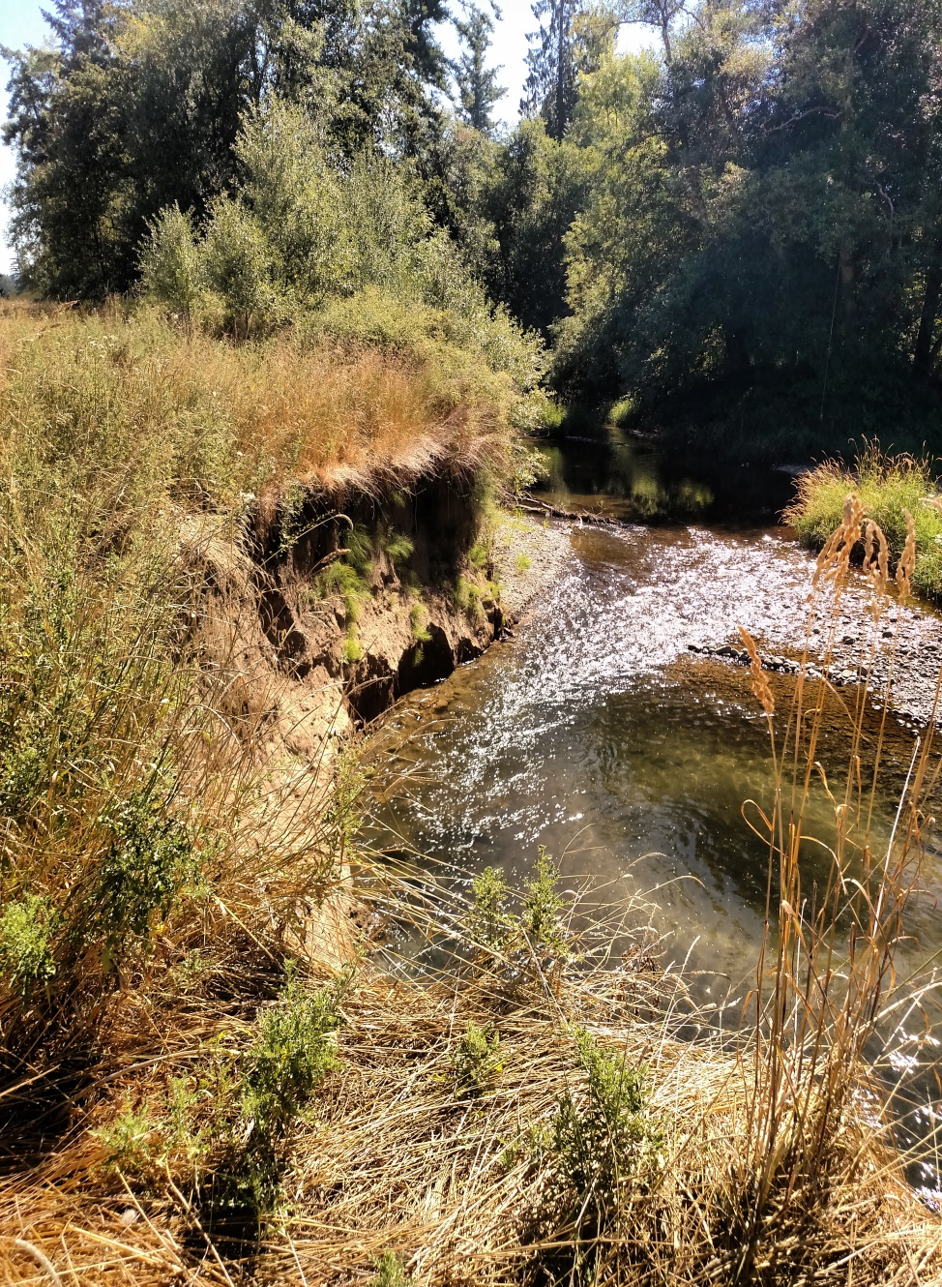
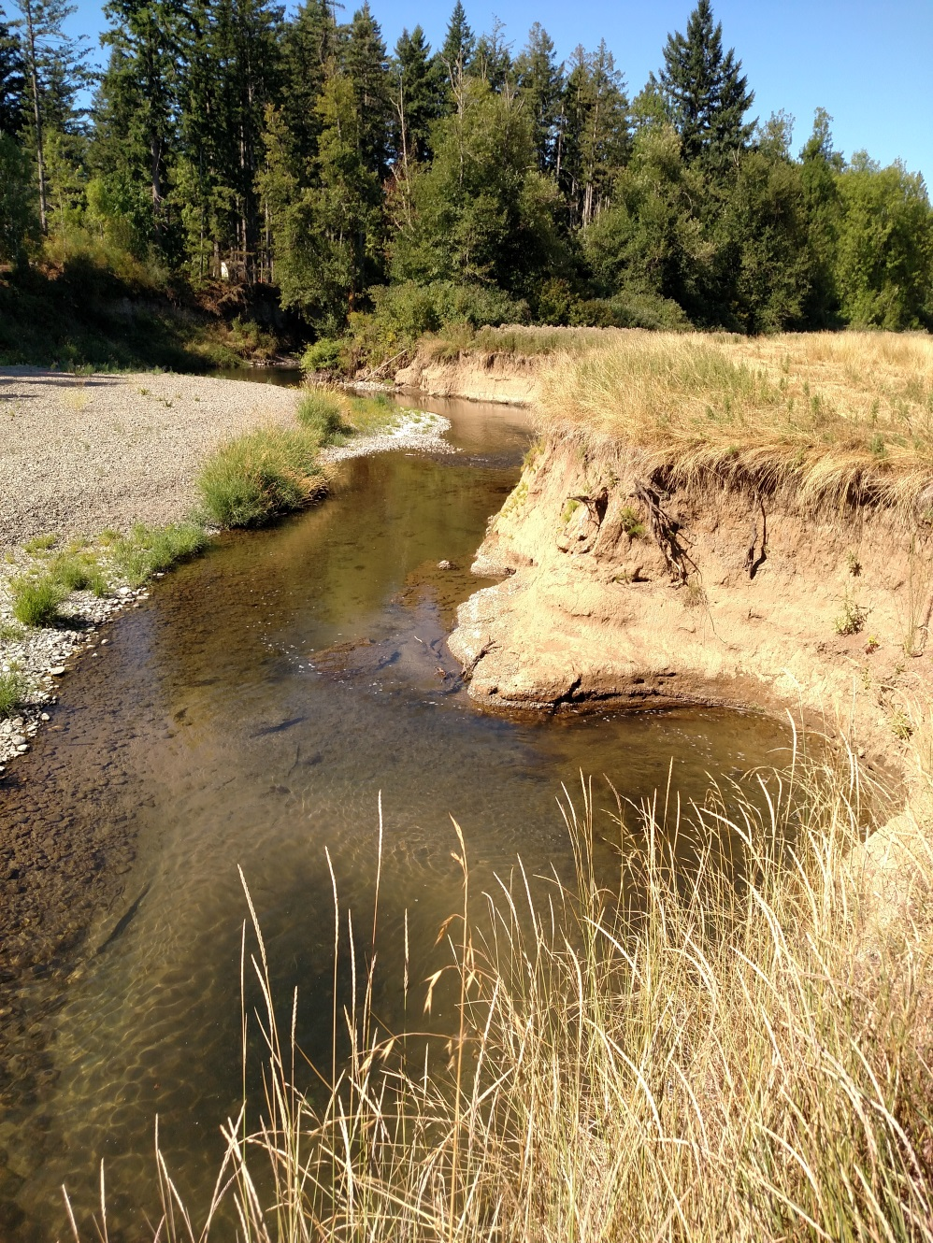
Similar Photos: Different Locations

Slide 5
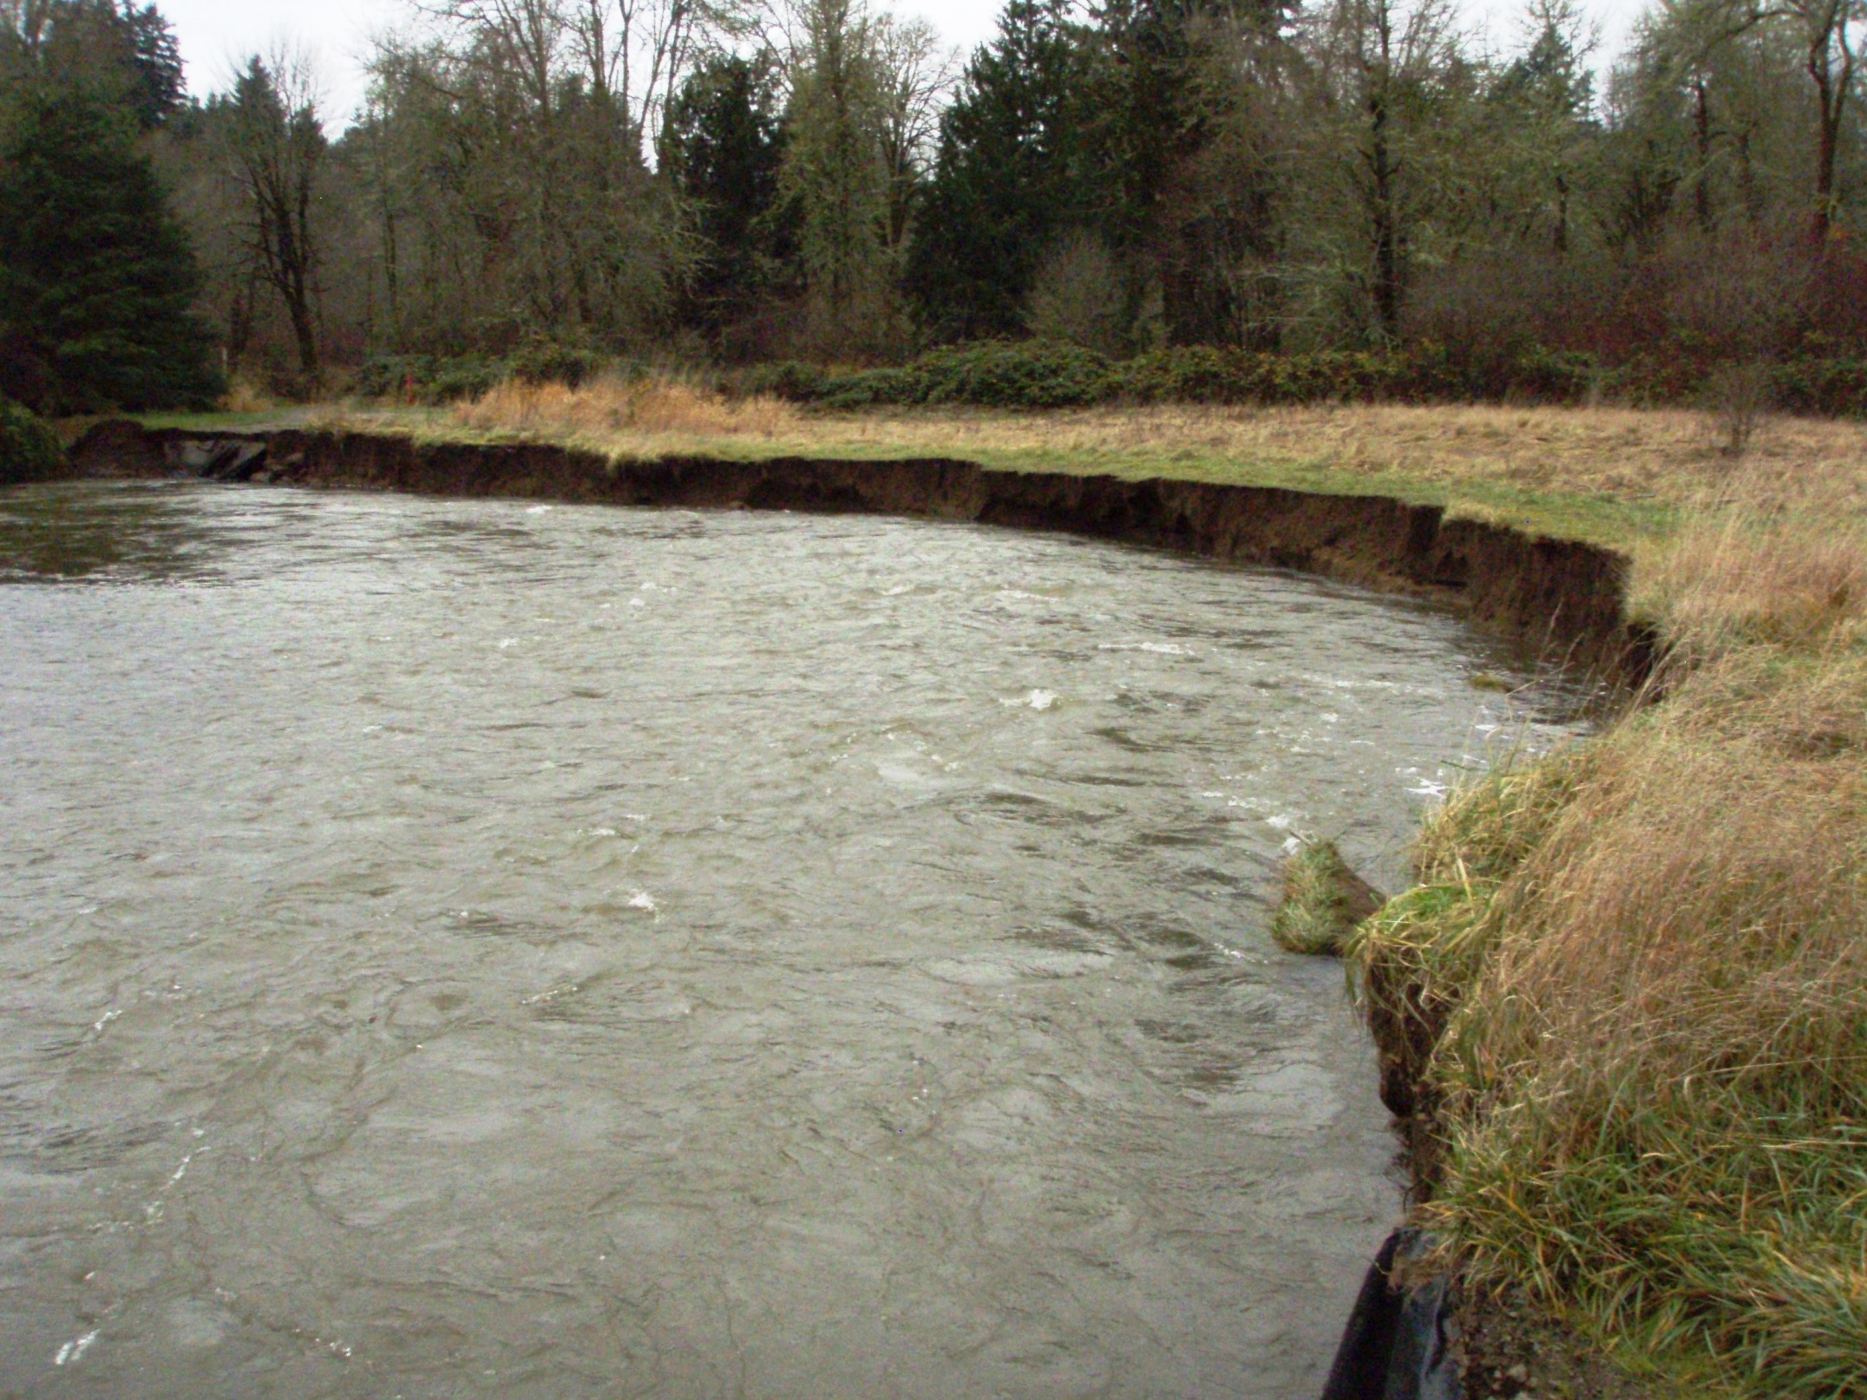
Deschutes River

Slide 6
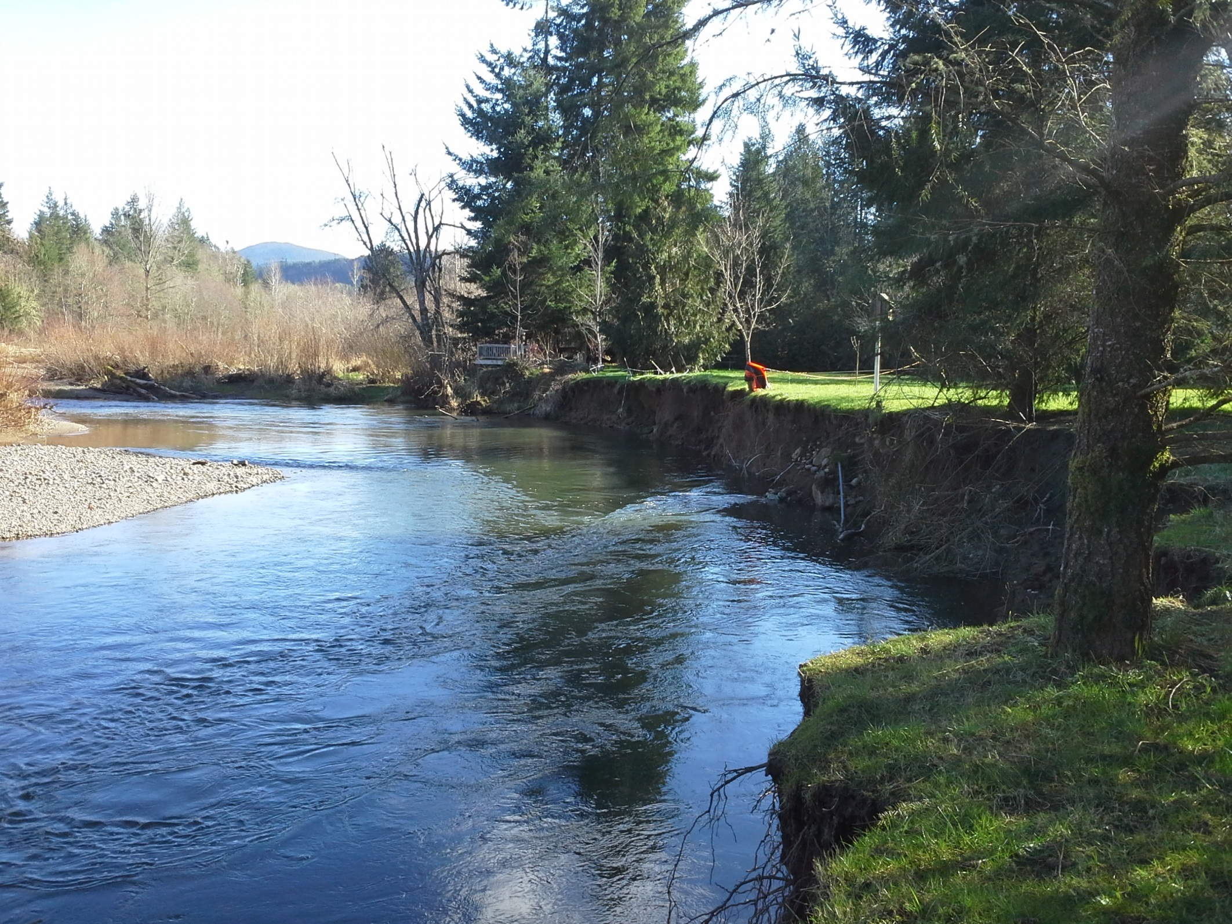

Slide 7
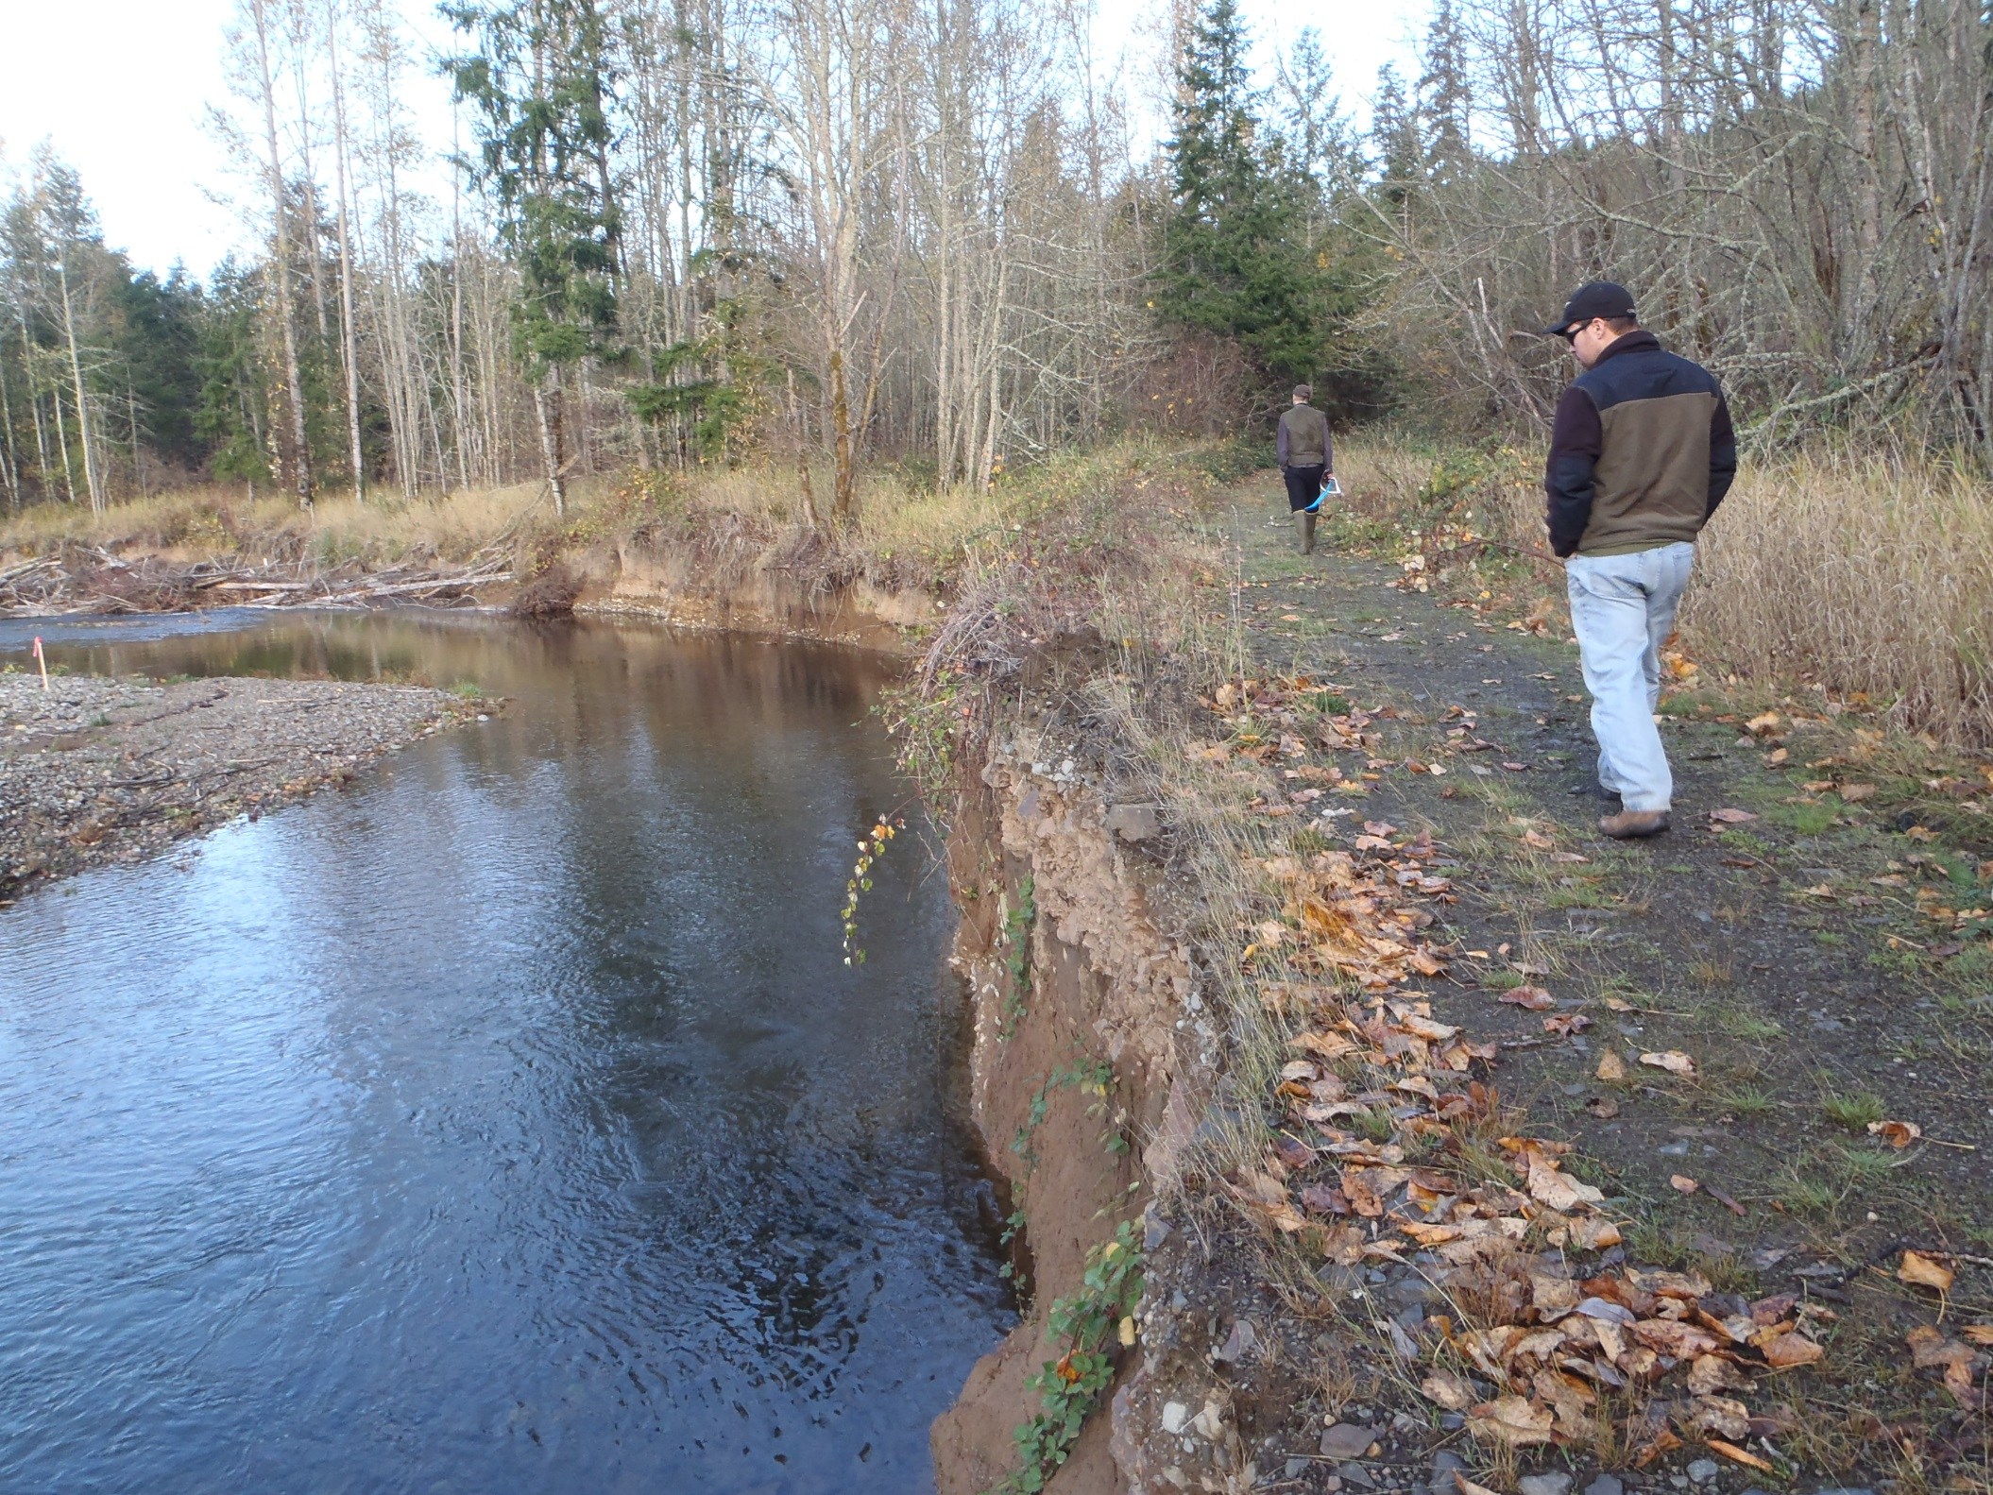

Slide 8
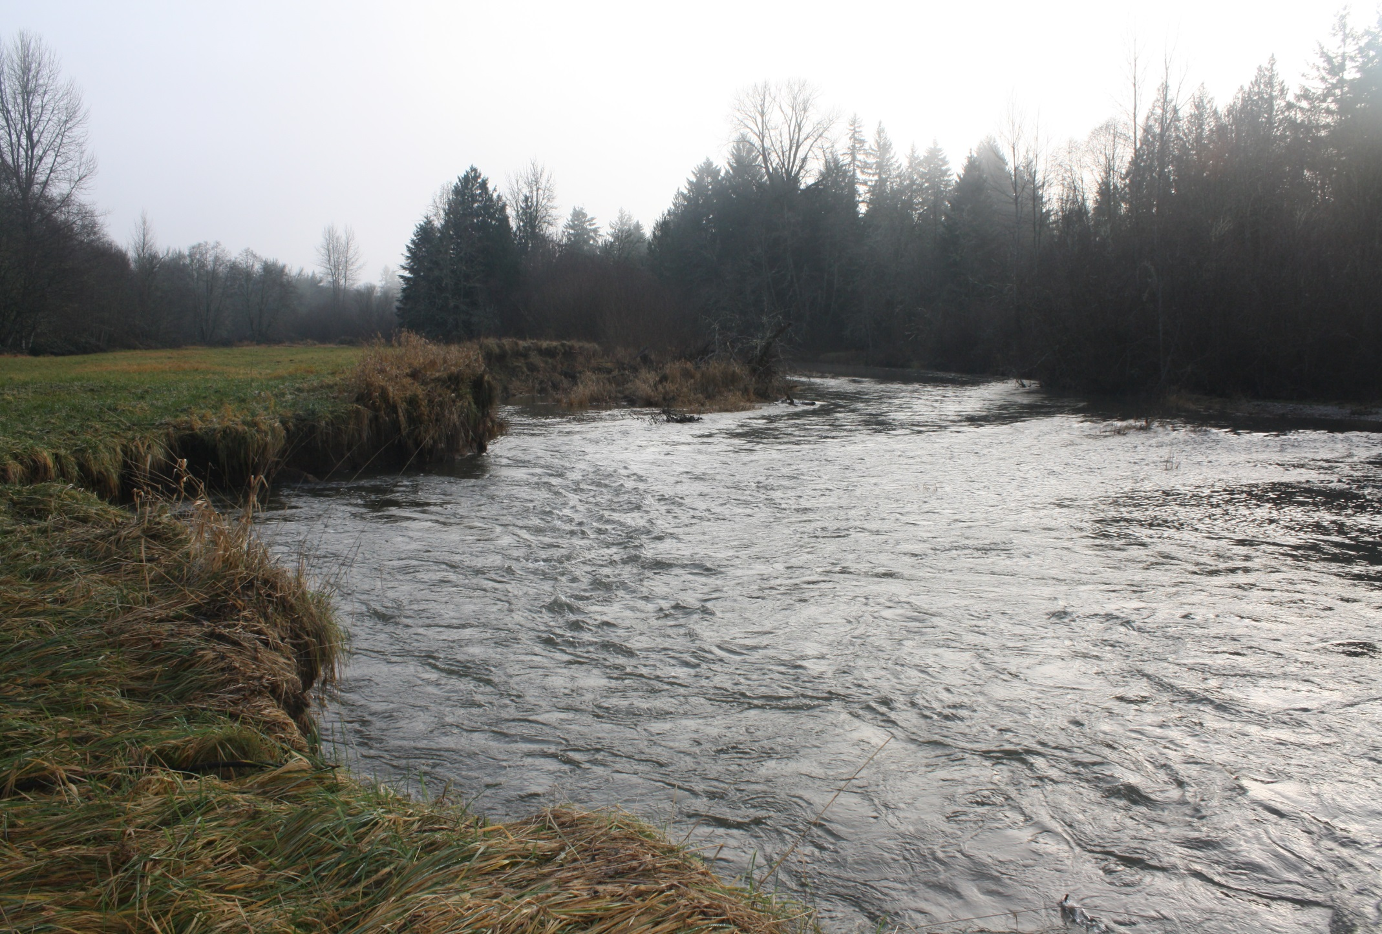

Slide 9
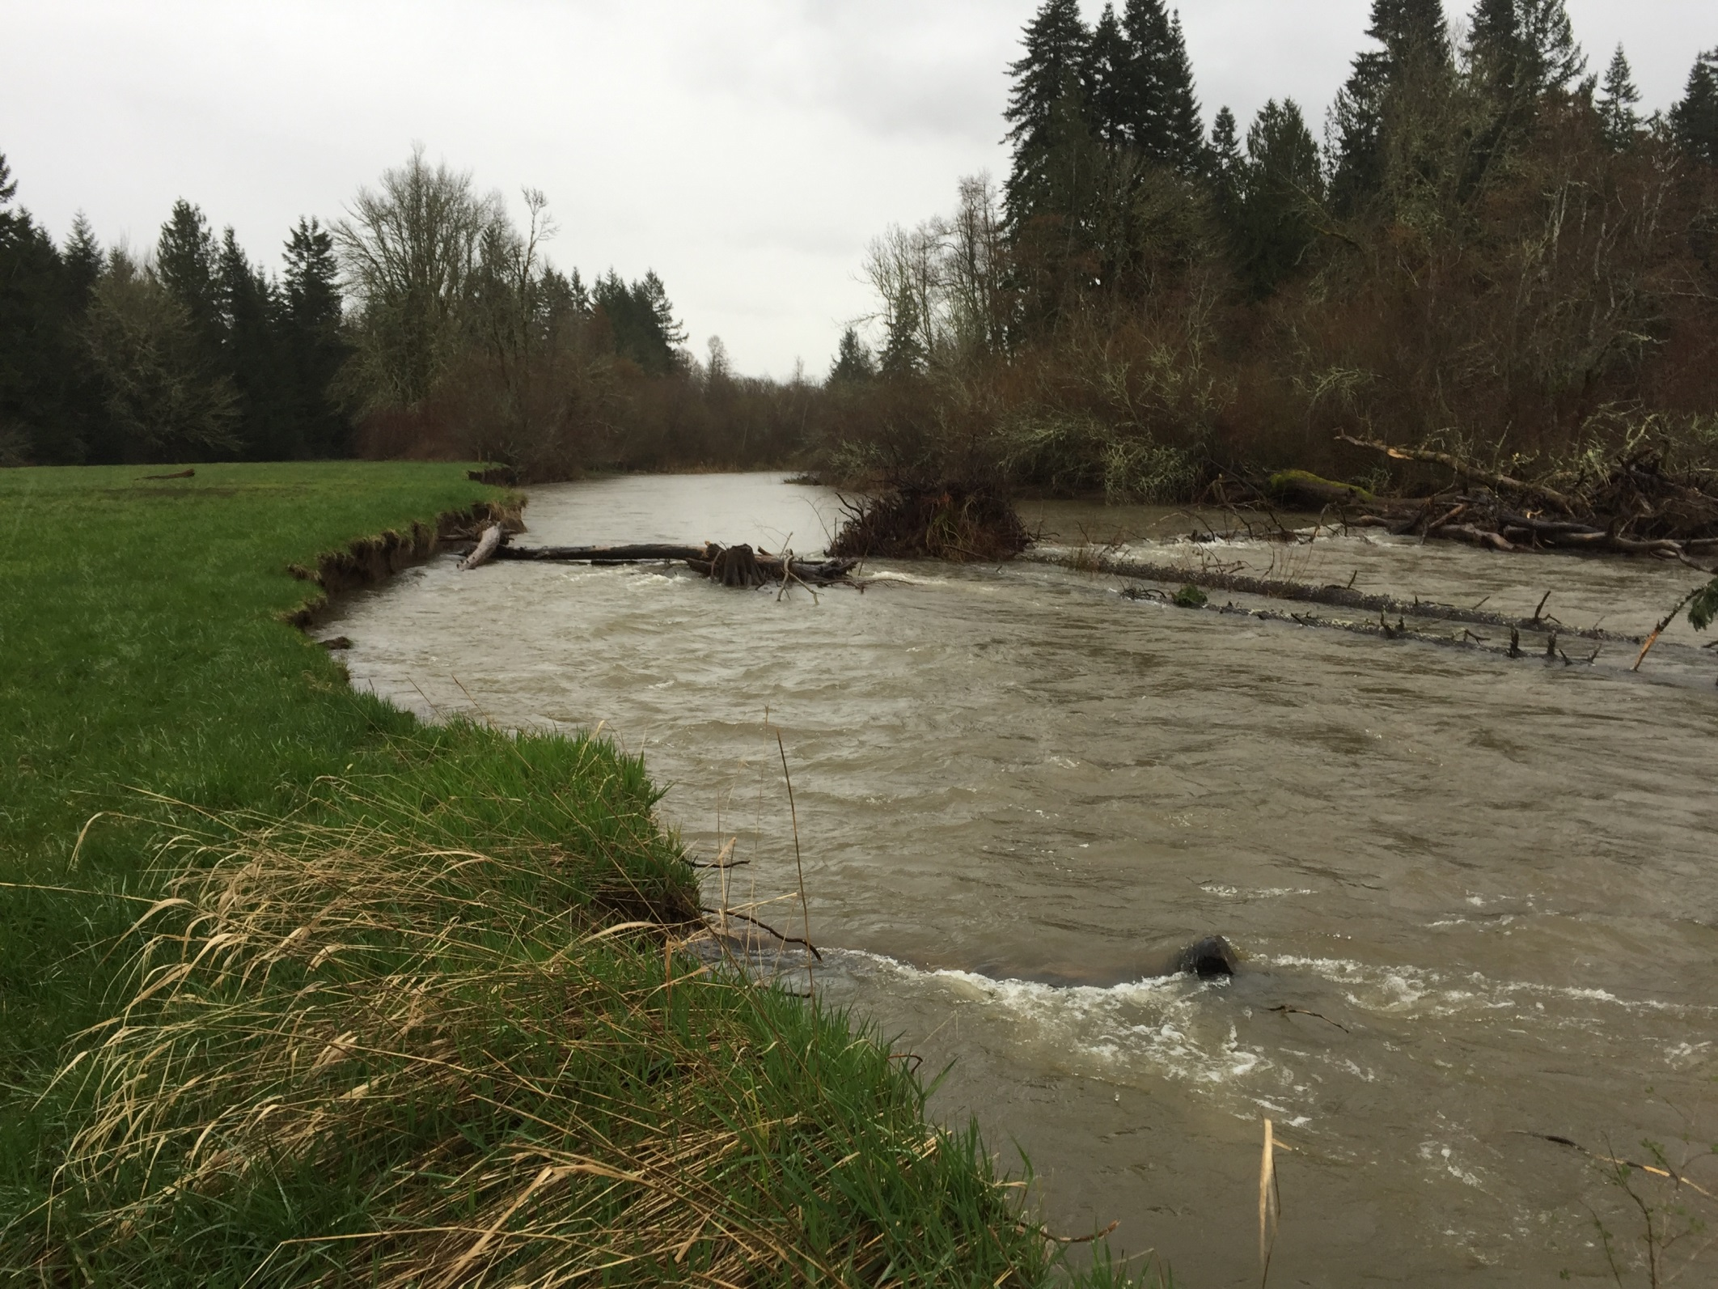

Slide 10
Design Options

