Slide 5
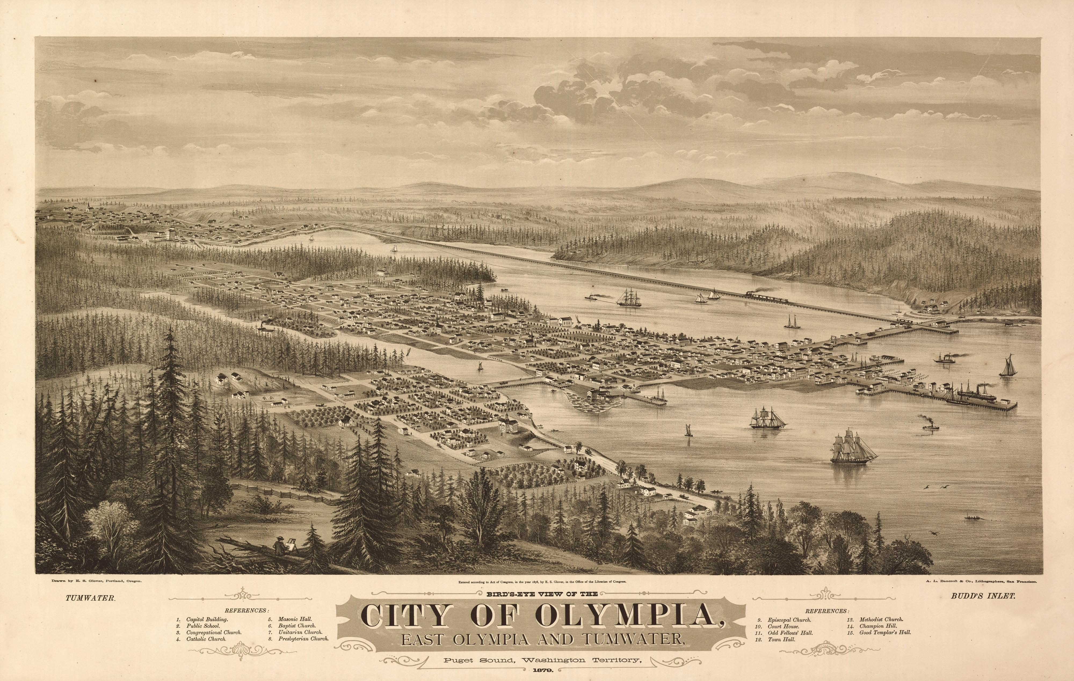
East Olympia and Tumwater, 1879

