Slide 1
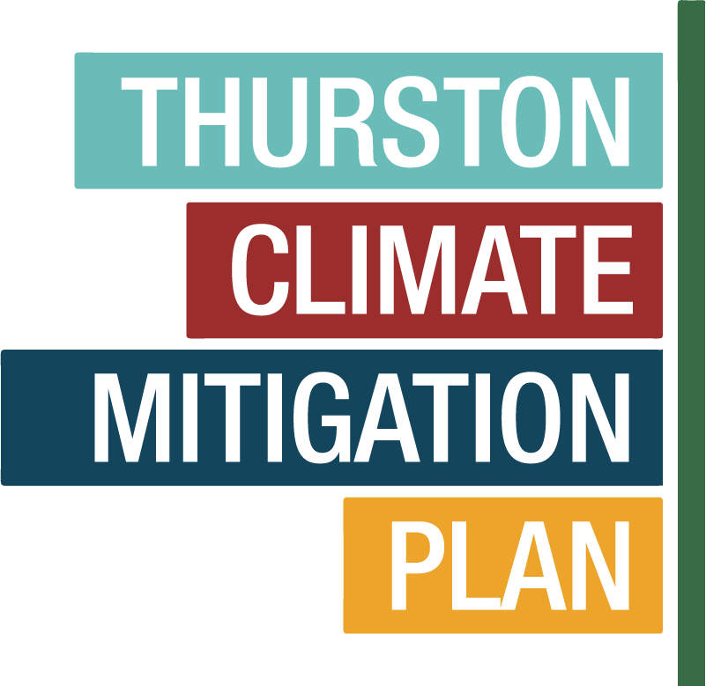
Regional Climate Action
An Overview
September 11, 2019

Slide 2
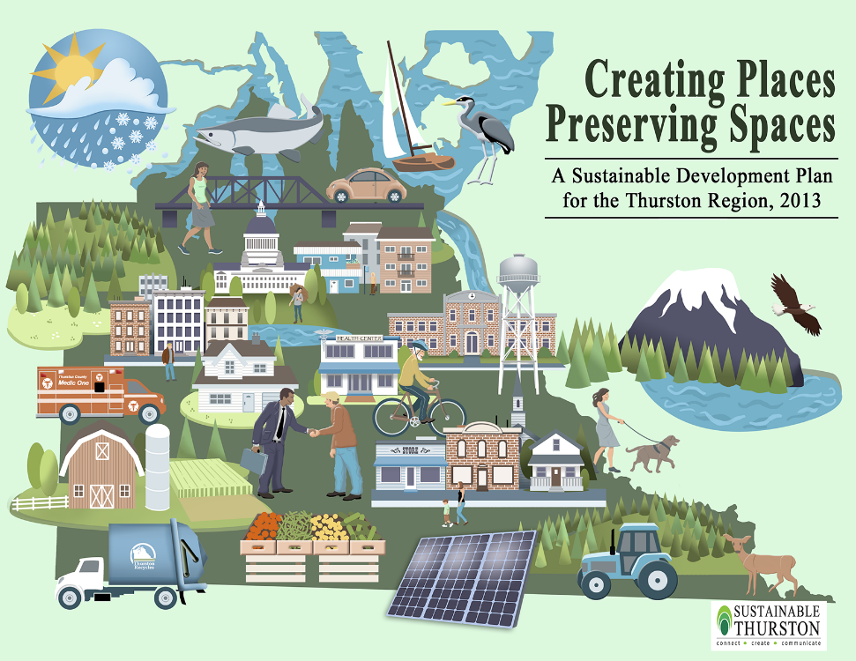
Sustainable Thurston
12 Priority Goals, including:
Protect and improve water quality, including groundwater, rivers, streams, lakes and Puget Sound.
Ensure that the region’s water supply sustains people in perpetuity while protecting the environment.
Move toward a carbon-neutral community.
First Action Step: Find resources for climate action planning
Notes:
So if you recall, Sustainable Thurston has a dozen Priority Goals – three of which related directly to Water and Climate Change
Protect and improve water quality, including groundwater, rivers, streams, lakes, and the Puget Sound.
Ensure that the region’s water supply sustains people in perpetuity while protecting the environment
Move toward a carbon-neutral community.
One of the first action steps is to create a regional Climate Action Plan
Such a plan is a big undertaking. It would include both mitigation recommendations — actions we could take to reduce our emissions of carbon dioxide and other greenhouses — as well as adaptation actions — steps we could take to cope with projected changes in the climate.

Slide 3
Adaptation addresses the impacts
Adjusting to actual or expected future climate and changing conditions
Actions that include:
Avoiding Hazards
Reducing vulnerability
Increasing community strength and resilience
How much we need to adapt will be determined by how our emissions continue and how exactly our climate responds to those emissions

Slide 4
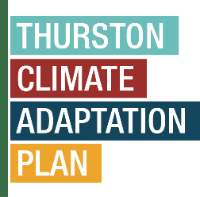
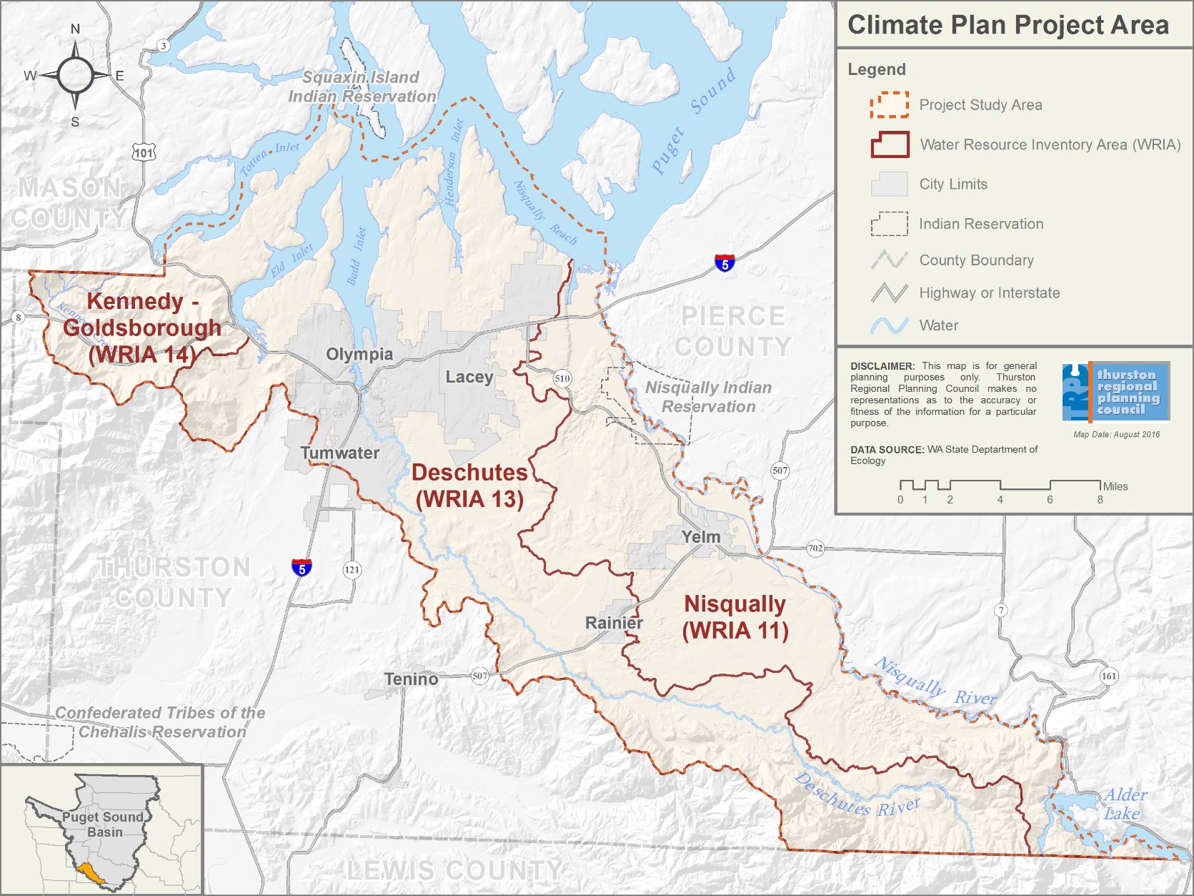
Overview
Purpose:
Develop plan to help the region prepare for and cope with climate impacts (“adaptation”)
Project Area:
South Puget Sound watersheds in Thurston County, WA
Plan
Science Summary
Vulnerability Assessment
Action Plan

Slide 6
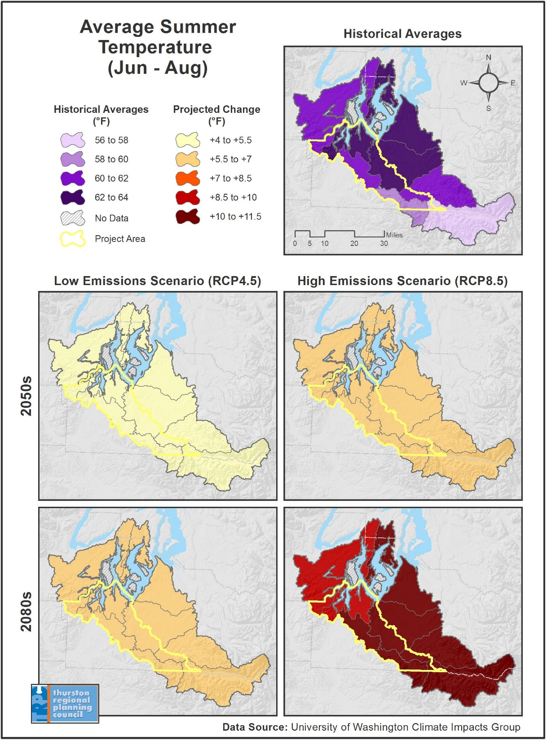
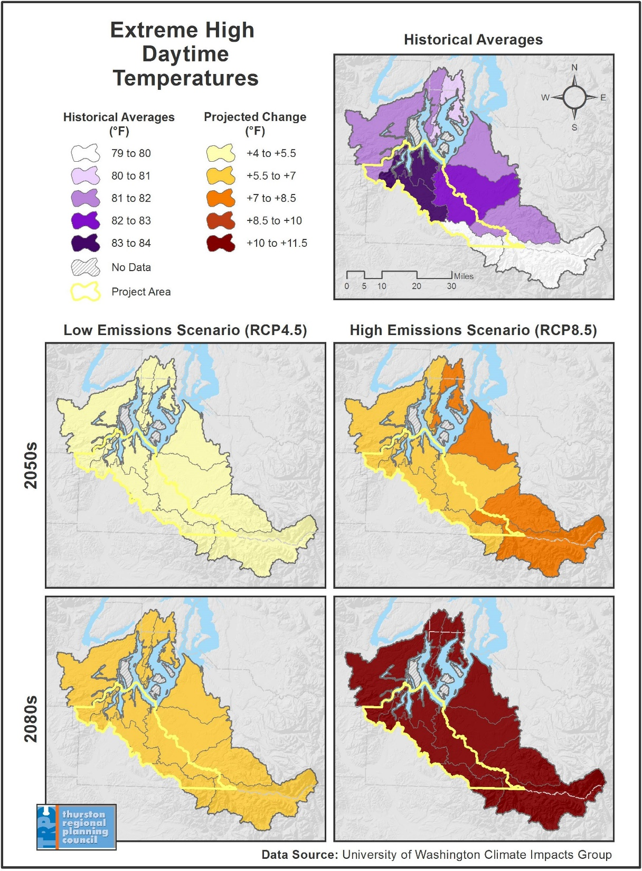
Warmer Summers
Impacts:
Avg summer temperature +5 to 10 degrees by 2080s
Avg August high temp
88 degrees today
98 degrees 2080

Slide 7
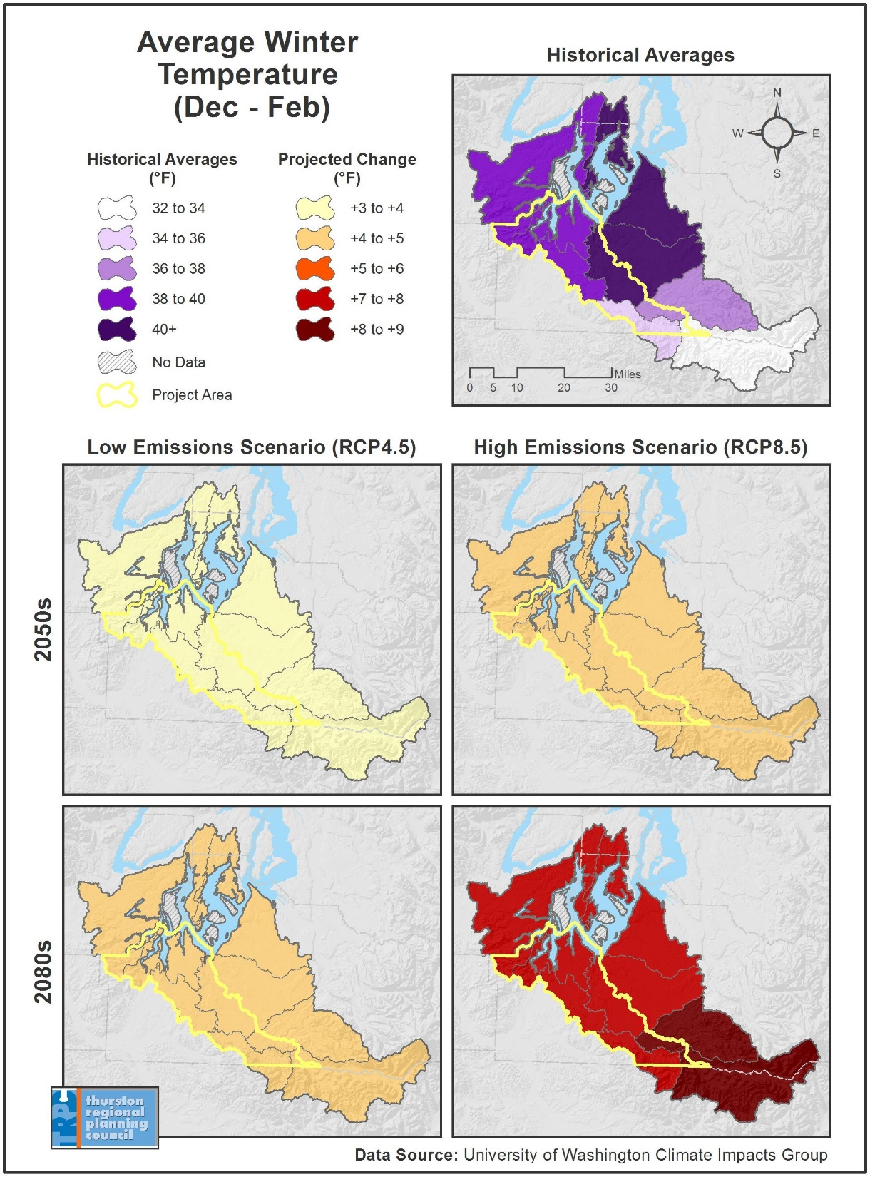
Warmer Winters
Impacts:
Avg winter temperature +4 to 9 degrees by 2080s
Shorter snow season; Deschutes is already a rain-dominant system

Slide 8
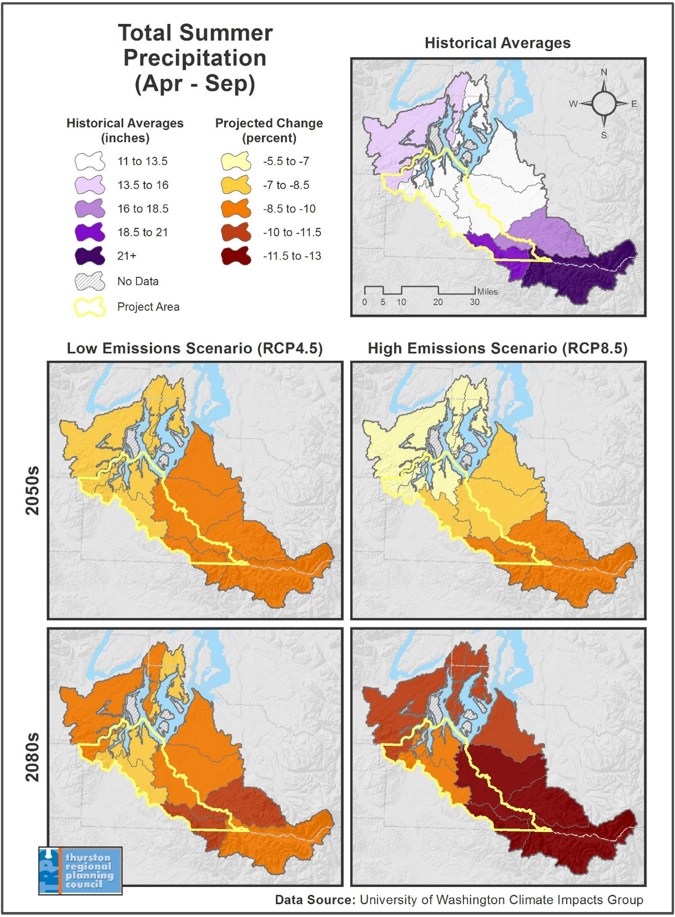
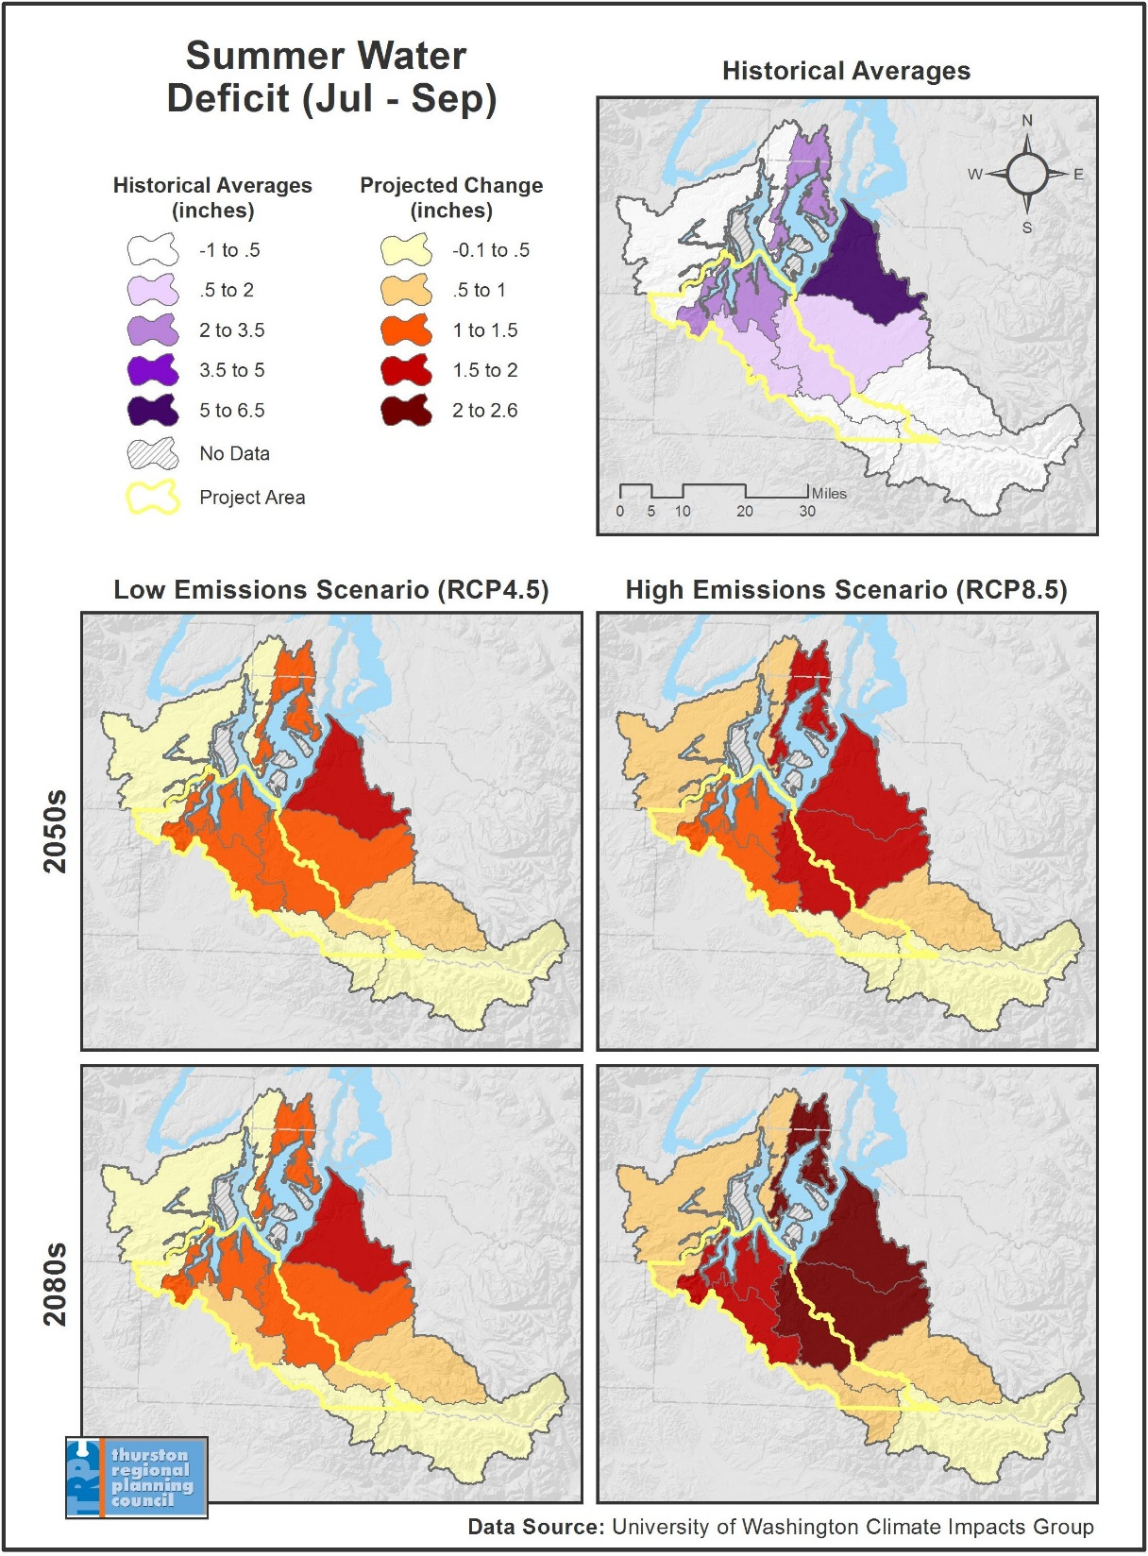
Deeper Drought
Impacts:
-22% summer precipitation

Slide 9
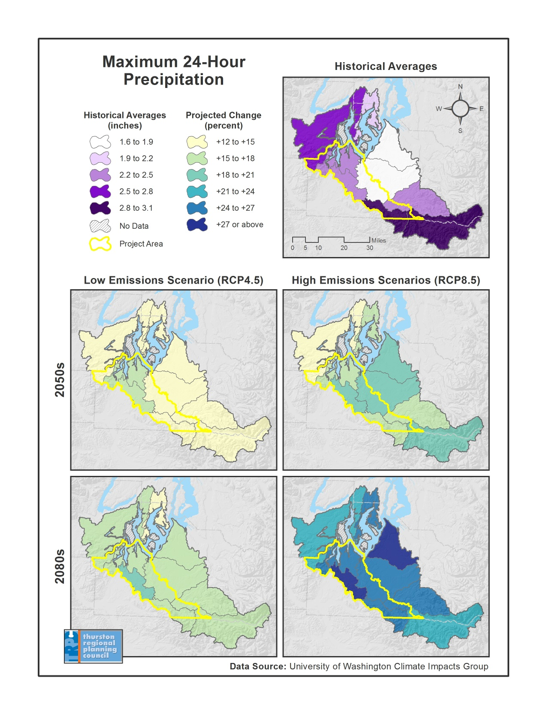
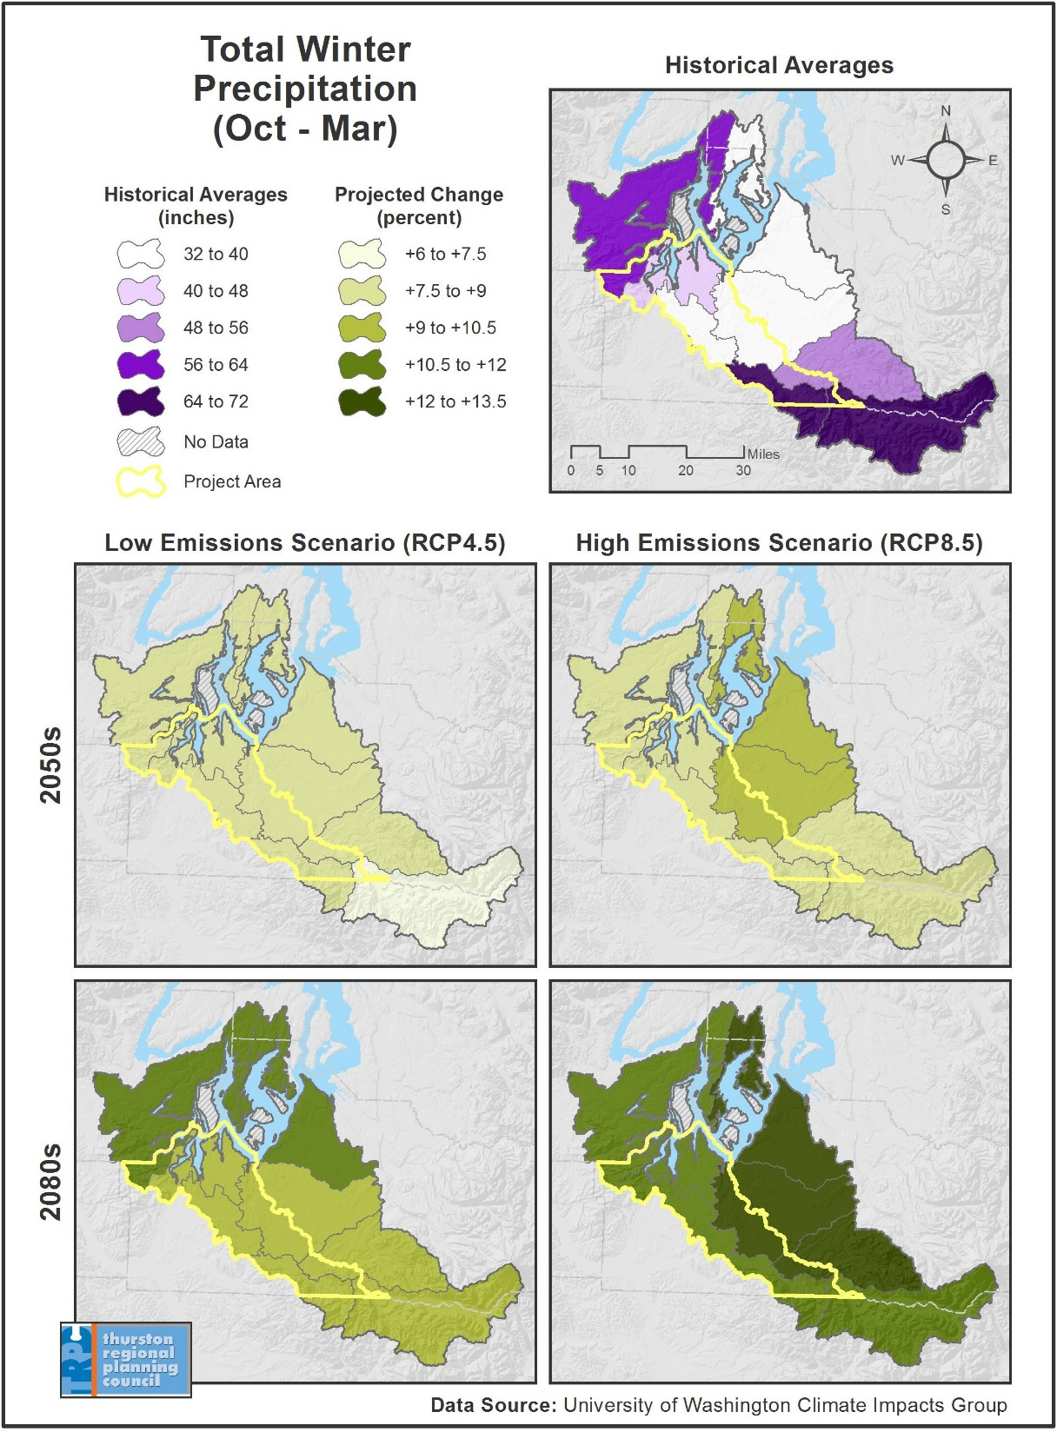
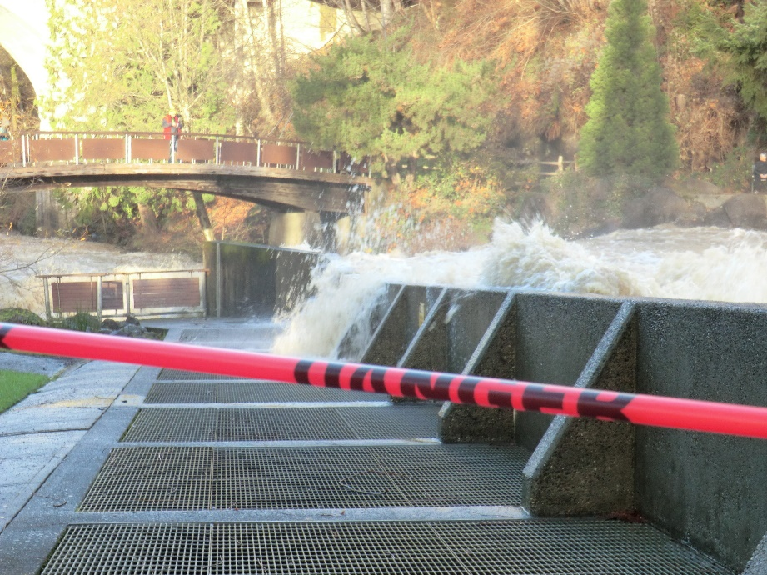
Intense Precipitation
Impacts:
Up to an additional foot of rain in the winter
~ 5 more days per year of most intense precipitation

Slide 10
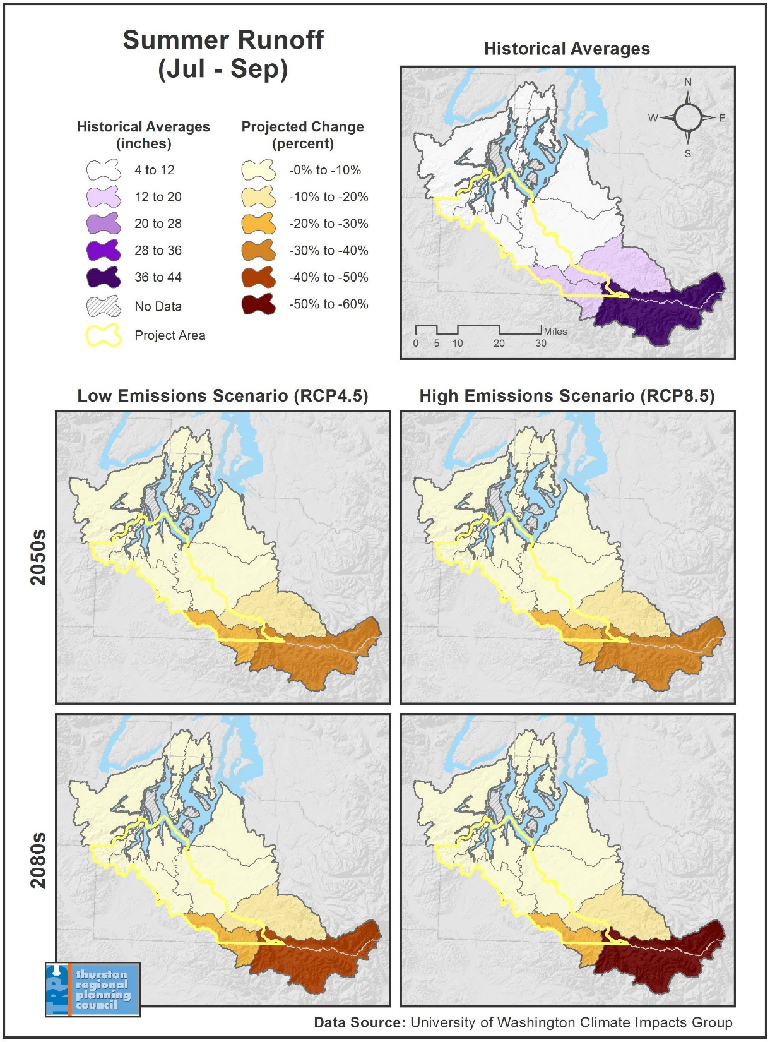
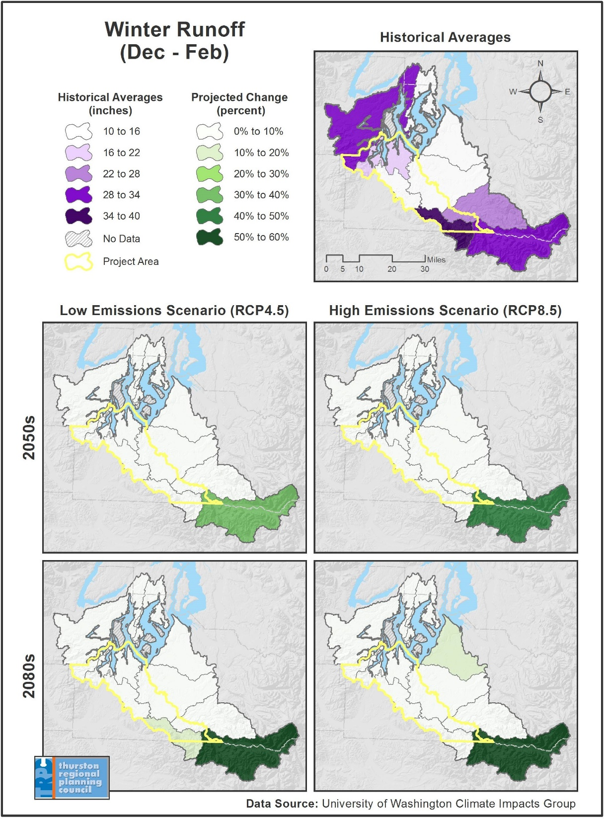
Runoff & Streamflows
Impacts:
Higher flows in the winter
Lower low flows in the summer

Slide 11
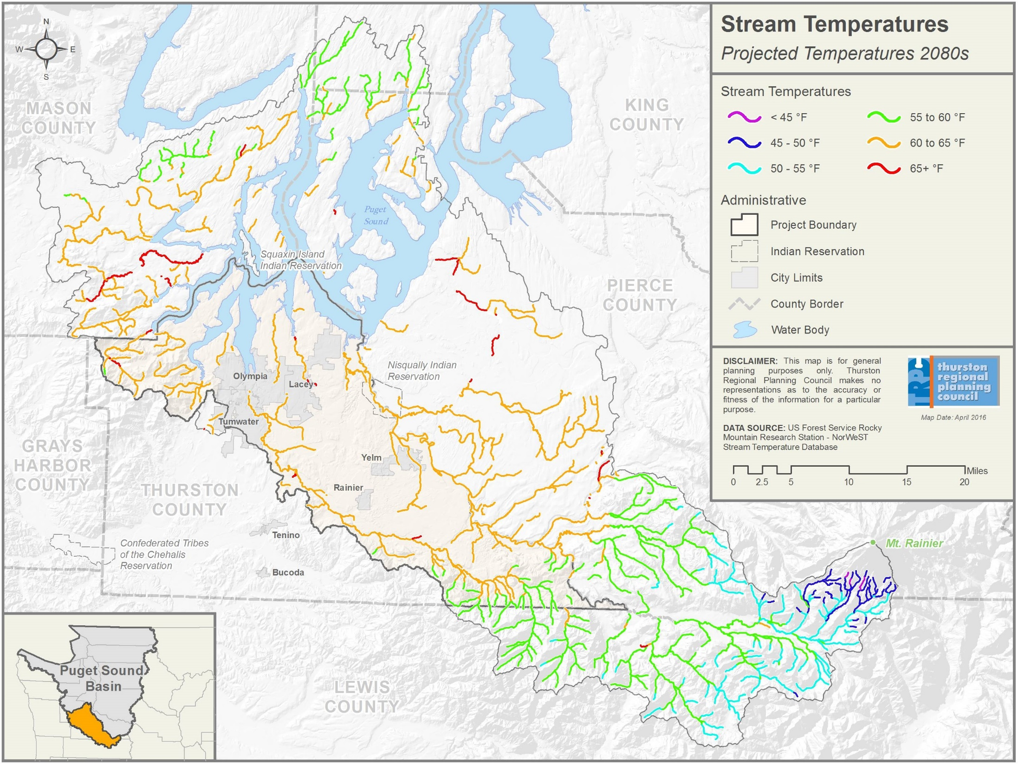
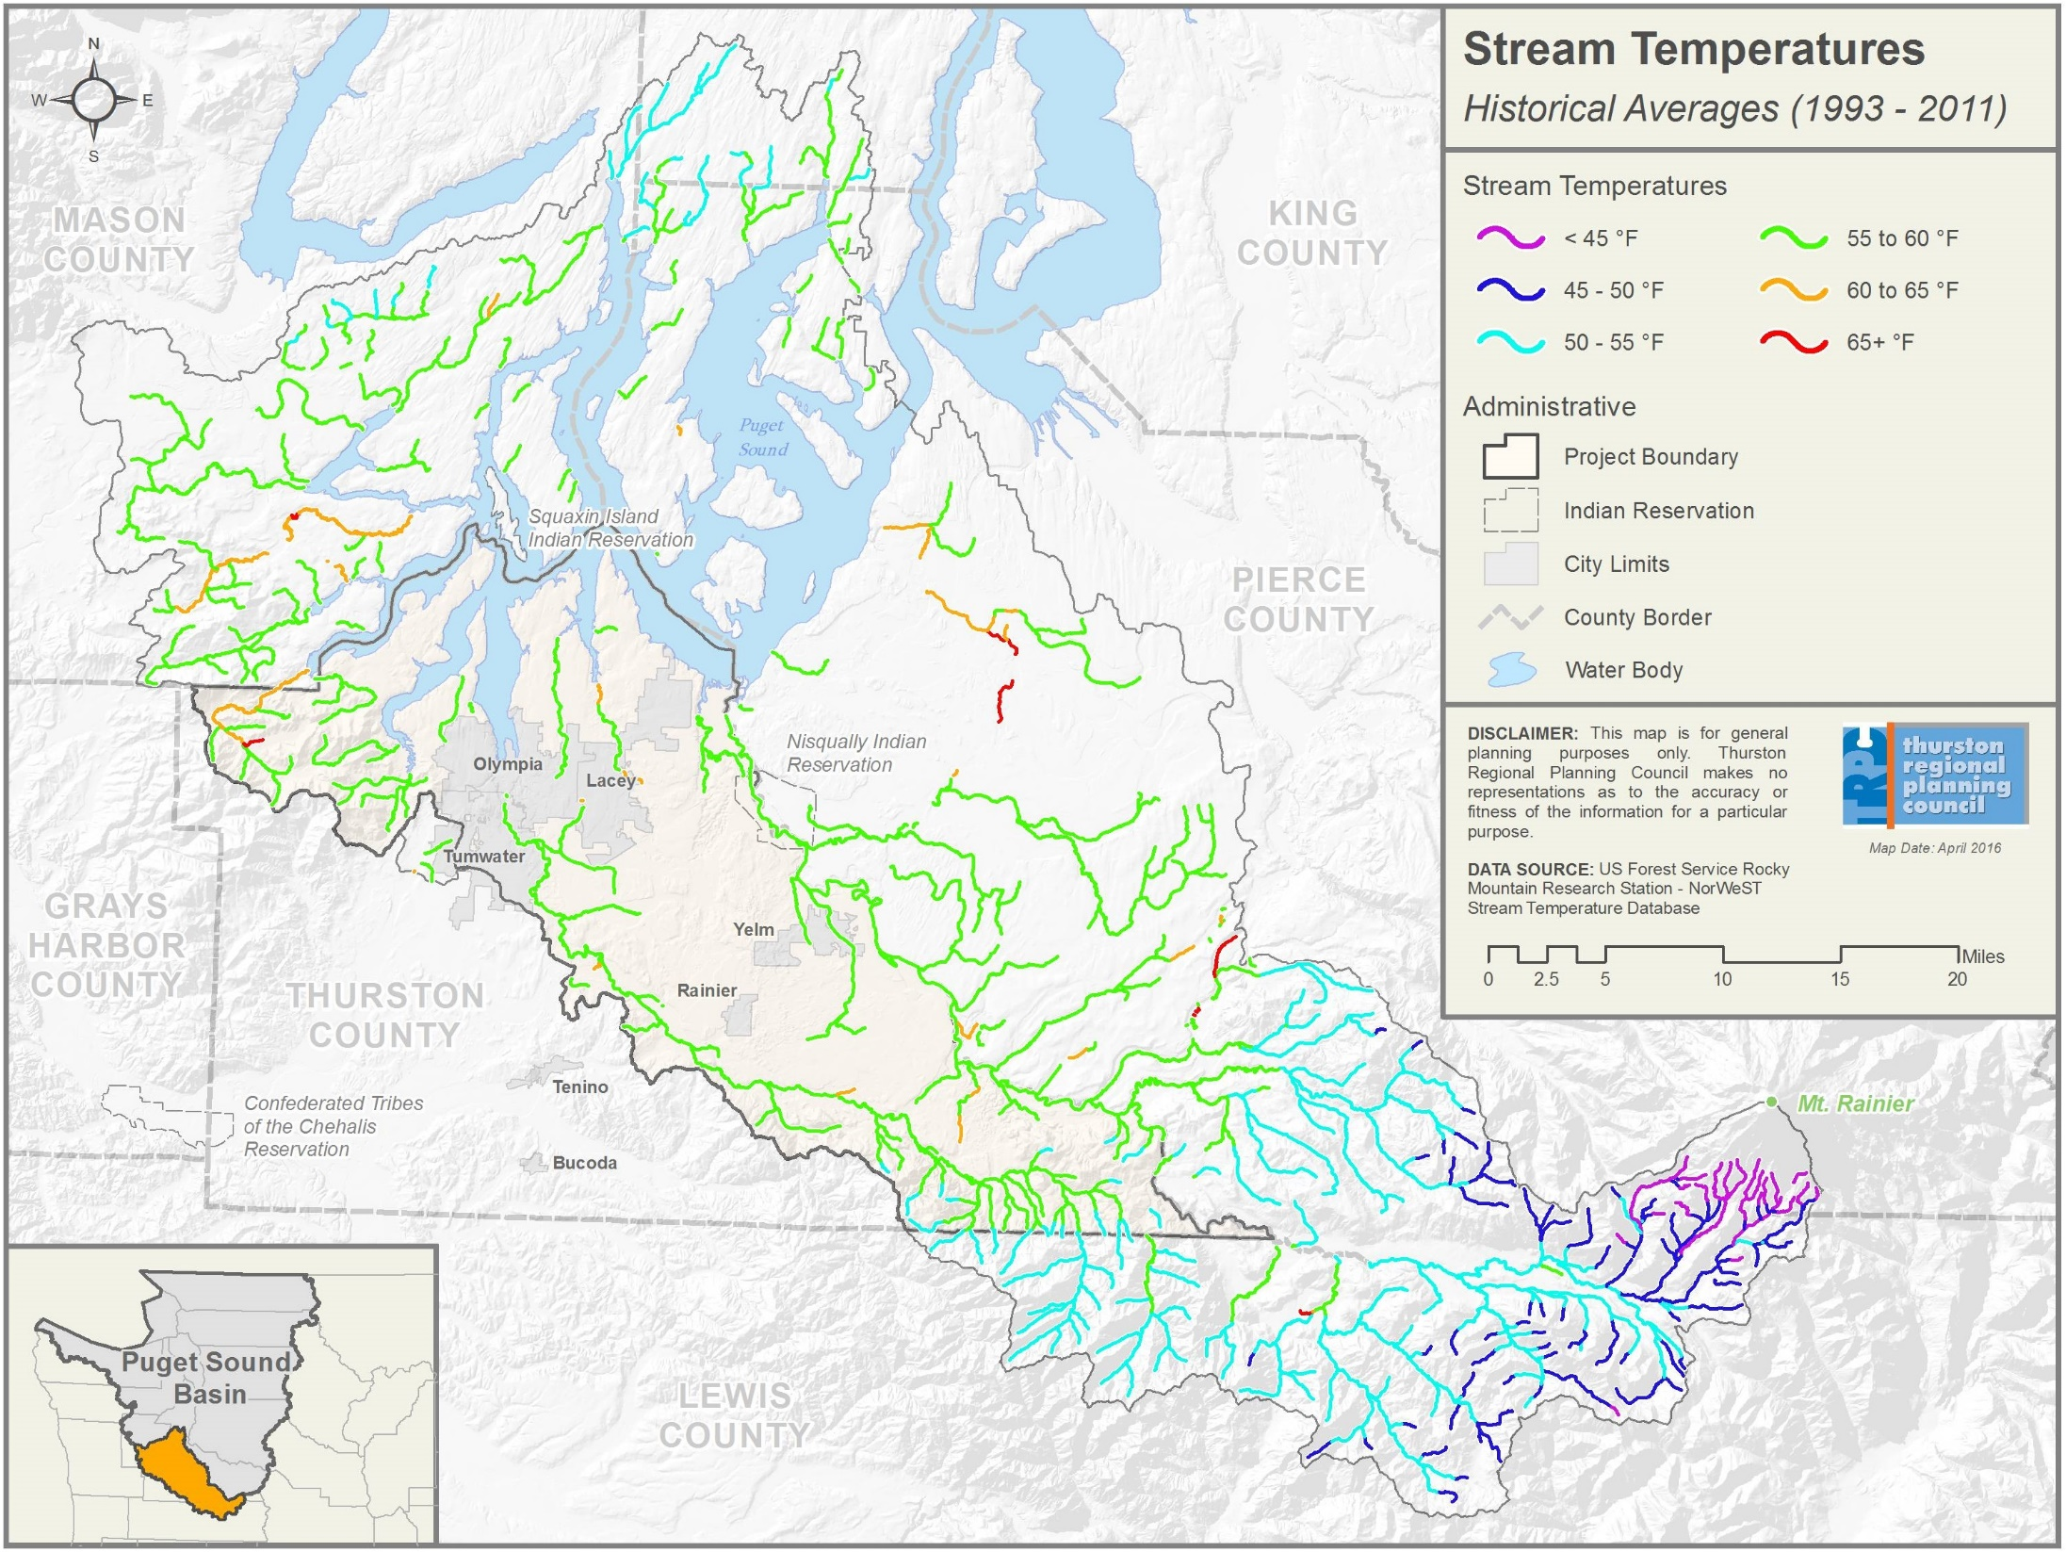
Stream Temperatures

Slide 12
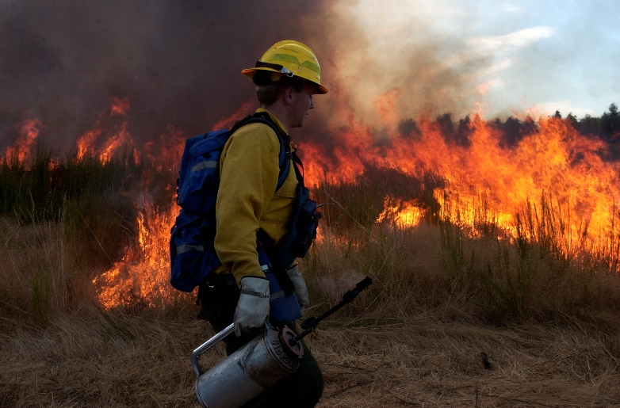
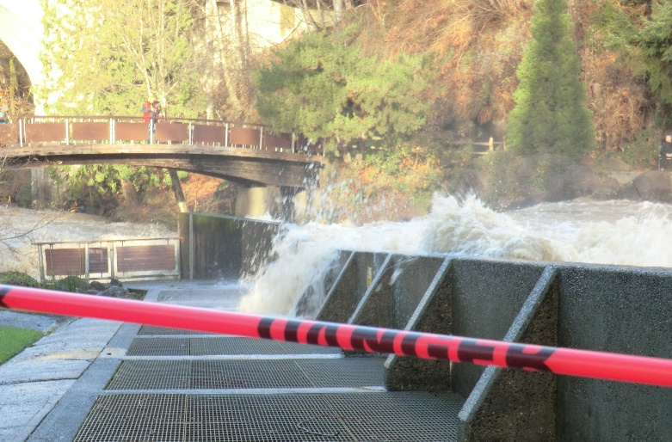
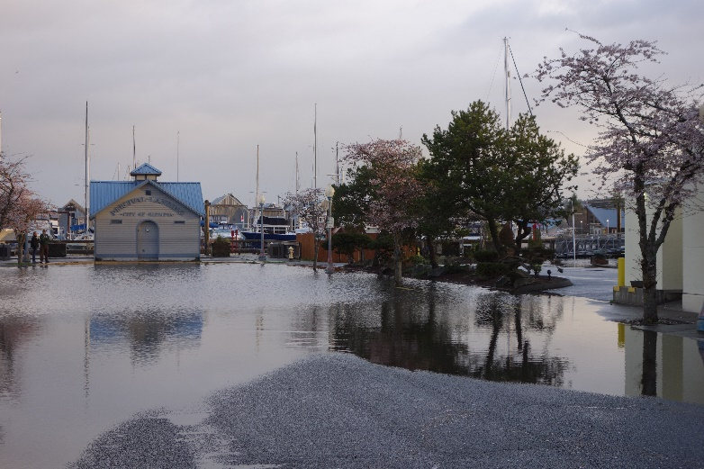
Climate Impacts
Outlook:
Average annual air temperate continues to rise over 21st century
Generally, warmer, wetter winters and hotter, drier summers
Changes anticipated to worsen hazards (droughts, floods, landslides, wildfires) and introduce threats (invasive plants and insects, diseases).
Risks & Impacts:
Shrinking snowpack = Changes runoff timing and streamflow volume
Changing oceans = Threatens local fisheries (acidification and temp.)
Rising sea levels = Exacerbates coastal flooding and erosion
Warmer waters = Threatens water quality for humans, salmon, etc.
Bigger storms = Damages infrastructure, endangers people & economy
Deeper droughts = Spurs water shortages, wildfires, crop losses
Notes:
So, what might that warmer world look like …
Here in the Pacific Northwest, climatologists project warmer and wetter winters and hotter, drier summers in the decades ahead. This could mean shrinking snowpack, rising seas, and more frequent and intense droughts and fires that would affect both the built and natural environments—everything from our farms, to our urban shorelines, to our forests, to our fisheries. … So what do we do about it?
The Intergovernmental Panel on Climate Change’s 2014 assessment report—which is peer-reviewed by scientists around the globe—concludes that adaptation is unavoidable; that is -- even if we halted emissions today, the global temperature would continue to rise as result of what we’ve already emitted.
And I think this underscores the importance of the work we’re about to begin in the region.

Slide 13
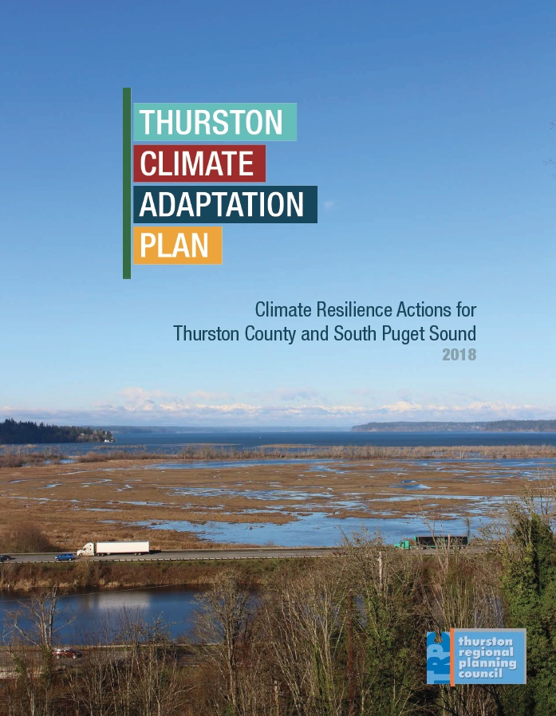
Plan Actions
Selected 25 priority actions based on risk
Identified a lead, partners, and timeframe
Examples:
Action G-01: Direct government staff members to develop their technical expertise and skills to prepare for and respond to climate change impacts.
Action F-01: Evaluate and secure sustained funding to restore and protect riparian vegetation along freshwater and marine shorelines.
Action T-05: Map transportation infrastructure that is vulnerable to repeated floods and/or landslides, and designate alternative travel routes for critical transportation corridors when roads must be closed because of natural hazards.

Slide 14
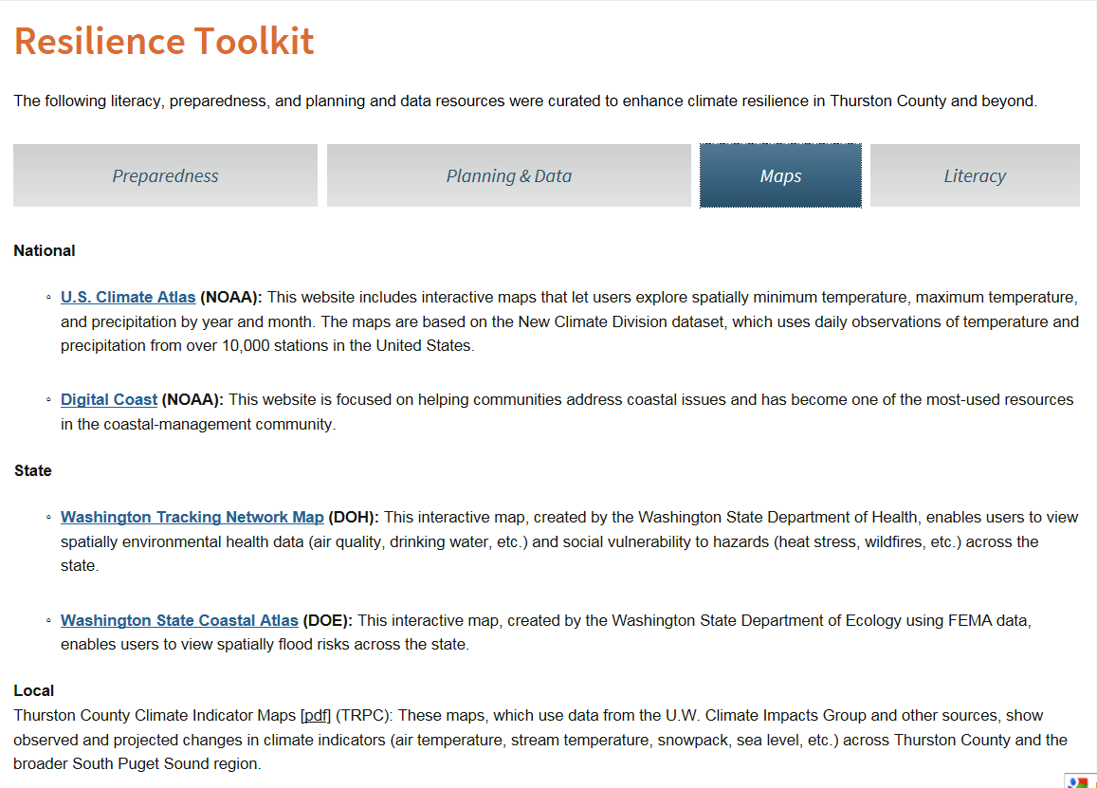
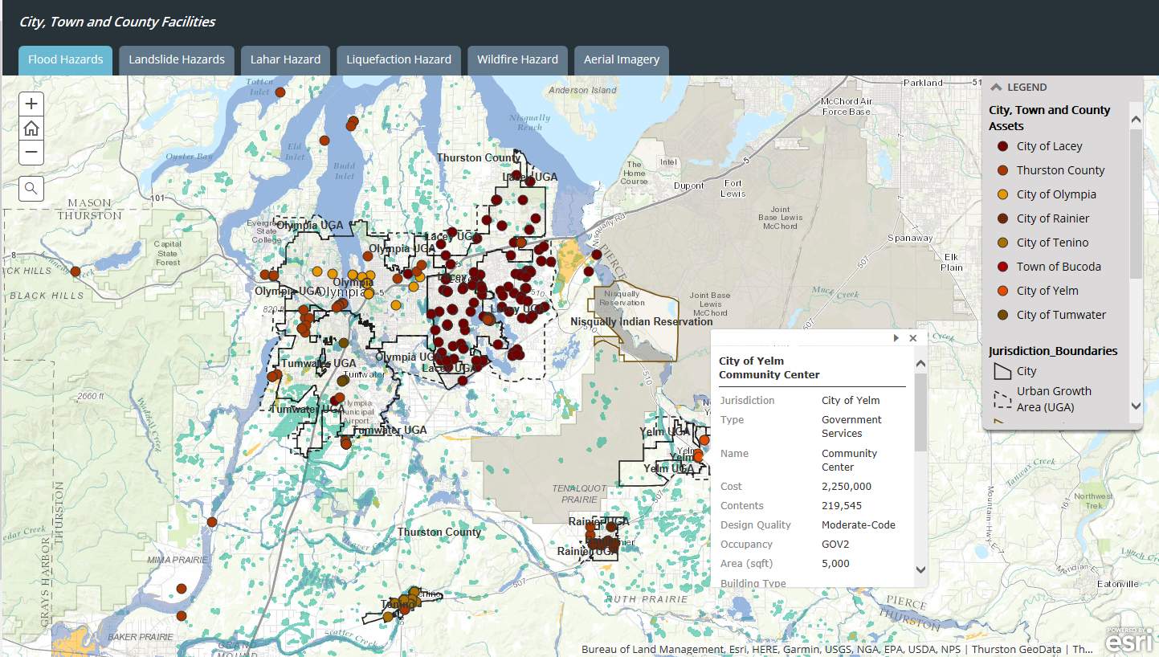
Plan Resources
Created Resilience Toolkit with links to TRPC’s Hazards Vulnerability map, climate data, preparedness resources:
www.trpc.org/resiliencetoolkit

Slide 15
Mitigation addresses the cause
Mitigating the effects of climate change by reducing human output of heat trapping gases into the atmosphere
Actions that include:
Reducing the sources of these gases
Reducing demand
Enhancing the sinks or sequestration that store these gases
The goal is to avoid significant human disruptions to the climate system to stabilize greenhouse gas levels in a timeframe sufficient to allow ecosystems to adapt naturally to climate change

Slide 16
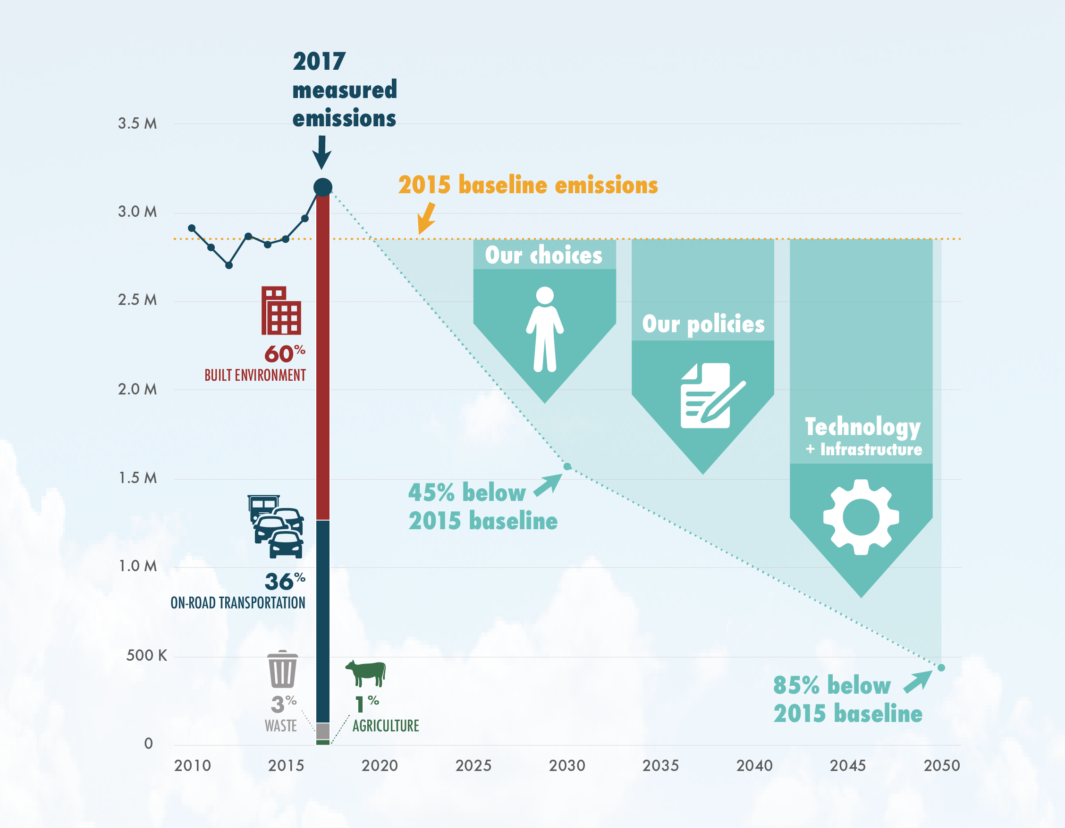
Adopted Emissions Targets Thurston County, Lacey, Olympia & Tumwater
Reduction Targets:
Reduce communitywide emissions 45% below 2015 levels by 2030 and 85% below 2015 levels by 2050.
2015 Baseline:
2015 inventory of countywide emissions ~2.84 million MTCO₂ equivalent
Incorporates real energy, solid waste, agricultural, and transportation data from PSE, TRPC, and other sources.

Slide 17
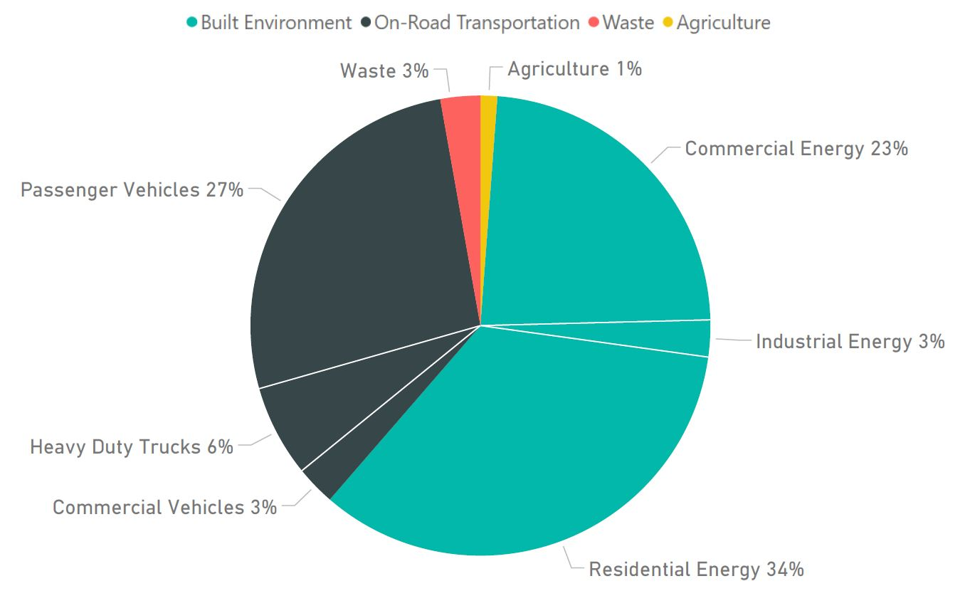
Source of Emissions (2016) for Thurston County, Lacey, Olympia, & Tumwater From Thurston Climate Action Team, August 2018

Slide 18
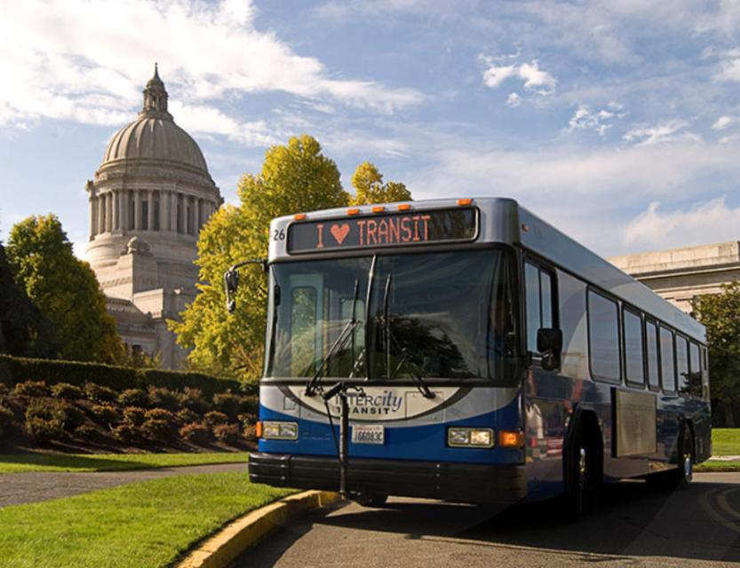
Thurston Climate Mitigation Plan
Transportation Strategies
Take our survey!
Public transit, bike, walking, carpool
Invest in efficiency upgrades and renewable energy sources
Electric and high efficiency vehicles

Slide 19
Thank you! Contact
Allison Osterberg, Senior Planner
Thurston Regional Planning Council
360.956.7575
osterberga@trpc.org
www.trpc.org/climate

