Slide 1
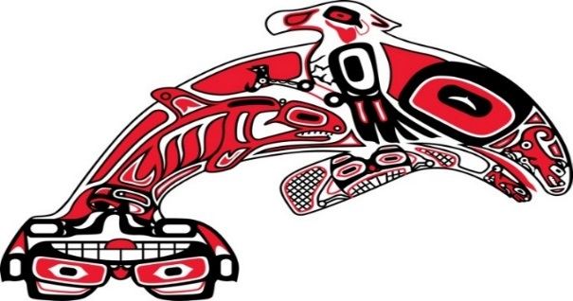
Shelton Harbor Restoration Climate Change Planning
Scott Steltzner
Squaxin Island Tribe

Slide 2
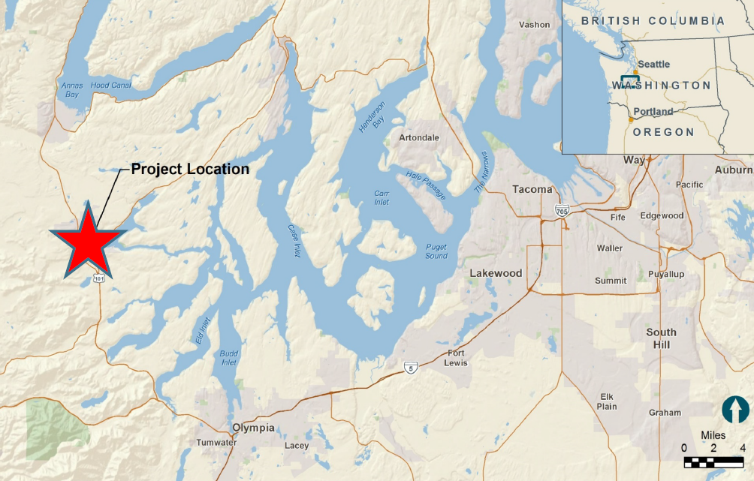

Slide 3
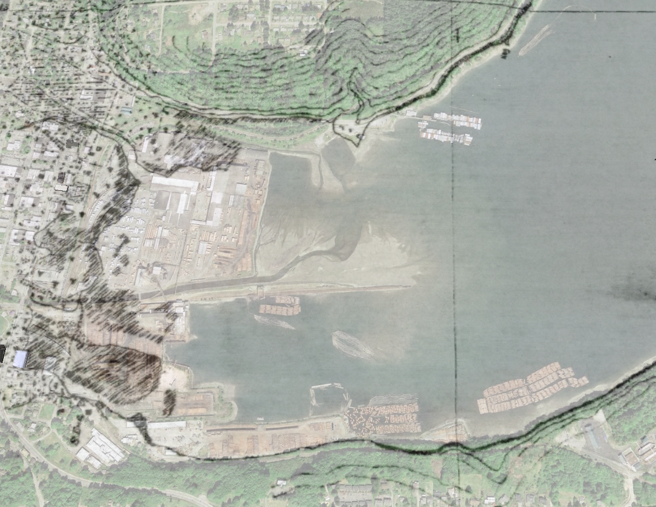
Shelton Creek
Goldsborough Creek
Notes:
1880’s T-sheets
Restoration but in a different location

Slide 4
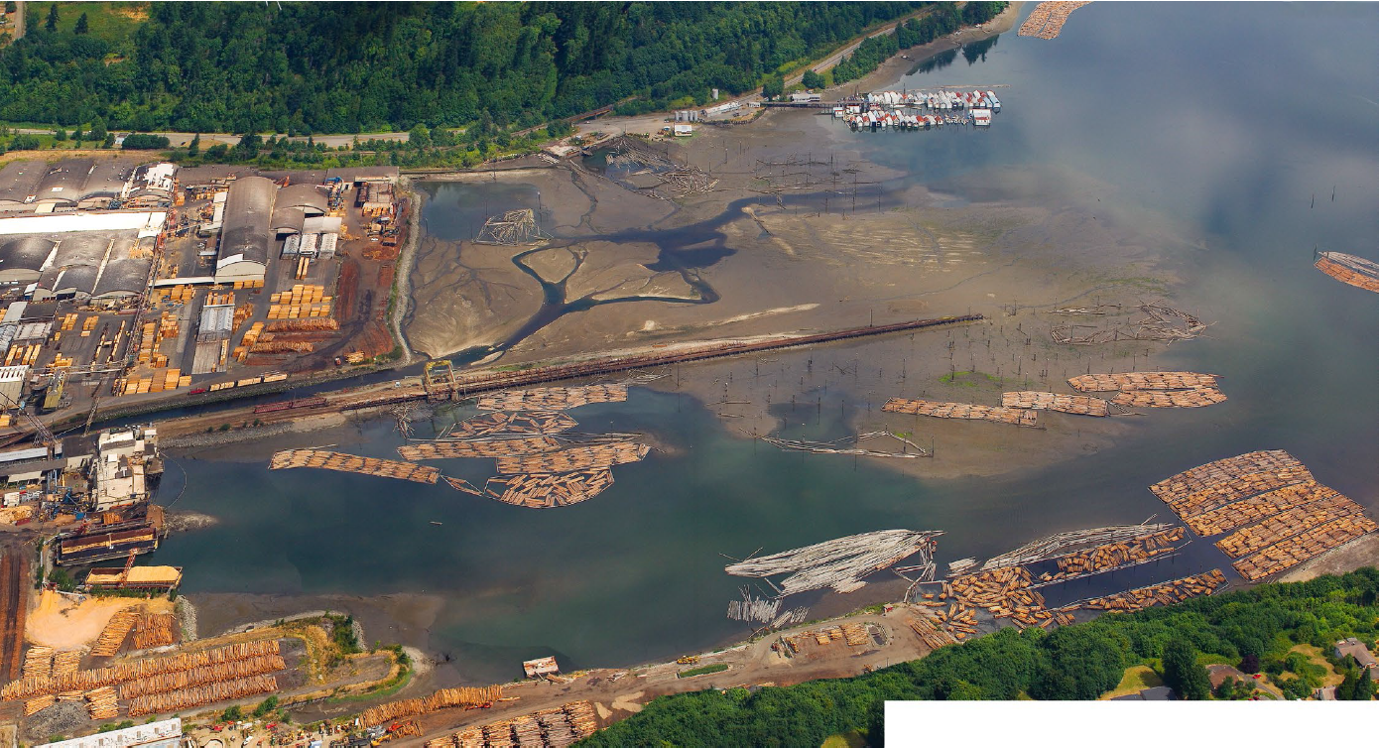
Notes:
Existing Harbor
Industrial for over 100 years
Fuel depots
Log rafting
Dredging
Filling

Slide 5
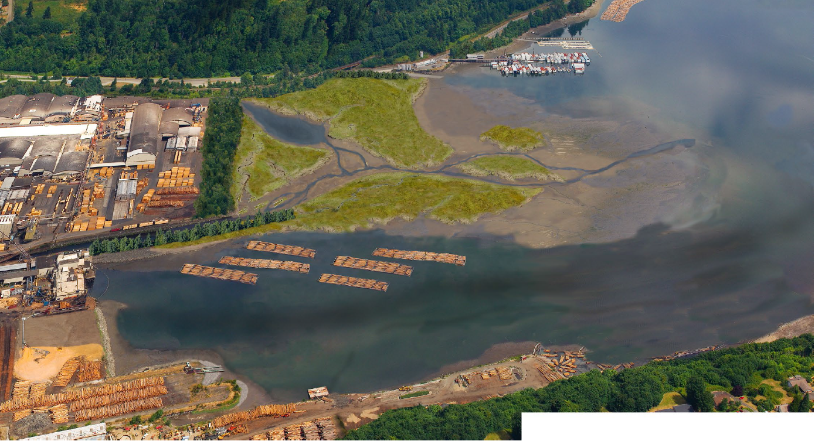
Notes:
Remove dikes
Remove bulkheads
Re-create lost saltmarsh
Simpson and Port willing to abandon for eternity over 80% of the harbor

Slide 6
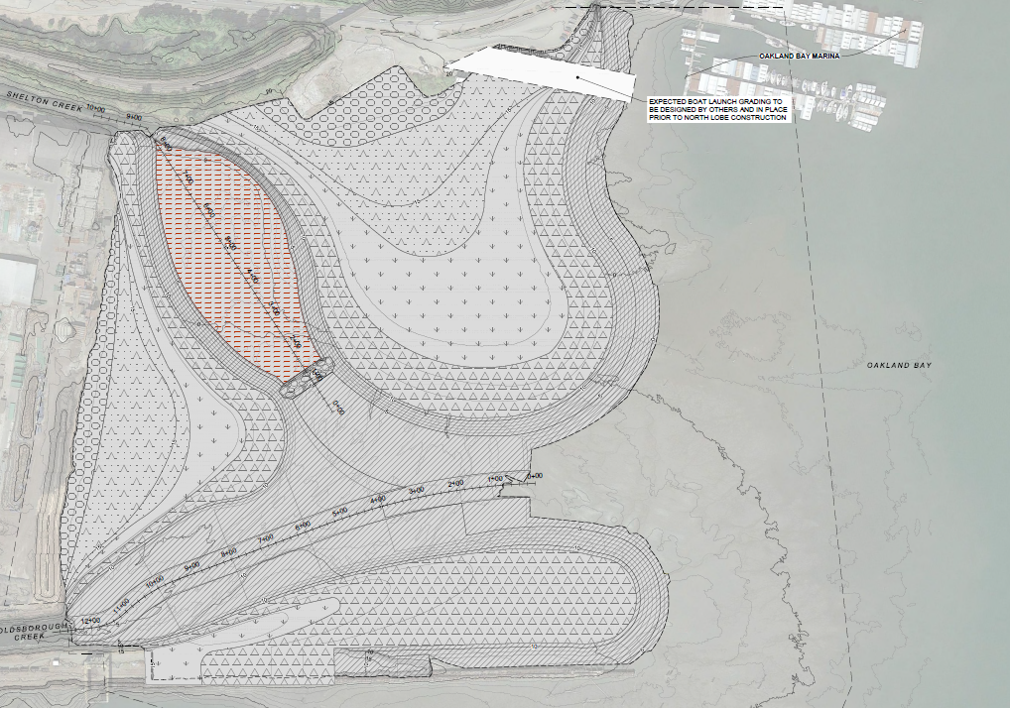
Notes:
West lobe- 12.2 acres
South lobe- 10.1 acres

Slide 7
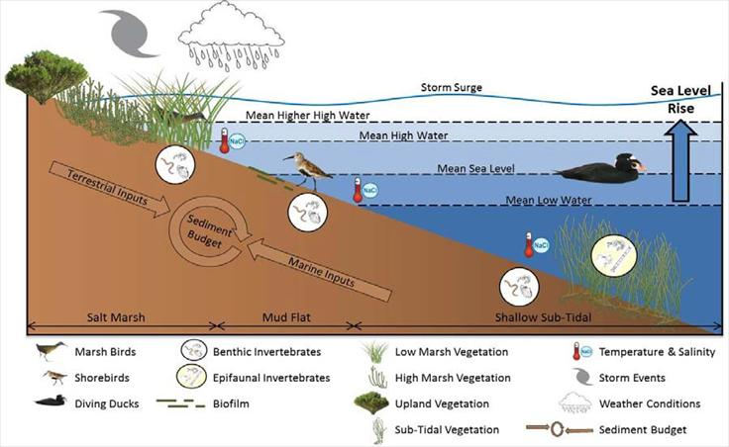
Signals of Climate Change in Estuaries
Water/Air Temperature
Changes in Precipitation
Sea Level
Freshwater inflow
Coastal storms
Coastal Currents
Acidification

Slide 8
Climate Change Design Considerations
Changing Hydrology
Sea Level Rise
Ocean Acidification

Slide 9
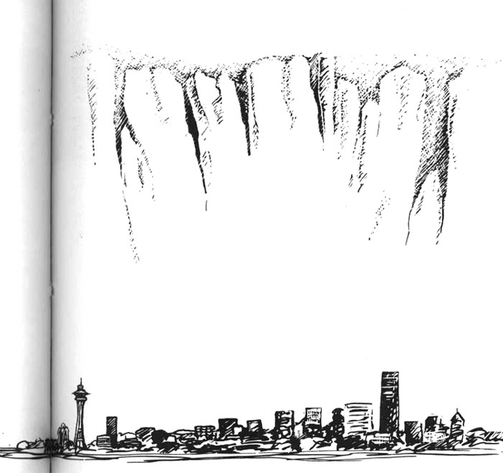
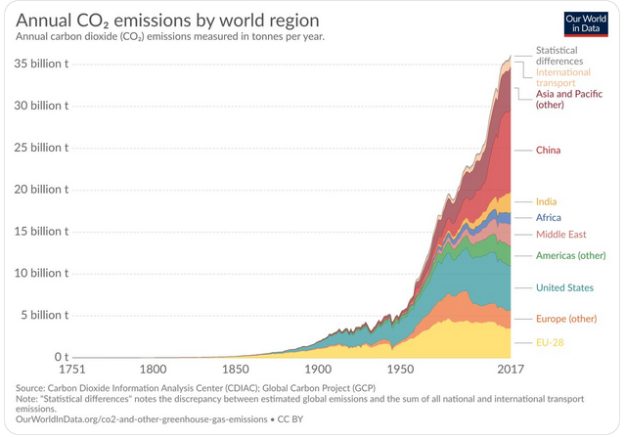
Sideboards
Notes:
South Sound is sinking as land rebounds from ice age. North South rising at same rate = sea level rise
Climate change is happening and collectively we are not doing anything about it. Emitted as much Co2 in the last 30 years then previous 200.
As Europe, the Americas and to a lesser extent China have slightly decreased India and parts of Africa are coming online.
If the world doesn’t reduce emissions by 45 percent by 2030, then get almost 3 degree F with catastrophic. That’s in 10 years and the U.S. is currently lowering standards.
Answer- don’t quit but can’t depend on others. Look at local resiliency.

Slide 10
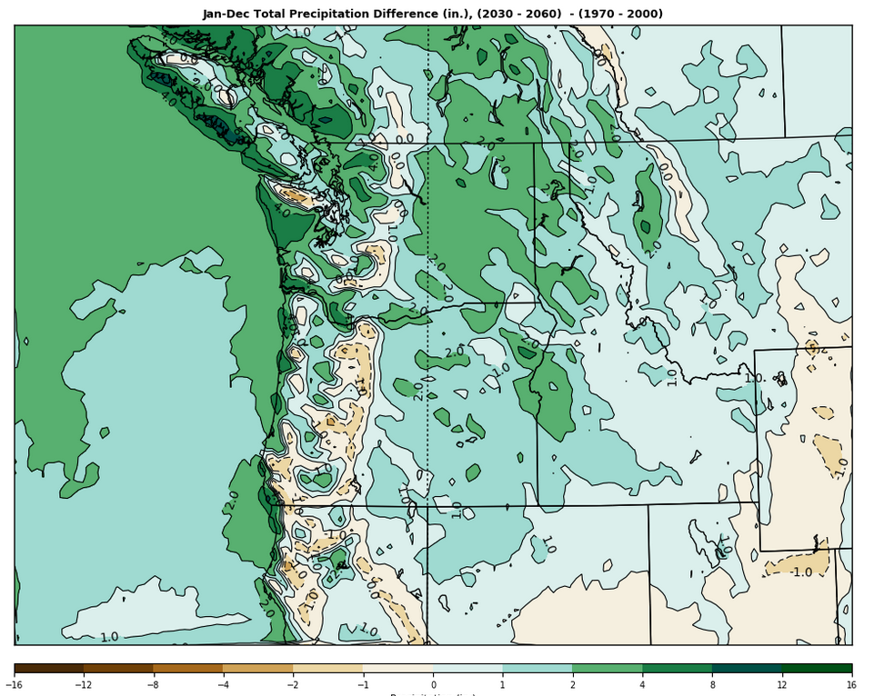
Changing Hydrology Precipitation to 2060 1”- 2”
Notes:
Climate Impacts Group model.
41 years out- 1-2” increase

Slide 11
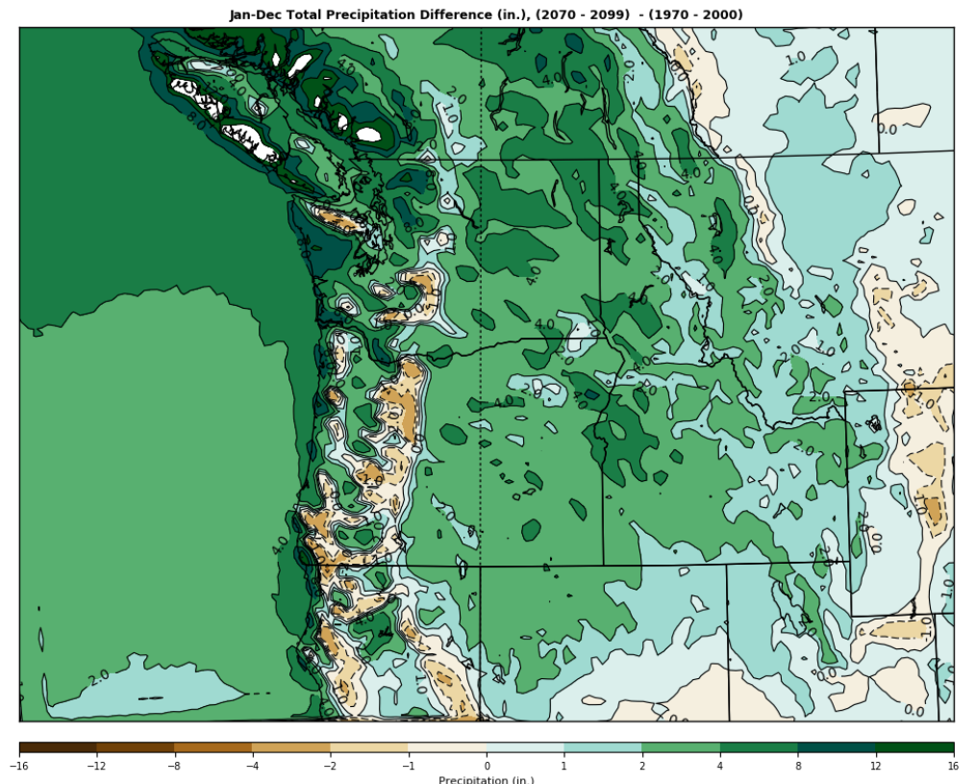
Changing Hydrology Precipitation to 2099 2”- 4”
Notes:
Climate Impacts Group model.
41 years out- 1-2” increase
80 years out – 2-4”

Slide 12
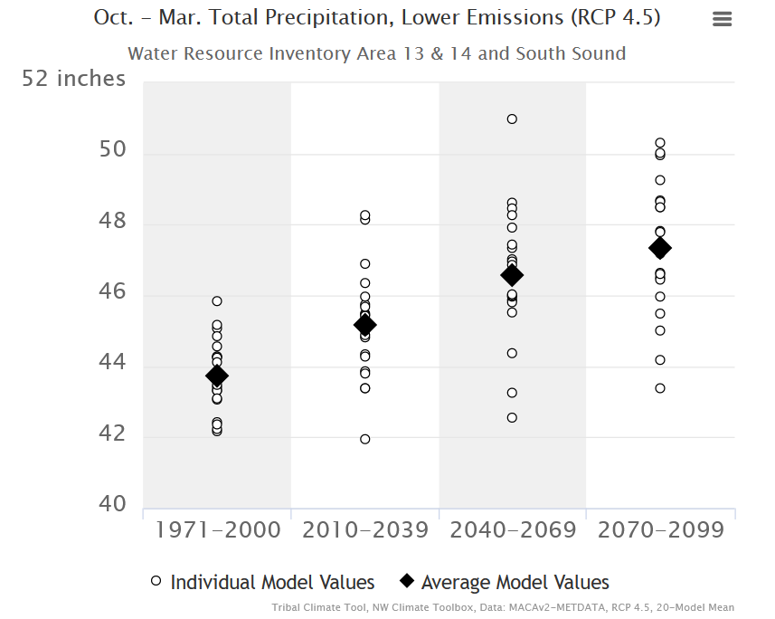
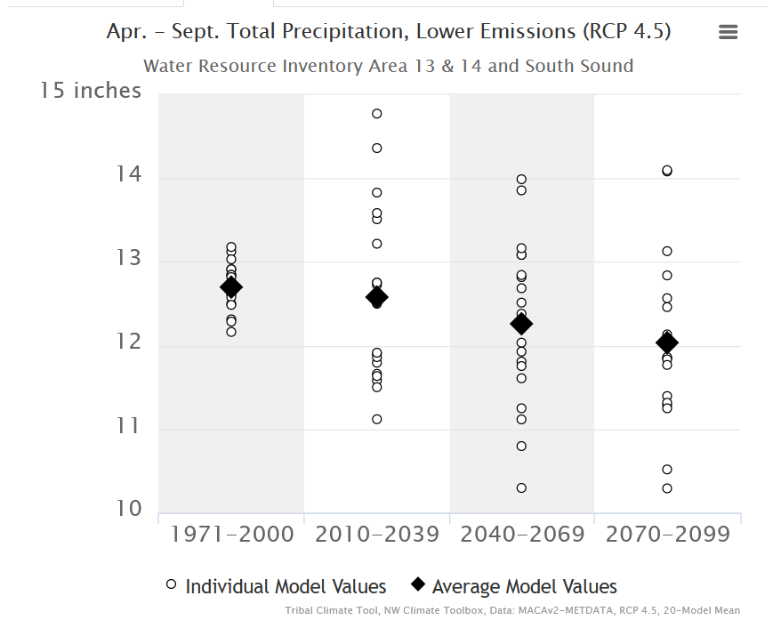
Changing Hydrology Seasons
By 2069
Winter > 0.4” Summer < 0.4”
Notes:
Slight increasing flows in winter
Slight decreasing flows in summer
Winter includes spawning but Goldsborough has low impervious, all spawning above Shelton and over 40% of the stream has access to extensive wetlands.
Summer is the worry. Must have cool water refugia sites for over summering fish like coho, steelhead and cutthroat

Slide 13
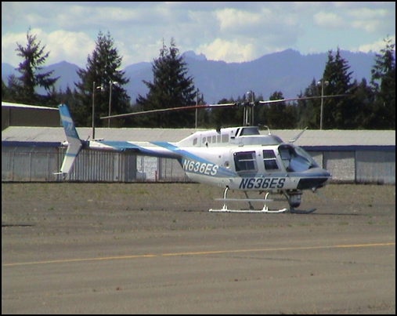
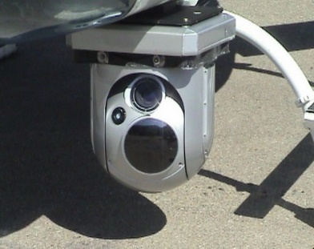
Changing Hydrology Temperature
Notes:
FLIR

Slide 14
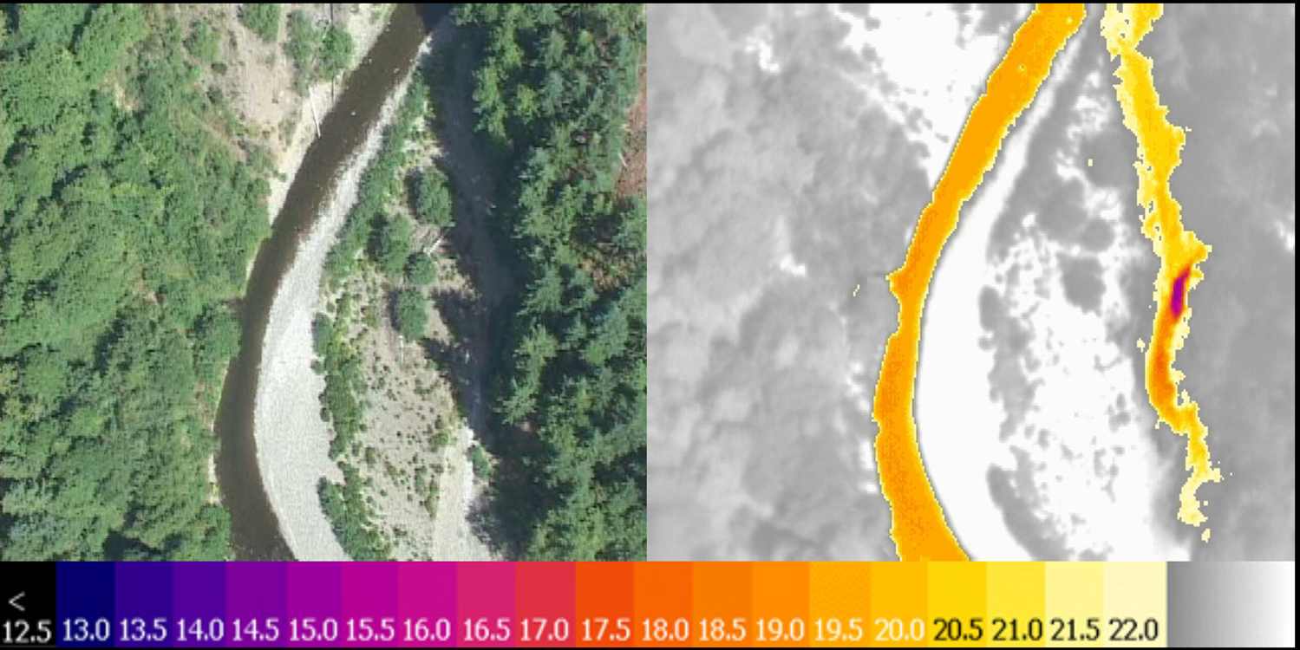
Changing Hydrology Temperature
Notes:
FLIR

Slide 15
Sea Level Rise
Notes:
Sinking 6/10” every 10 years
Olympia end of century 5’

Slide 16
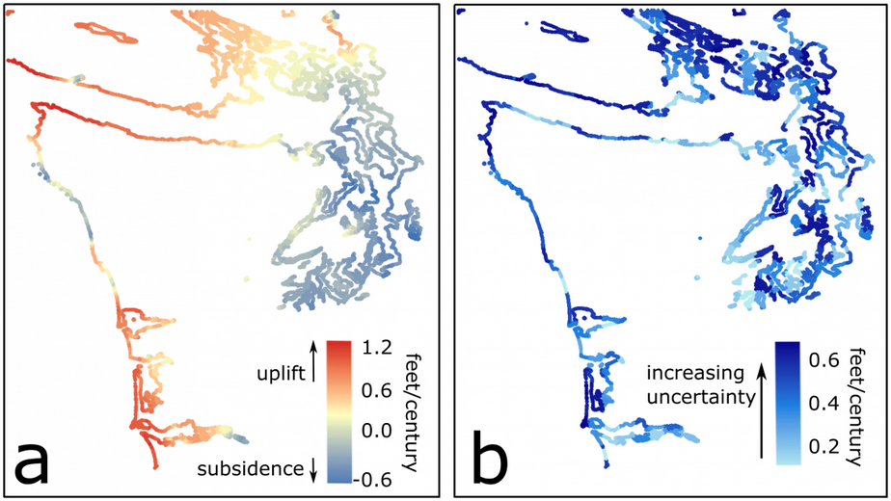
Sea Level Rise
Notes:
Sinking 6/10” every 10 years

Slide 17
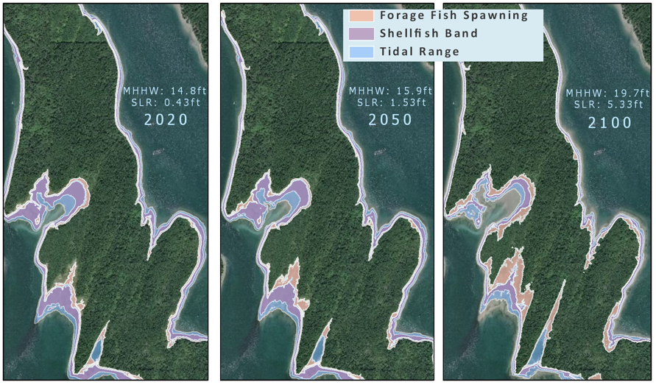
Sea Level Rise
Notes:
Flew LIDAR on Island and Oakland Bay to get detailed elevations
Did multi year studies of tidal gauges. Everything in South Sound is based off of a tidal gauge in Tacoma. If look up SS tides are looking at a model.
Showed off by up to 1’ from reality
Created detailed models for Squaxin Island and Oakland Bay. Less detailed for rest of the Sound.

Slide 18
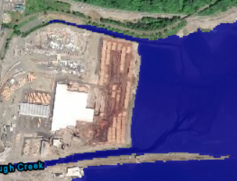
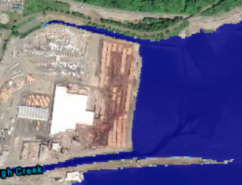
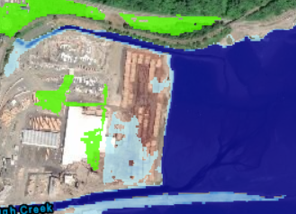
Sea Level Rise Scenarios
Current 2050 2100
0’ 1.53’ 5.31’
Notes:
Mid-level scenario based on carbon input

Slide 19
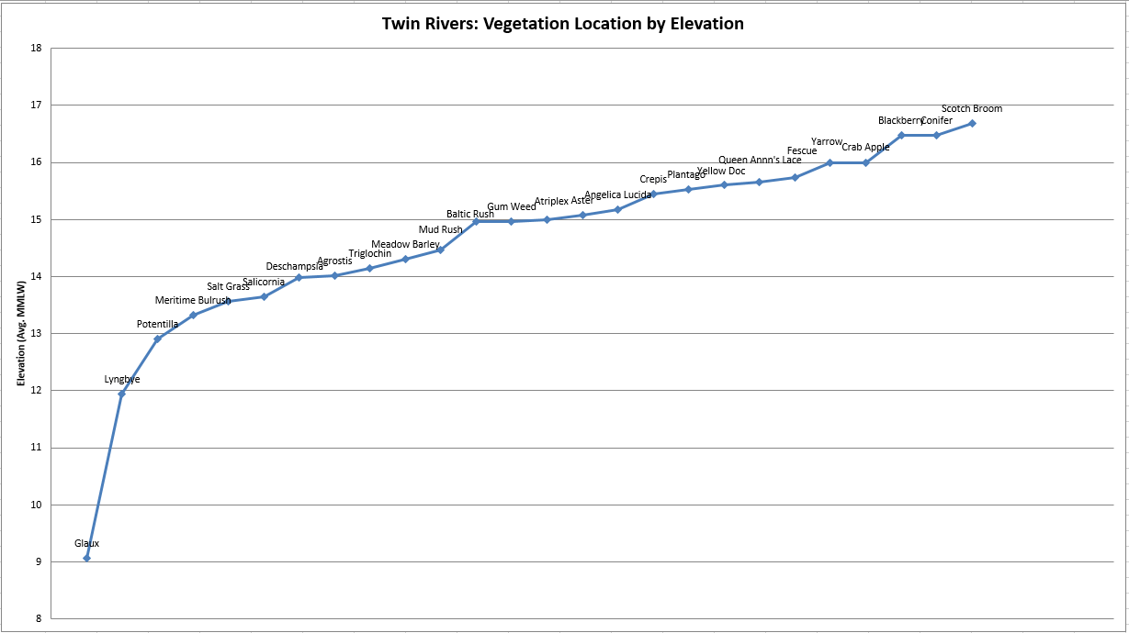
Sea Level Rise Plant Elevations
Notes:
Looked at multiple sites throughout Oakland Bay
Everywhere where elevation was appropriate we found salt tolerant species
This shows Twin Rivers which is the mouth of Cranberry and Deer Creeks
In general we found beneficial species from 11’ to 15.5’

Slide 20
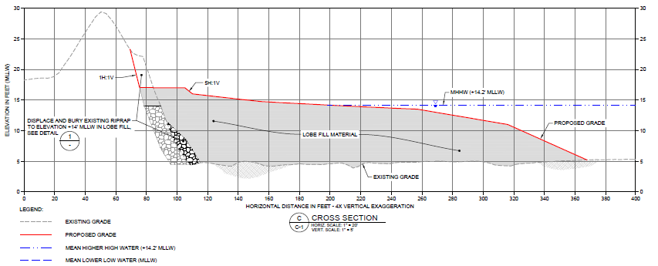
Sea Level Rise Plant Elevations Existing
High
Low

Slide 21
Sea Level Rise Plant Elevations 2050
High
Low

Slide 22
Sea Level Rise Plant Elevations 2100
High
Low
Notes:
Possibilities- natural sediment recruitment matches to raise the marsh on the lower end
“only” need to add about 2’ of sediment to extend marsh out to deeper water. Keeps roughly the same size

Slide 23
Sea Level Rise Plant Elevations 2100
High
Low
Notes:
Possibilities- natural sediment recruitment matches to raise the marsh on the lower end
“only” need to add about 2’ of sediment to extend marsh out to deeper water. Keeps roughly the same size

Slide 24
Ocean Acidification Carbon Dioxide
Svante Arrhenius- Sweden 1896
temperature increase 2.88 F due to CO2
Oceans would absorb excess
Charles Keeling- U.S.
1950’s-CO2 increase
1970’s- ocean acidification
Notes:
When talking ocean acidification are really talking carbon
Not new predicted long ago
Thought oceans would absorb 4/5 so no short problem
Keeling predicted ocean acidity would increase
Only studied in depth since 2003

Slide 25
Ocean Acidification
Steady since last ice age ~12,000 yrs
~1750 has increased 30%
Increase fastest in 800,000 years (ice core)
Increase is fastest in 50 million years (rock)
In ~80 years increase of 100-150%
Notes:
-Have had far higher pH and CO2 in the past but was millions of years ago

Slide 26
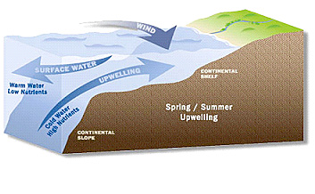
Ocean Acidification What can we do? Nothing!
Notes:
The water that is upwelling is 30-50 years old
Most of the acidification dealing with now is from 1970!
This is an experiment we as a society have chosen to do
Changes on atmospheric carbon would be for the benefit of our children and grand children
Up to 50% of acidification is upwelled water

Slide 27
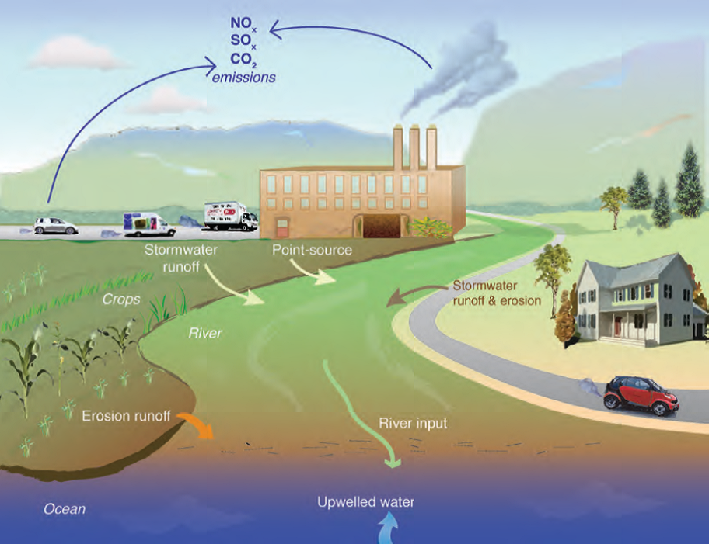
Ocean Acidification What can we do? Something!
Notes:
We can have an immediate effect on local inputs that effect acidification
Much of this

Slide 28
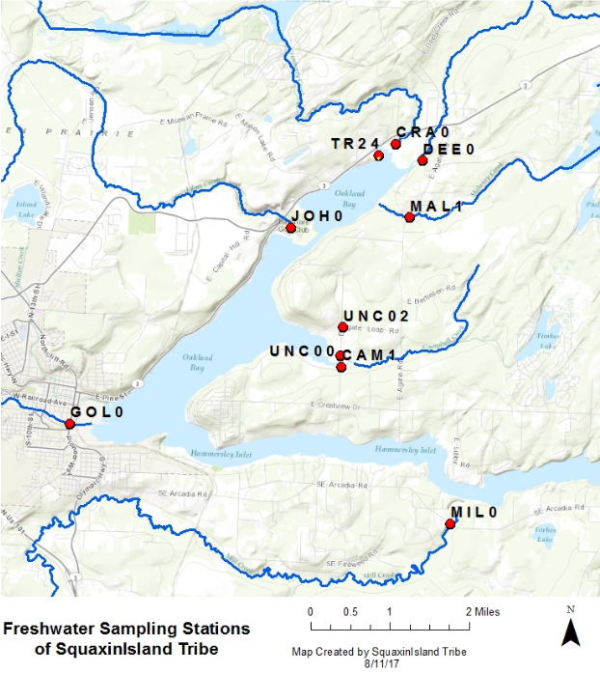
Ocean Acidification
Notes:
Tribe quantifying the sources of local carbon and therefore acidification

Slide 29
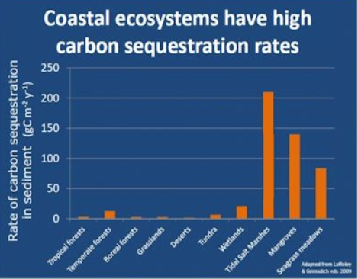
Ocean Acidification Blue Carbon
Store 10X the amount of forests
42 acres project = 2.5 tons of carbon per year
Same as removing 1,944 cars
Has small buffering effect. Focus of studies
Notes:
Salt marsh has the ability to store more carbon faster than any other ecosystem
It’s ability to decrease existing local acidification is not well understood (remember 2003)
Preliminary studies show may only have a small effect
Acidification at current rates or levels does not appear to effect the plants. Being studied.

Slide 30
http://sheltonharbor.org/
http://www.squaxin-nr.org/

Slide 31
Story Map
SLRstorymap.squaixn.us

