Slide 1
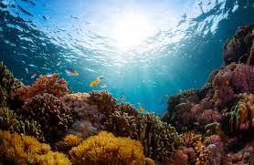
Overview of Ocean Acidification – a growing climate-change problem
Allan Chartrand, DABT
DERT Forum, September 2019

Slide 2
The big picture; how OA happens

Slide 3
What is OA and how does it affect the Salish Sea?
Chemical changes occur in ocean water when atmospheric CO₂ is absorbed through the surface
Increasing atmospheric CO₂ leads to acidification when CO₂ dissolves in ocean water to become carbonic acid [H₂CO₃], thus lowering pH and increasing corrosivity
Corrosive conditions especially hard on calcifying organisms such as certain zooplankton (pteropods, copepods), which form aragonite (calcite) shells which then may dissolve;
Lowered pH can also affect metabolic responses affecting growth or reproduction of numerous species
OA in the Salish Sea is of particular concern as estuarine processes and huge freshwater inputs, some human caused or promoted, increase CO₂ and lower marine pH
Nitrogen loading and organic-matter inputs from various local sources fuel algae growth. This decreases oxygen levels and increases CO₂ levels in the water

Slide 4
Other Factors…
Local industrial emissions of CO₂ and acidic gases can be absorbed by Puget Sound marine waters to enhance OA
Natural coastal upwelling of deeper waters with higher CO₂ levels (already acidic) brings these waters into the SS via the Strait
Thus, the PS/SS is influenced by a variety of factors that tend to make our waters particularly sensitive to OA
OA has strong implications for marine food webs, including our own marine food supply, and are areas of active research

Slide 5
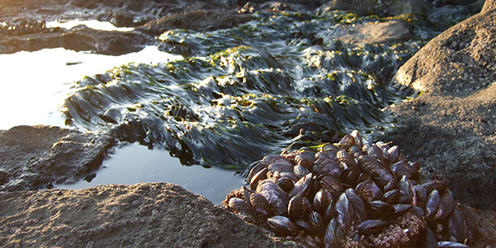
Effects to marine life in the Salish Sea
Elevated CO₂ impairs olfactory-controlled behaviors in ocean Coho salmon (NOAA NWFSC)
Combined effects of OA and water warming on Pacific herring (WWU)
Effects on Dungeness crab reproduction in increasing CO₂-rich waters (NOAA NWFSC and NOAA OAP)
Numerous other investigations

Slide 6
What are we doing about this??... current WA activities
Extensive monitoring by researchers of OA in local waters.
Water quality monitoring at six existing shellfish hatcheries in WA to reduce intake of acidic waters
Large ongoing interdisciplinary modeling effort (Salish Sea Model) to understand OA processes and influences
.Coordination with similar research and regulatory groups in OR and CA

Slide 7
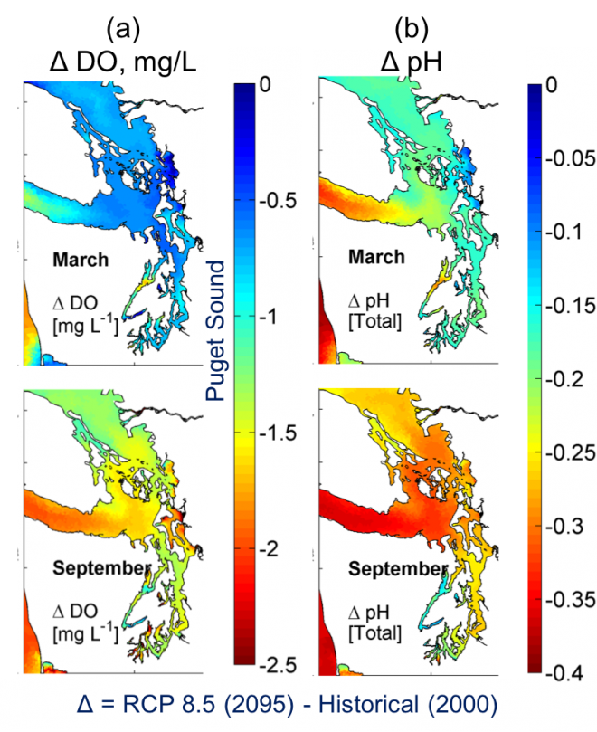
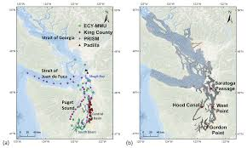

Slide 8
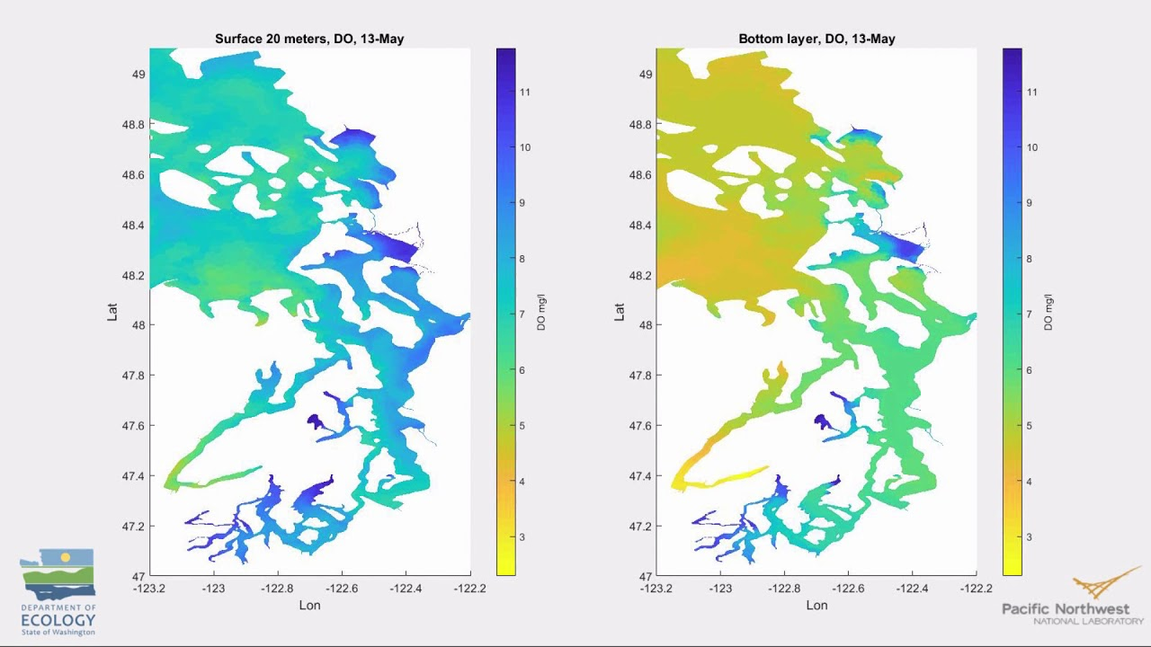

Slide 9
Lots of info!
UW Washington Ocean Acidification Center:
https://environment.uw.edu/research/major-initiatives/ocean-acidification/washington-ocean-acidification-center/
NOAA Ocean Acidification Program: https://oceanacidification.noaa.gov/WhatWeDo/Monitoring.aspx

Slide 10
Thanks for your time; Questions?

